Slide 1
JRC Field Reporting Tool
D. A. Galliano, A. Annunziato

Slide 2
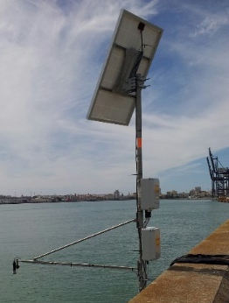
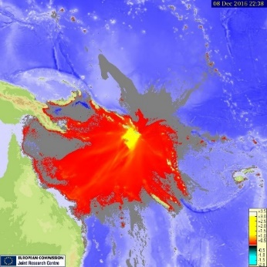
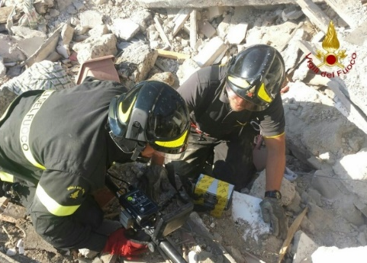
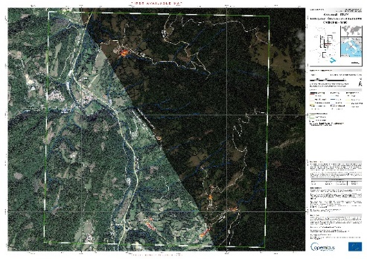
DRM Unit
The whole information flow related to the Crisis Management is studied
Sensors
Models
Analysis
Practitioners
Decision making

Slide 3
Timeline
Project start: June 2016
First prototype: September 2016 (UWA)
Test and user experience feedback until September 2017
Integration in IFB platform and Android porting: whole 2018
iOS porting and ERCC customization: 2019

Slide 4
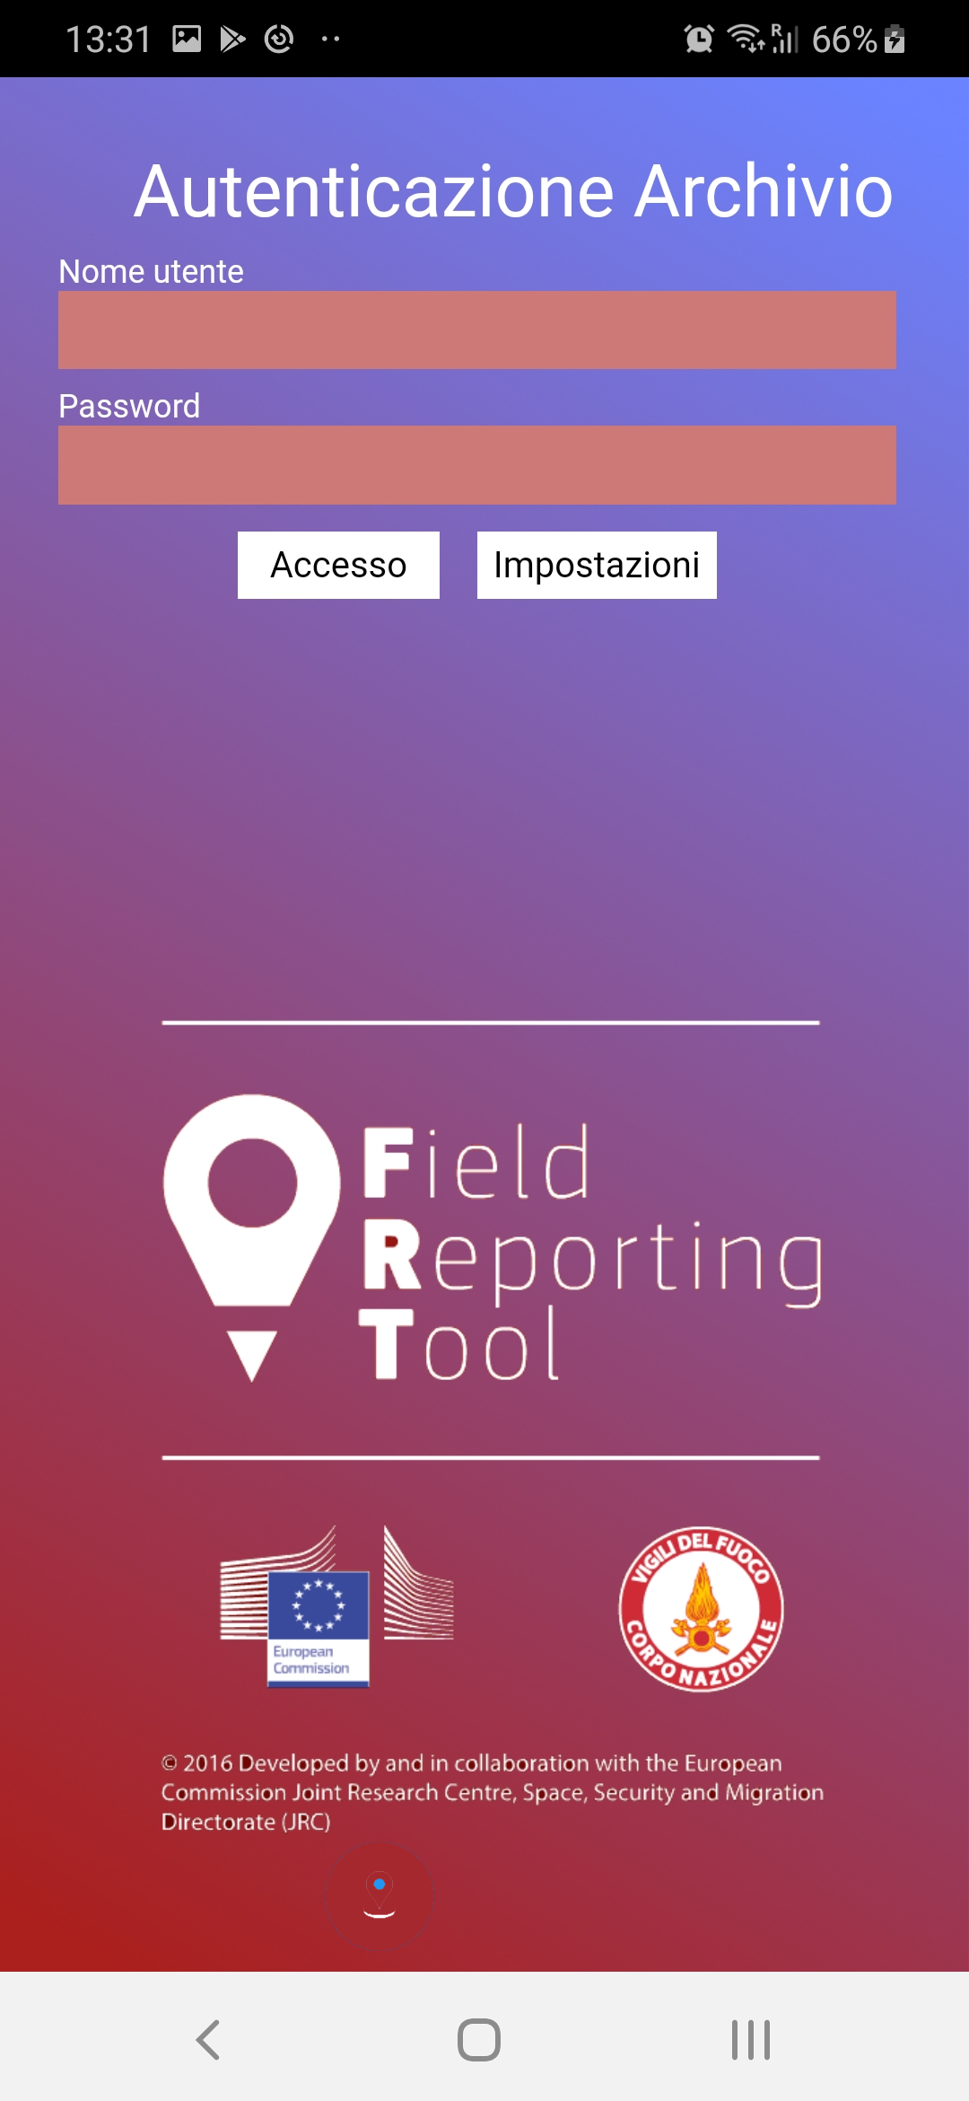
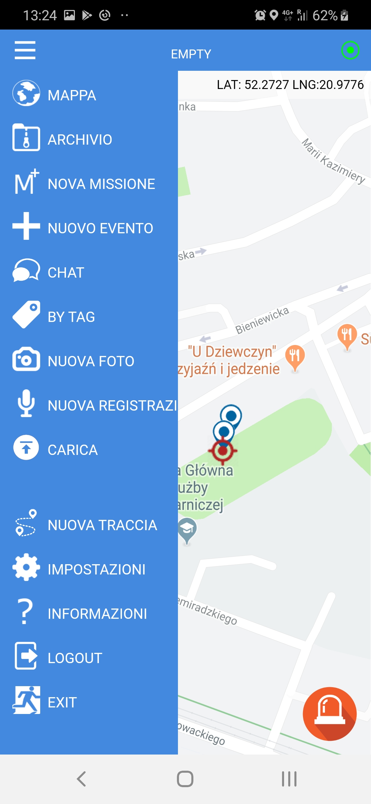
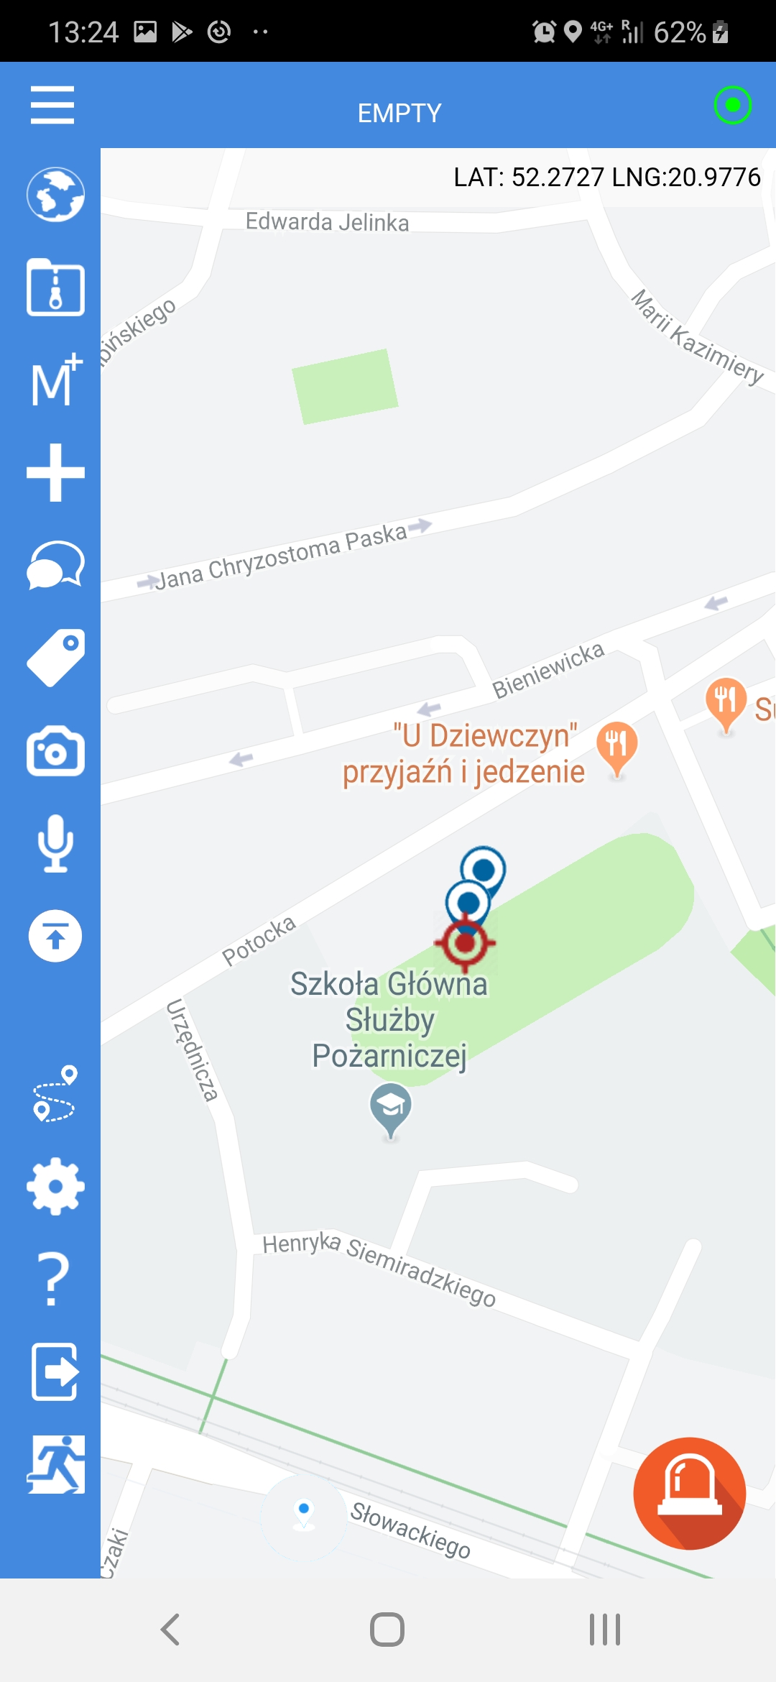
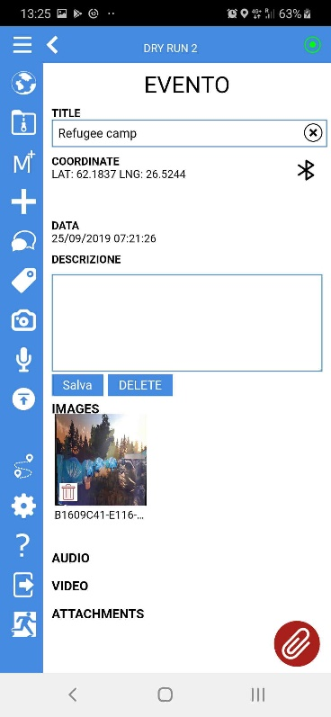
Several geographic references
GPS based
Offline and online data
Rapid multimedia
Data creation
Rapid sharing
Tracking utility
Customizable

Slide 5
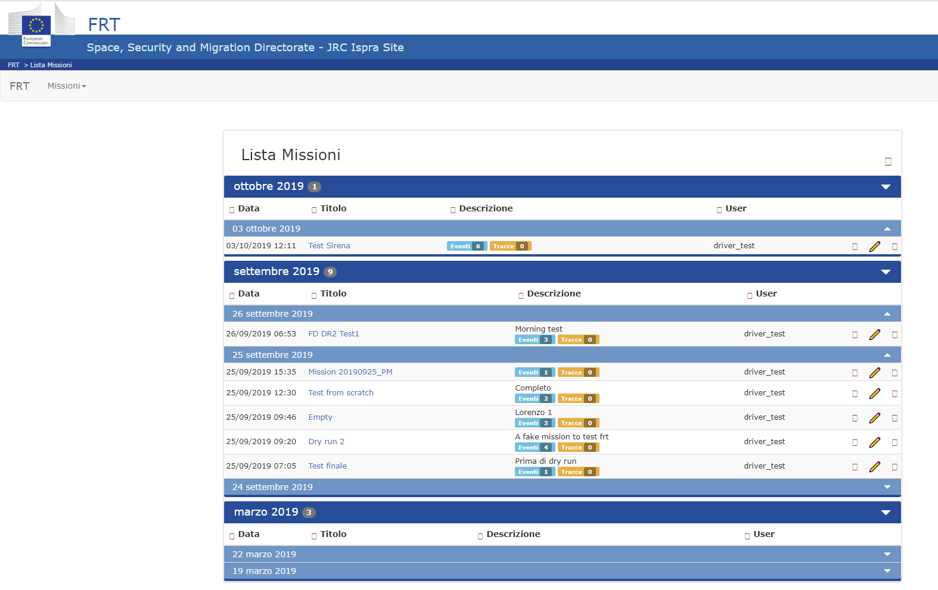

Slide 6
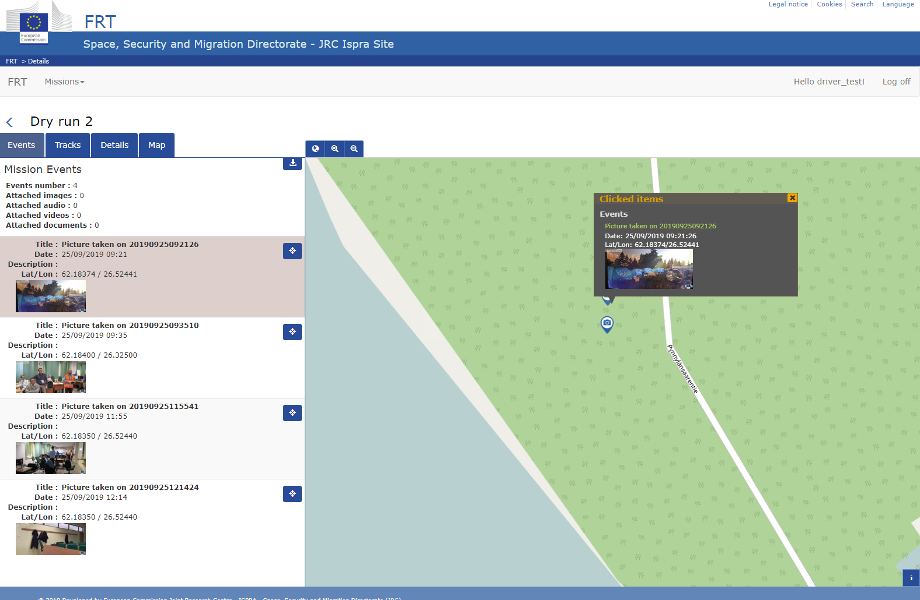

Slide 7
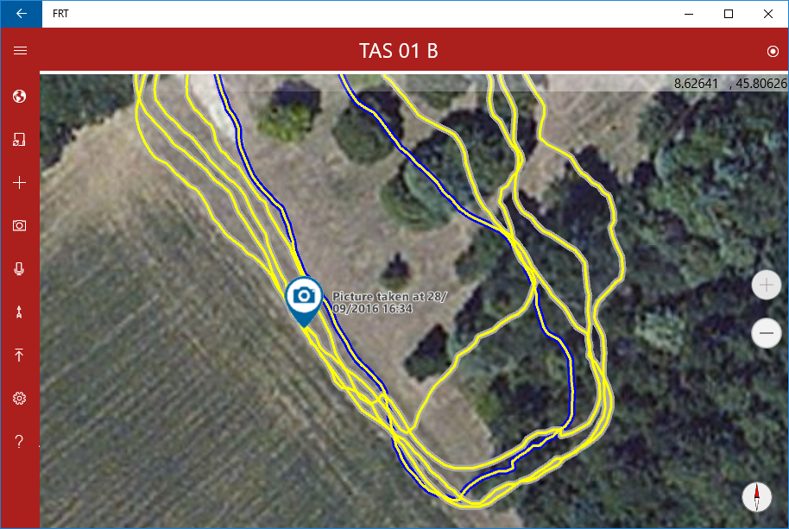
Search and rescue simulation
More efficient than presently used technology
Low cost and personal devices up to the task
Untrained users require quite no formation

Slide 8
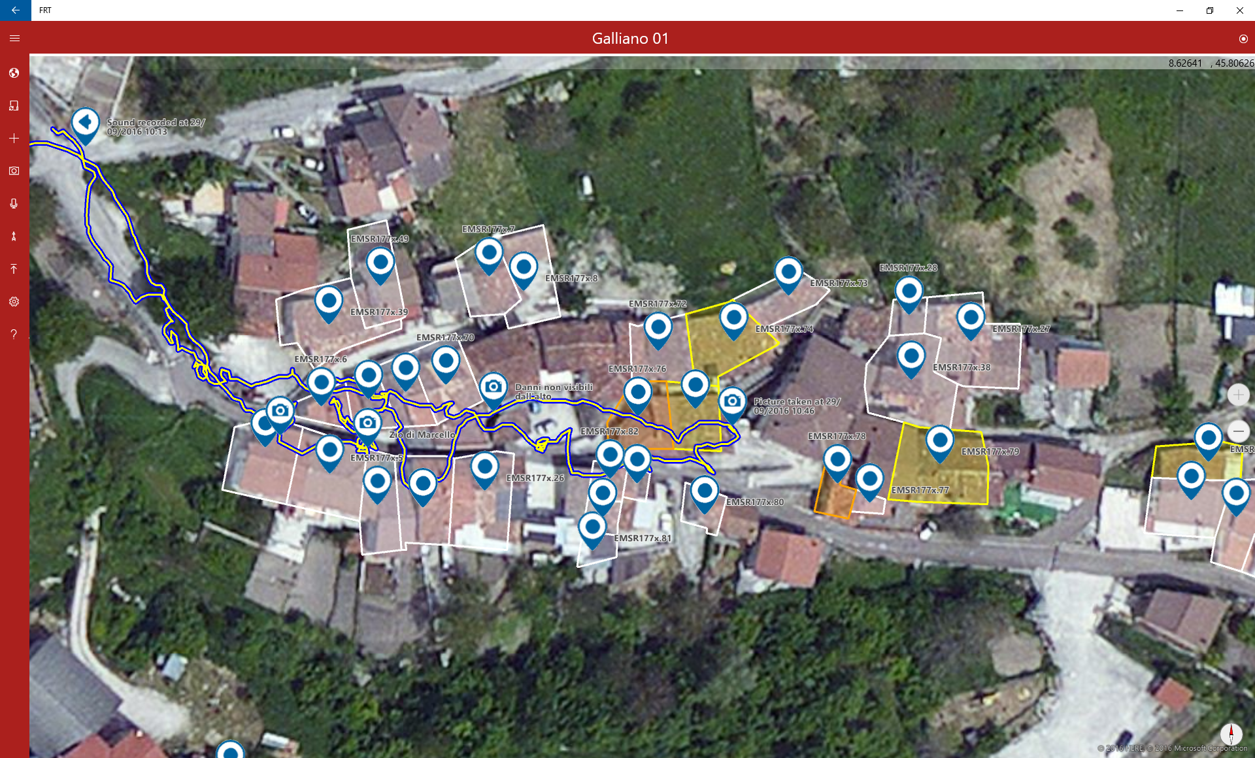
Tested in real-like situation
Combined visualization of new information and a reference (Copernicus data)
Real-like survey stepping into destroyed houses
Comparison of remotely performed assessment with the real situation

Slide 9
FRT4ERCC
Integration with the ERCC tools
Team oriented usage

Slide 10
Integration with the ERCC tools

Slide 11
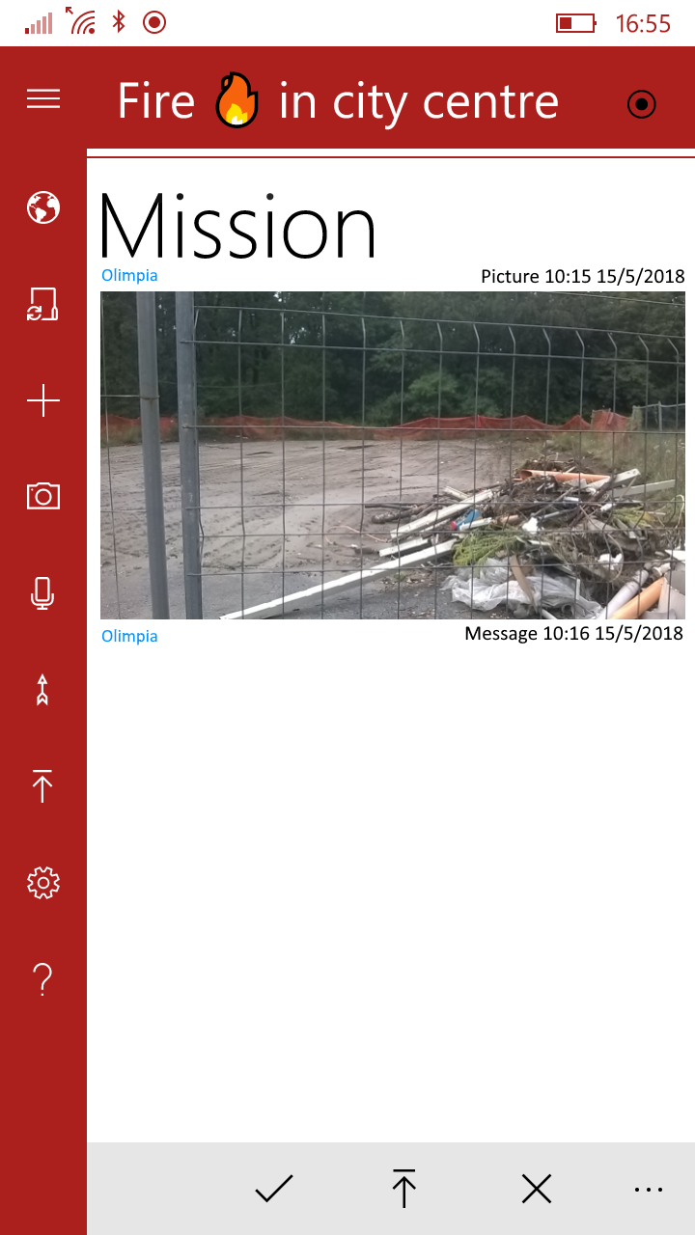
Team oriented usage
Easily created and managed team will group users and allow them sharing the information (visibility)
Rubbles and other evidences of reconstruction
The flowing interface will show the activity of the team at a glance
Ioannis
Message 10:20 15/5/2018
Yes, but very recent, in my opinion

