Slide 1
Drone Rapid Mapping
Marcin Marjasiewicz, Hexagon SI

Slide 2
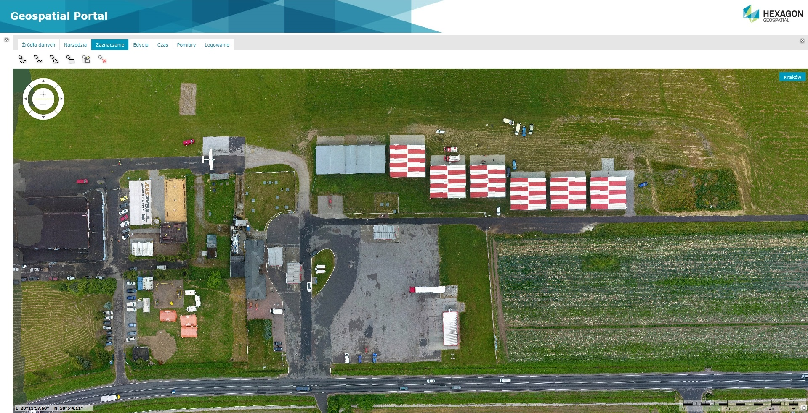
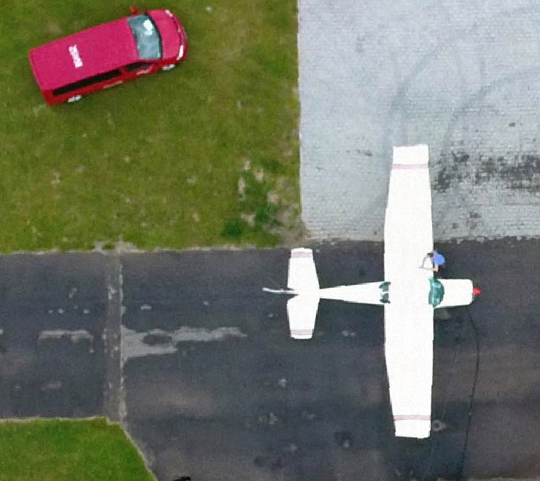
Drone Rapid Mapping
Our solution offers fast, ON cloud UAV photos processing.
As a product Consumer got current picture of situation, which enables him to perform further analyses on it.

Slide 3
drone Rapid mapping
User Story (solution utilisation) in accordance with Trial 1 scenario:
Generating ortophotomap and 3D model of:
riverbanks – determining the range and extension of the leak (environmental damage assessment, collecting data to measure surface stream of the river)
reservoir embankments - assessing the current state of levees without risk of injure (damage assessment, support of identification of breach)
fast finding best location for pumps and spill barriers dislocation
Ortophotomap is instantly displayed on all connected geoportals and COP’s and easily shared with other:
Incident Commander is provided with visualisation that can be further used inside any COP
3D model aids navigating the responders vehicles through rough terrain, it depicts also damages that was caused by incident
3D model aids quickly brief highest level of management and politics. It is shown during press conference to helps informing population
Solution shares data as standard georeferenced map images, e.g. WMS or displays it on own, dedicated Geospatial Portal.
Notes:
Any spontaneous volounteer with a drone and standard application for photo automatisation and rotue planning can provide responders with photos

Slide 4
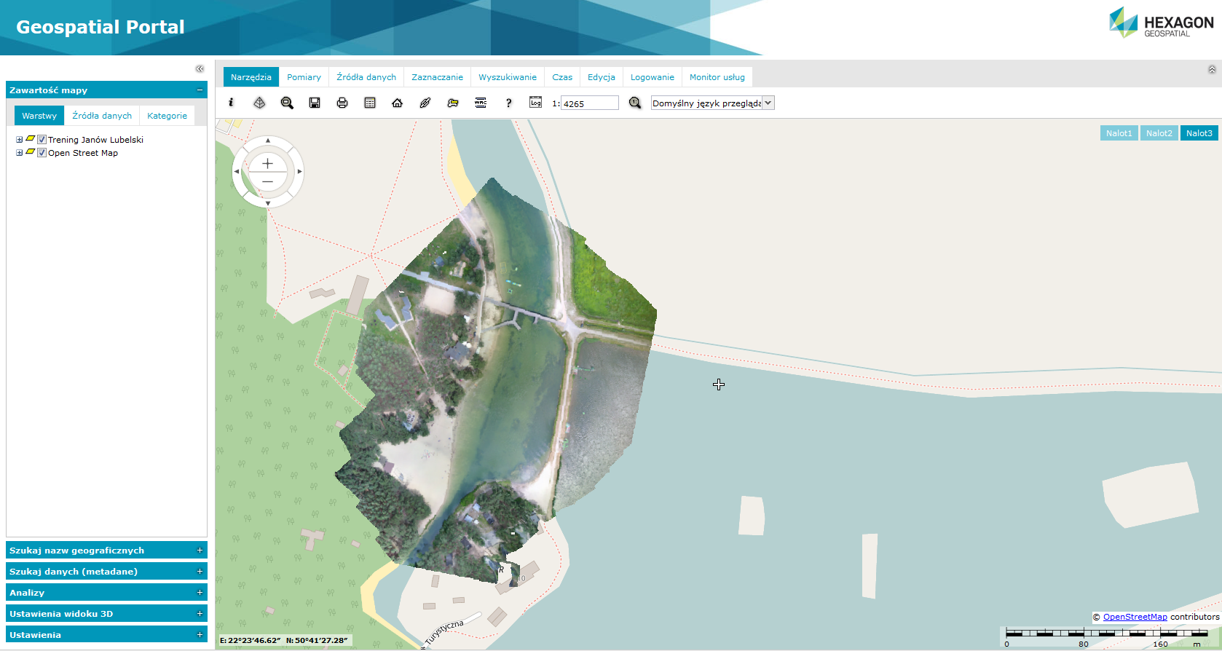
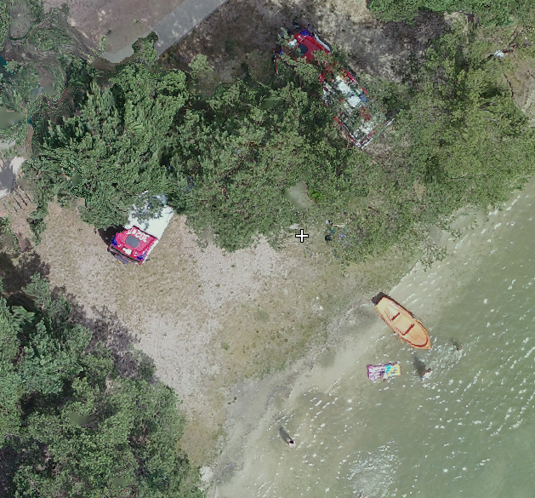
08.40 Reservoir leakage
08.55 Responders, alarmed by automatic system arrive. The incident commander asks for additional support.
09:10 Reservoir owner, local CM team or other responder sets the 5 minute automatic mission for aerial photography with casual off-the-shelf hobby drone. The area: about 9 ha.
09.19 Mission ends, it was lenghtened due to light rain and wind up to 12 m/s
09.21 Data (84photos, 700mb) is transferred on lap-top
09.30 Data is sent via LTE (10Mb/s) [9 min]
09.34 Processing into ortophotomap, that is instantly available on geoportal via link, pixel is 20mm [4 min]
09.51 3D model is available for download [17 min]
Total for map: 24 minutes, 3D: 41 minutes
User Story (solution utilisation)

Slide 5
How Does it work?

Slide 6
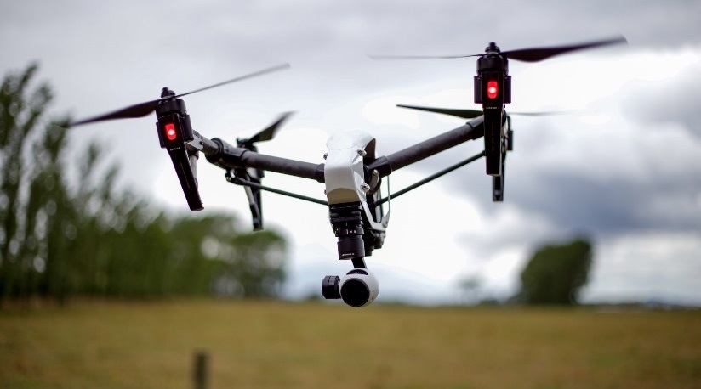
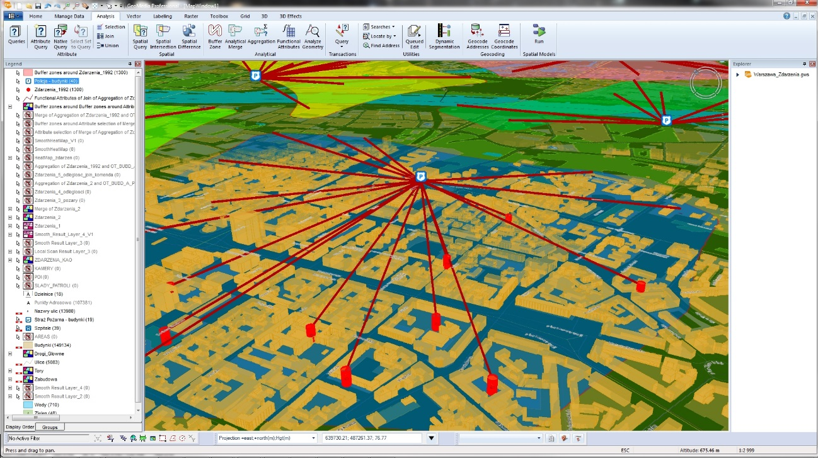
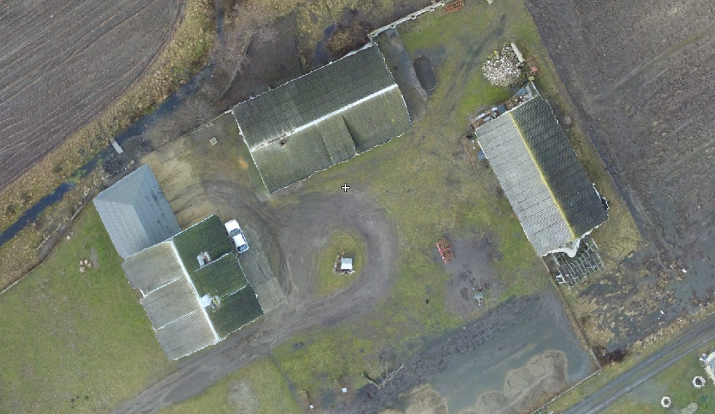
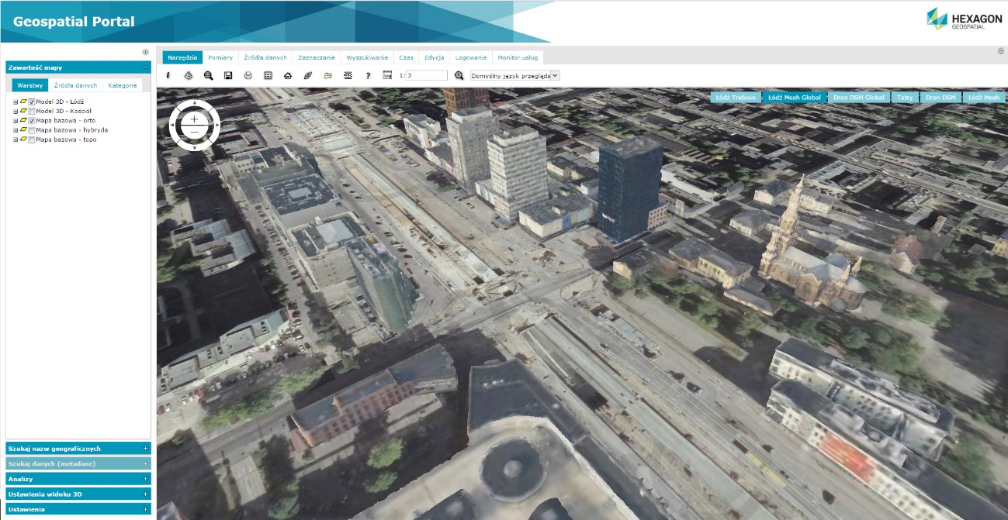
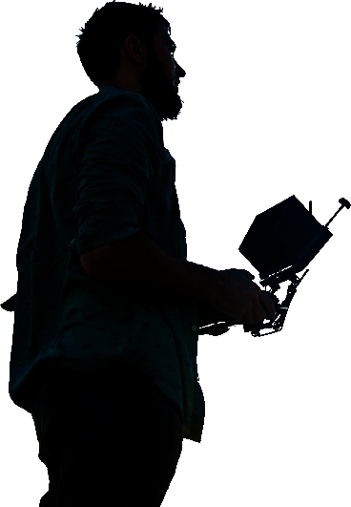
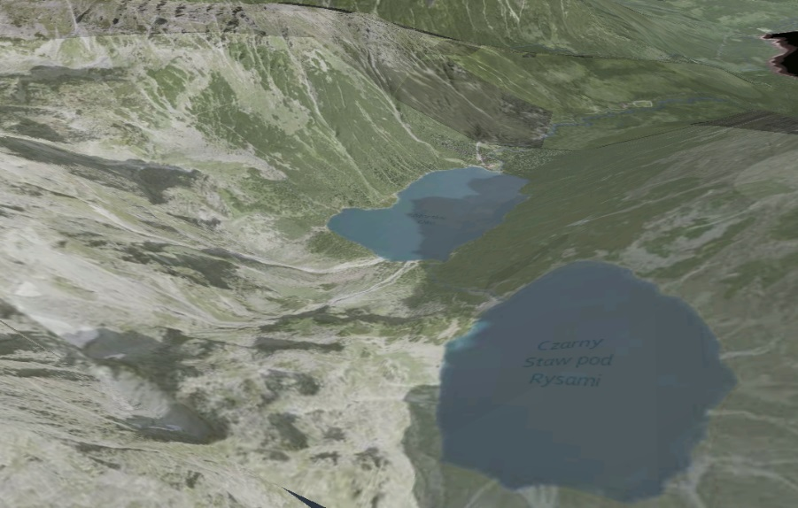
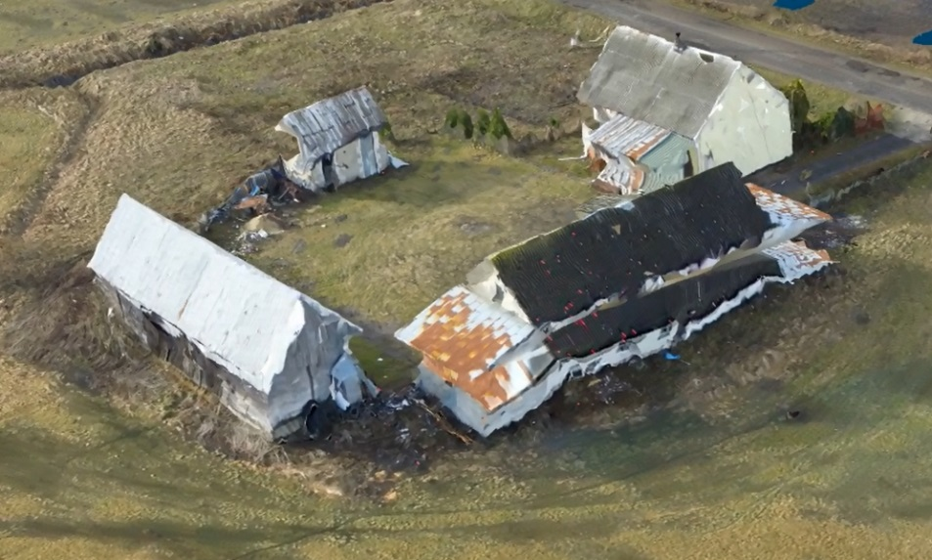
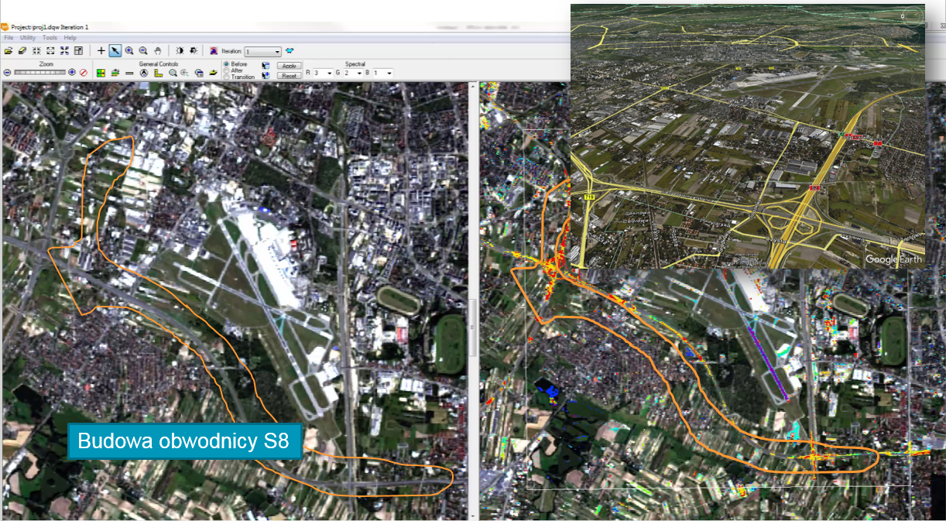
How does it work?
Operators
Processing Cloud
Consumer
Spatial Analysts
Processing
Ortho
Situation Overview
Internet
Services
DSM
3D Model
Remote Sensing
Fully automated processing

Slide 7
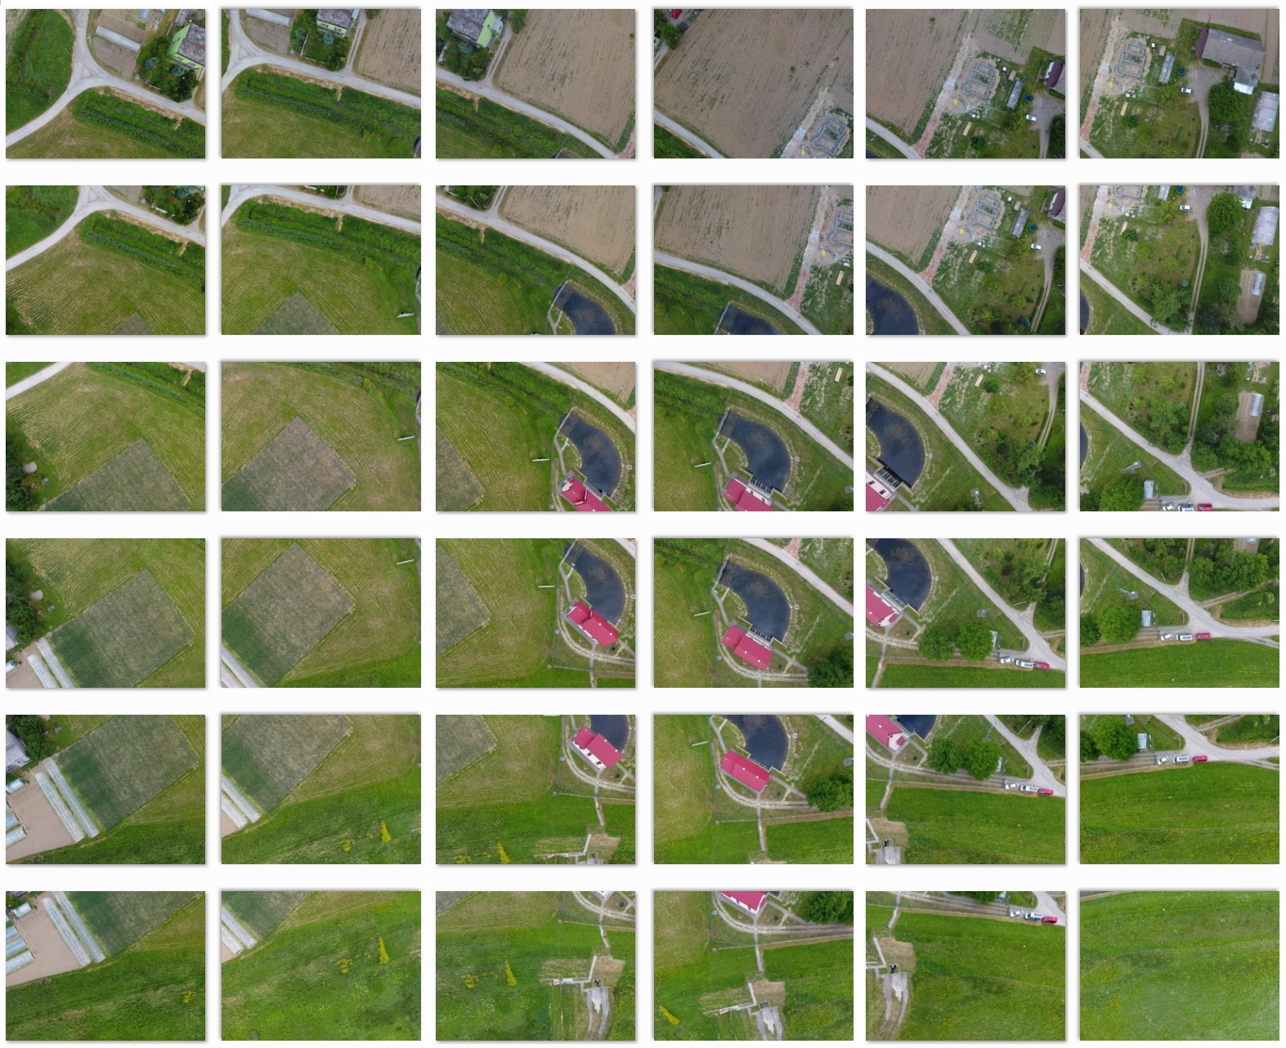
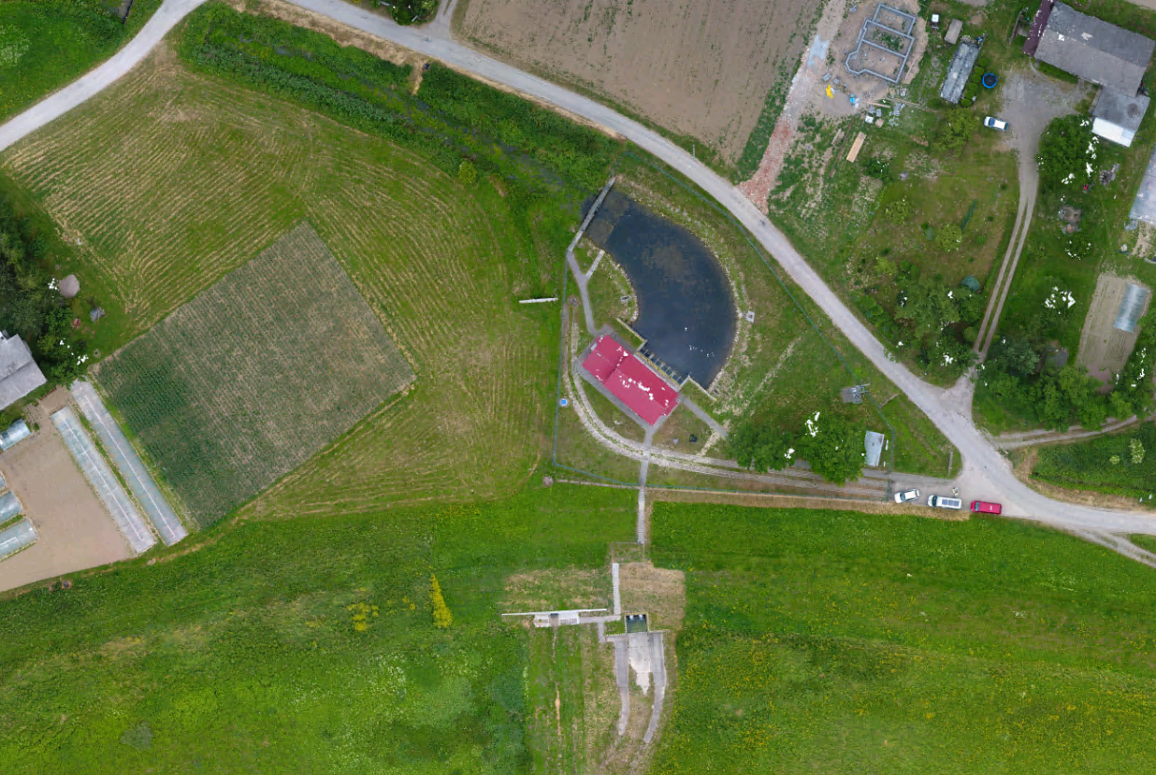
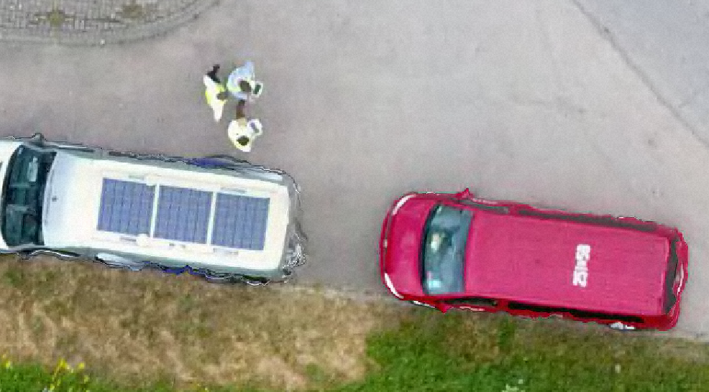
Data processing
Raw Drone Data
Orthophoto Map
Resolution 0.018 m

Slide 8
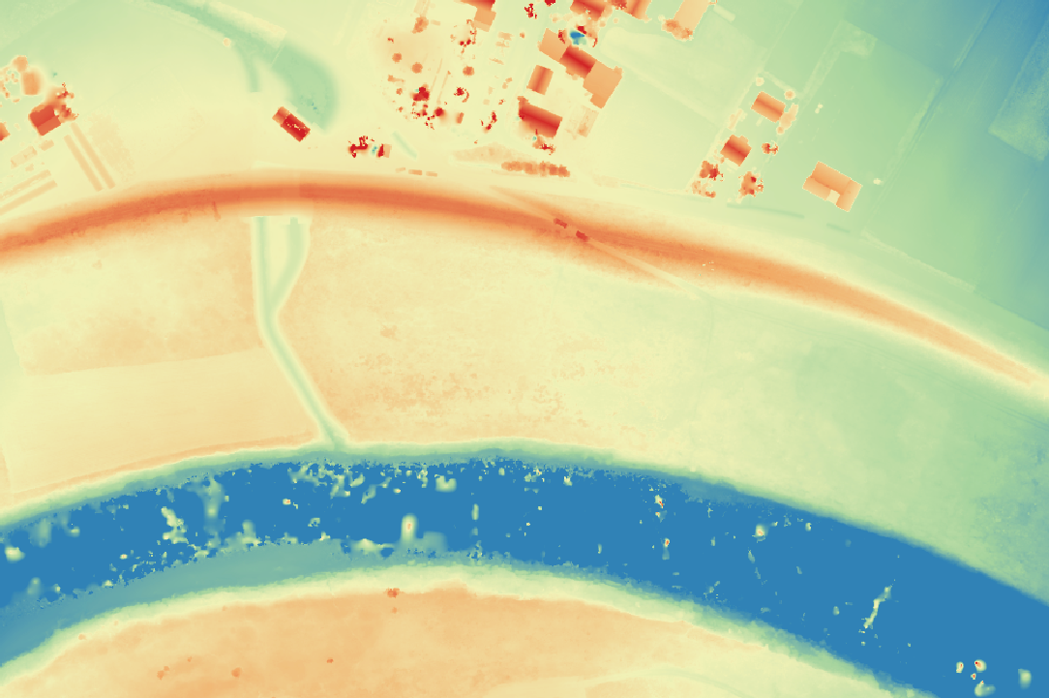
Digital Surface Model
Height AMSL [m]
Floodbank on Vistula river

Slide 9
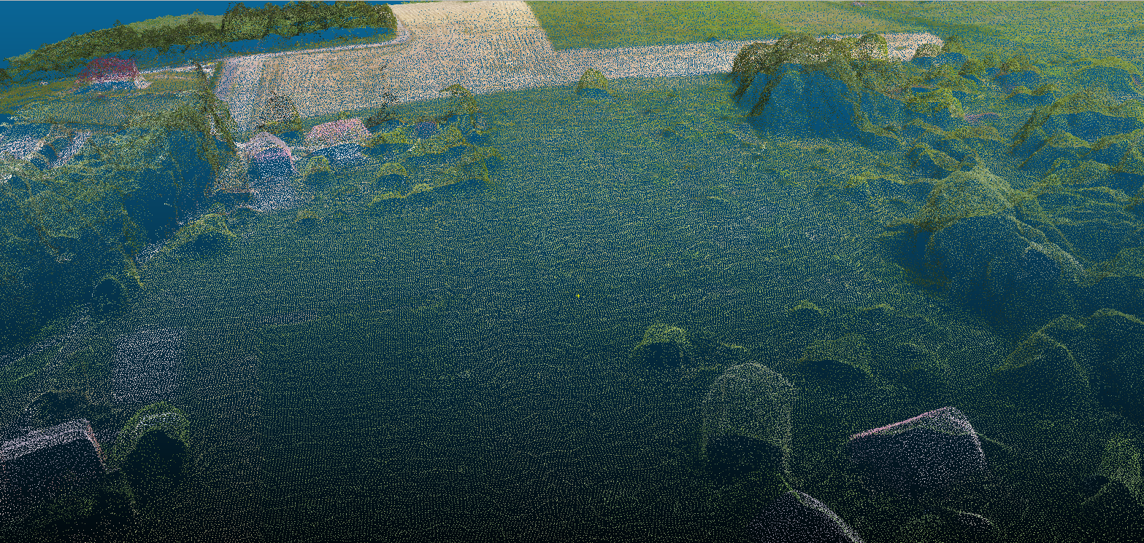
Point cloud

Slide 10
Model 3D

Slide 11
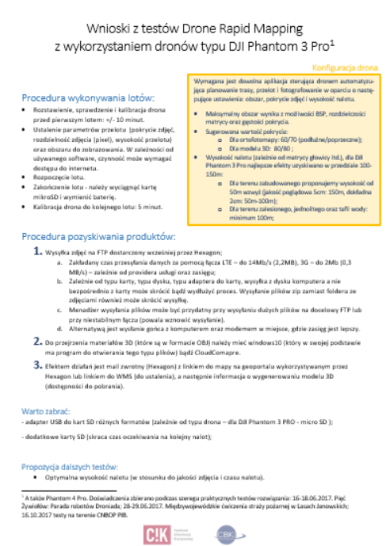
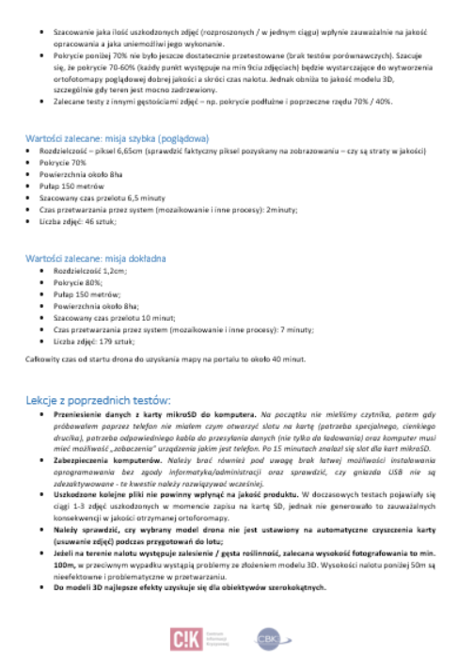
How about drone mission planning?
It’s all about an experience
Best practices in UAV mission planning
Dependencies:
-Drone model
-Camera resolution and focus length
-Type of area (city, rural, forests)
-Type of product
-Expected time of processing
-Weather

Slide 12
Drone Rapid Mapping in Driver+

Slide 13
STEP 1
Operators
Processing Cloud
Consumer
Spatial Analysts
Processing
Ortho
Situation Overview
Simple FTP upload of photos
Internet
Services
DSM
3D Model
Remote Sensing
Fully automated processing

Slide 14
STEP 2
Operators
Processing Cloud
Consumer
Spatial Analysts
Message to
Driver+ Test-Bed
with URL
Processing
Ortho
Situation Overview
Internet
Services
DSM
3D Model
Remote Sensing
Fully automated processing

Slide 15
STEP 3
Operators
Processing Cloud
Consumer
Spatial Analysts
GeoTIFF got published on Geoserver
Hexagon portal with data
Processing
Ortho
Situation Overview
Internet
Services
DSM
3D Model
Remote Sensing
Fully automated processing

Slide 16
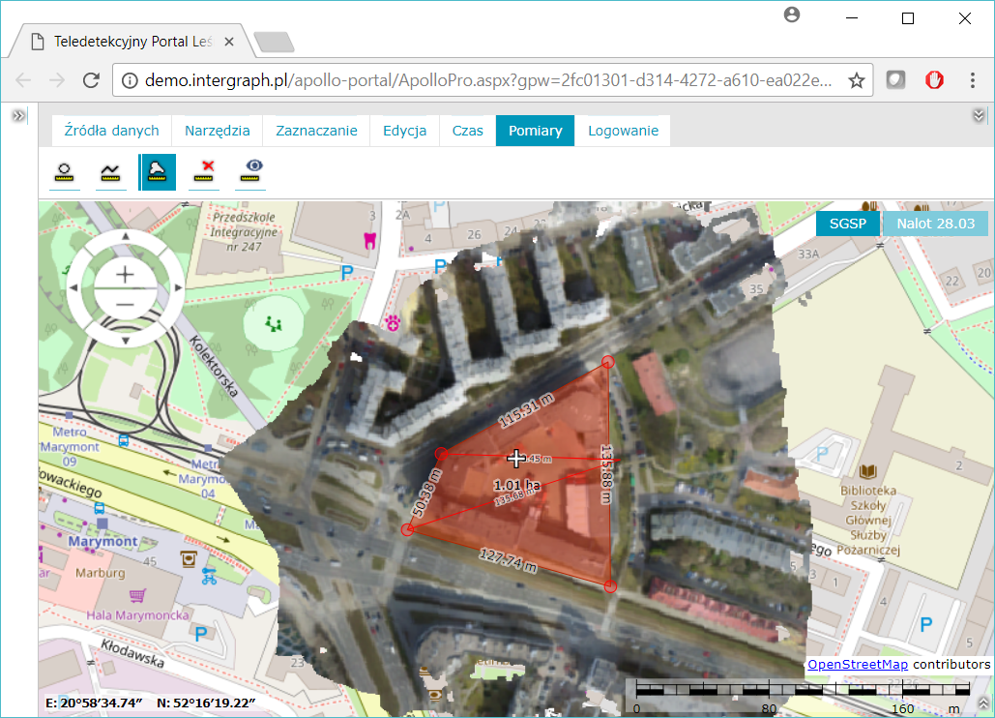
Explore your data
Hands-on training
LINK to Portal
Explore your data
Do measurements
Compare datasets

Slide 17
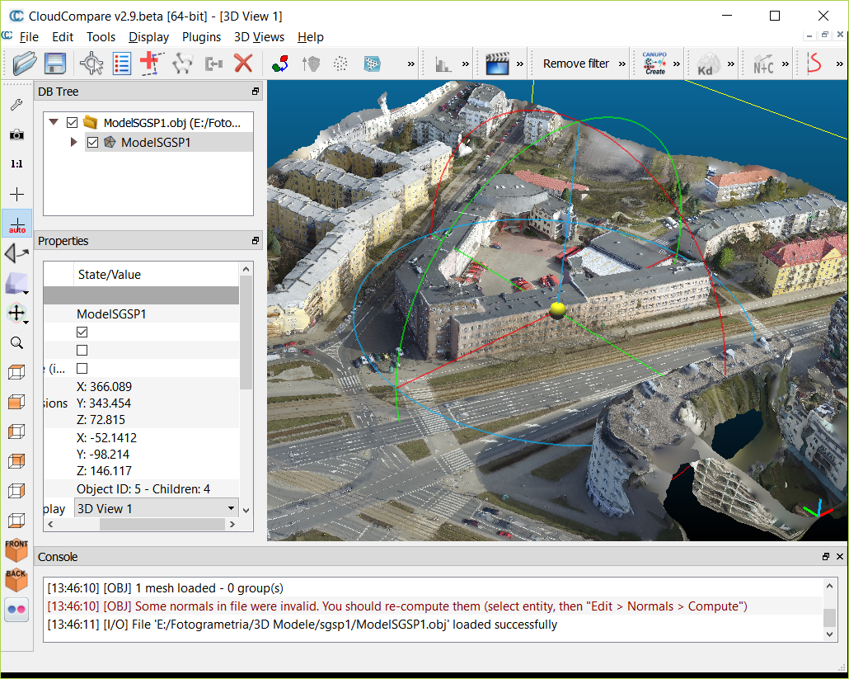
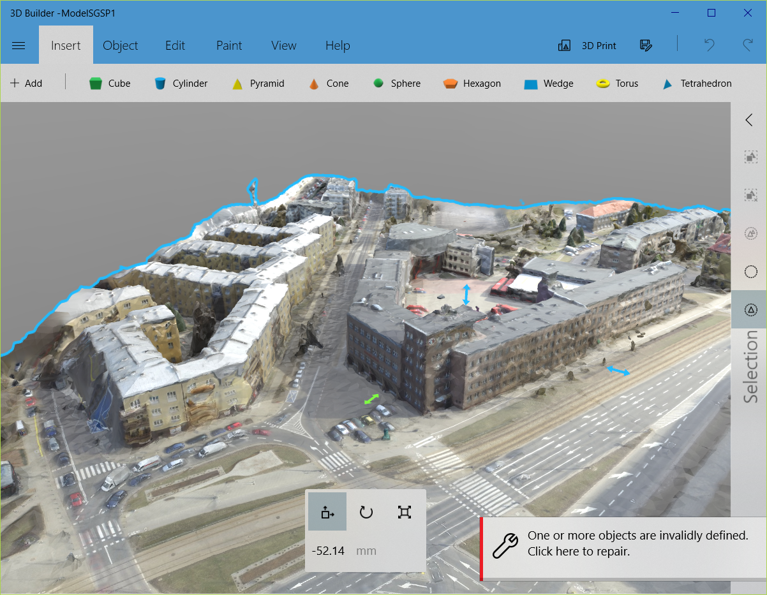
Explore your 3D data
Open SOURCE
Windows 10 build-in app
CloudCompare
3D Builder
Just Drag&Drop *.obj files of model into 3D Viewer app

