Slide 1
SMAP for crisis management
Practical training
THALES , Laurent & Antoine
6th of October 2018
Notes:
Give an overview of 3Di
Show crisis managers how to use 3Di
Get some hands on experience with 3Di yourselves

Slide 2
Rationale
Why we think SMAP makes sense in DRIVER+
FACT: Social Media contains information which relates to incident(s), Crisis Management, population needs, rumours,…
SMAP: Supports the Social Media Manager in finding and pushing the information of interest in Twitter

Slide 3
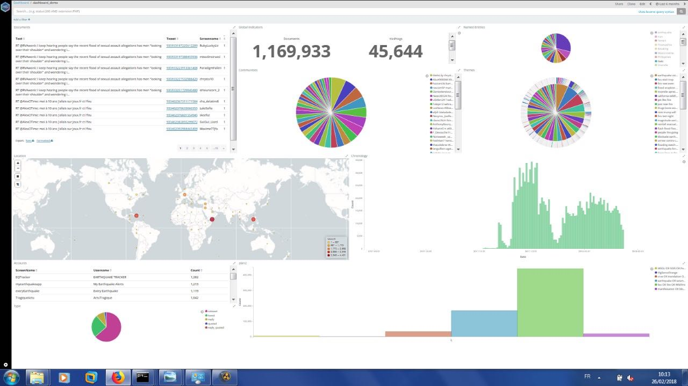
Social Media Analysis Platform (SMAP)
Supporting the use of Social Media in Crisis Management
REPORT /EXPORT
To COP
ANALYSE
Filter (time, space, content)
COLLECT
keywords, #tags, accounts
Thales / TRL 5-6 -> 6-7 in 2018
Biz. model : On premise or SaaS
Big Data architecture (>10⁶ posts)
Deep learning algorithms

Slide 4
Goal of SMAP practical training
To enable you to use SMAP’s main functions during Trial 2:
Limited to Trial 2 scope
Collect, Search and filter, Report to COP
Based on Trial 2 exercises
There is more to SMAP which will not be used in Trial 2:
Event detection
Communinities (for rumour debunking)

Slide 5
SMAP Training’s Schedule
Time slot | Activity | Leader
00 -> 5 mn | Introduction | Laurent Dubost
5 mn -> 20 mn | Guided examples | Antoine Léger
20 mn -> 45 mn | Hands on + assistance | All + Antoine Léger
45mn -> 50 mn | Report : Questions and Answers | All

Slide 6
SMAP’S Main functions
Used during Trial 2
Dashboard => overview of all collected Tweets
Search & filtering tools => focus on Tweets of interest
Export to COP = > send Tweets of interest to COP
Collect => define/ manage your queries
During the Trial, some assistance will be provided to you
Notes:
Expert hydrological knowledge needed to really understand the model.

Slide 7
terminology
Hashtag: keyword given by people Twitting: #Valabre
Named entity: known organisation, person, place…recognized in the text
Location: either geolocation metadata, or geolocated site recongized in Tweet
Notes:
As not to confuse terminology, used in model
Breach in a dam
Levee/flood bank/dike

Slide 8
Hands on Exercises
Divide into 5 groups
2-3 practitioners per group
Future players at the computers, others can follow my screen
Notes:
Audience: this part is aimed at practitioners to be able to run simulation in 3Di, observers to know options and buttons, others can follow if they want but this part is specifically aimed at practitioners and observers

Slide 9
Hands on: SMAP portal
http://myserver:myport/mydashboard
Guided Exercise 1: Dashboard
Guided Exercise 2: Seach & filter
Guided Exercise 3: Export to COP
Guided Exercise 4: Manage collection query
Notes:
Go to 3Di portal (leave ppt)

Slide 10
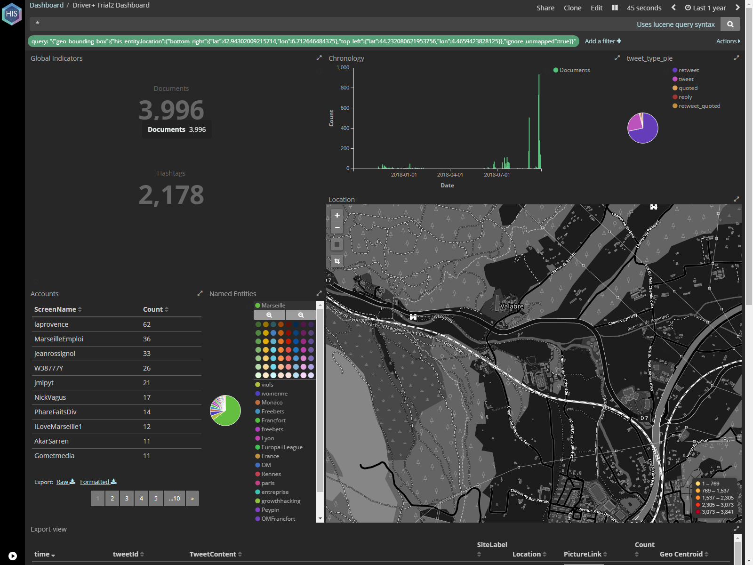
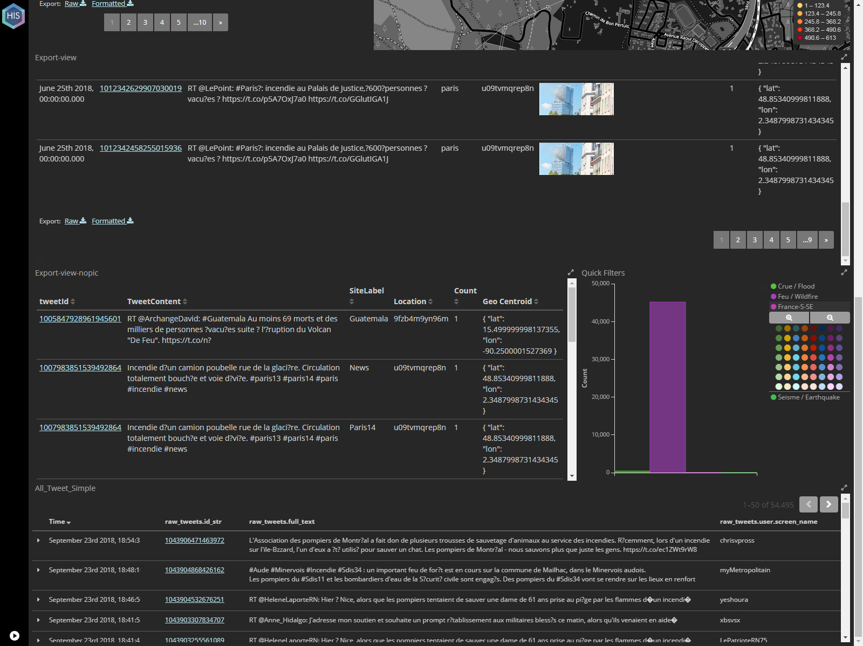
Dashboard
Overview of collected Tweets and access to functions
Time line
Full text search
Geolocated Tweets with Pics
Ratio Tweet/reTweet
Nr selected
Tweets
Geo view
Geolocated Tweets with no Pic
Accounts
Named entities
Non Geolocated Tweets

Slide 11
Hands on:
do it by yourself!
Repeat the steps we did together
Your Mission:
Find All Tweets related to:
xxHashtag xx, xxPlacexx, xxTime slotxx,
Push them to COP
xxxx
Explain how you could improve Collect query

Slide 12
Results

