Slide 1
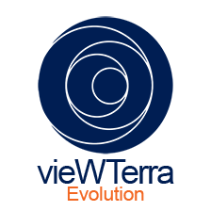
vieWTerra Evolution
Practical training
Florence Lévêque / Vincent Pourieux / Jean-François Lévigne

Slide 2
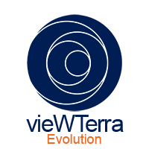
vieWTerra Evolution
SummAry
1 - General Interface
2 - Navigation and dynamic control features
2.1 - Navigating into the 3D
2.2 - Compass, Info Tab 2.3 - Layer Tab
2.4 - Display options
2.5 - 4D system: management of time and continuous time of day 2.6 - Dynamic weather system
2.7 - Various navigation mode 2.8 - Switch 2D/3D map
3 - Data and Assets Import
3.1 - Provided base for integration: vieWTerra Base
3.2 - Imagery, DEM, Land Cover import
3.3 - Shapefiles import / edit
3.4 - Auto-extrusion of buildings based on footprints
3.5 - 3D Objects and Terrain Objects (eg. photogrammetry)
3.6 - OGC WMS-WMTS data streams & draping of Local Maps
4 - 3D Editor Tool (3D scene & scenario building)
4.1 - Provided Bank of 3D Objects
4.2 - Drawing and painting functions into the 3D
4.3 - Vertex tool; auto-extrusion of buildings
4.4 - Texture Editor Tool
4.5 - Automatic creation of objects from shapefile
5 - GIS tools
5.1 - Distance measuring
5.2 - Distance measuring
5.3 - Height measuring
5.4 - Terrain Profile
5.5 - 360° Horizon: line of sight
6 - Building one’s own GIS:
6.1 - Adding custom geotagged content
6.2 - Displaying photos into the 3D
7 - Screenshots and Video recording mode
8 - Trial Austria assets/functions:
8.1 - Connection to the test-bed
8.2 - Trace window and pins
8.3 - Display OGC Stream (DLR)
8.4 - Display Geotagged photo (Crowd Tasker)
8.5 - Display Geo-oriented (3D) photo (ASIGN)
8.6 - Display Danger zone (Crowd Tasker - ASIGN)

Slide 3
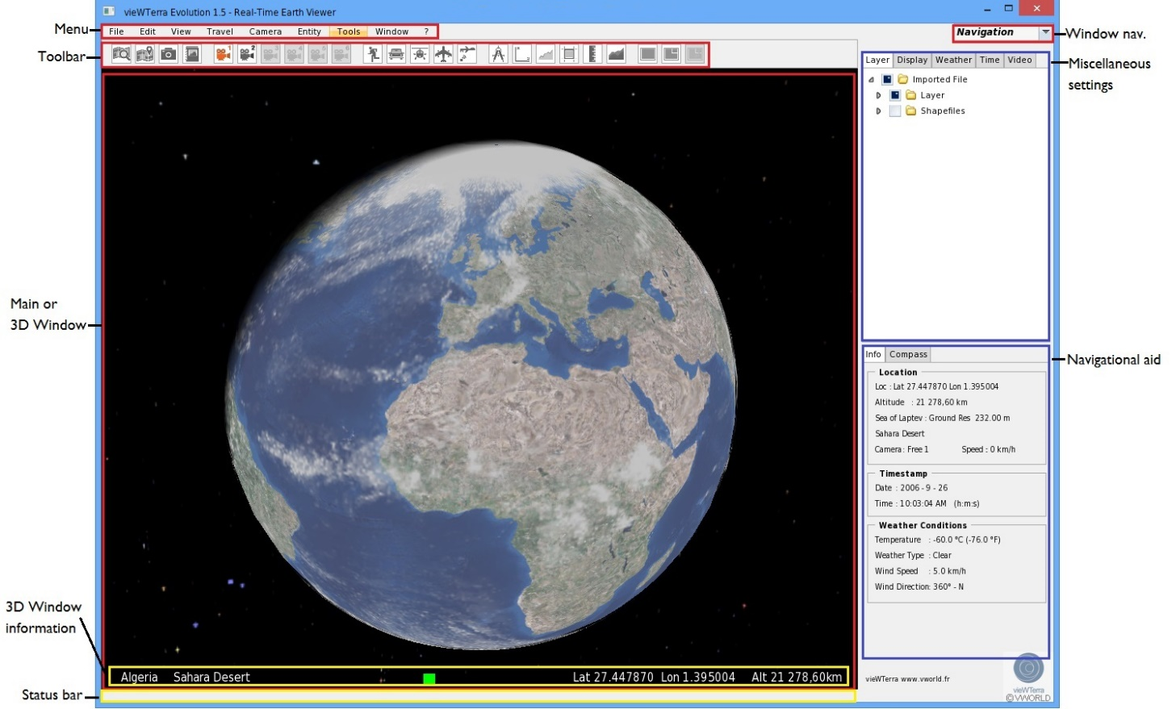
1 - General Interface

Slide 4
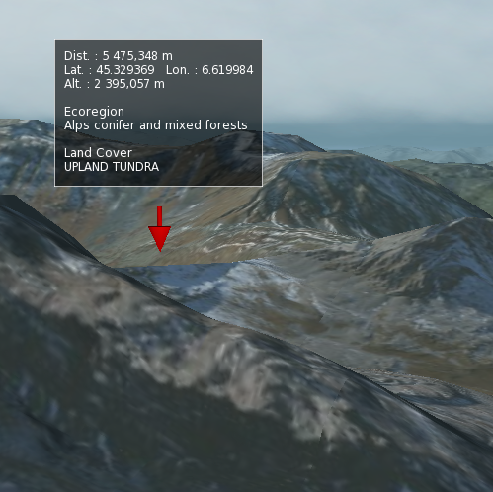
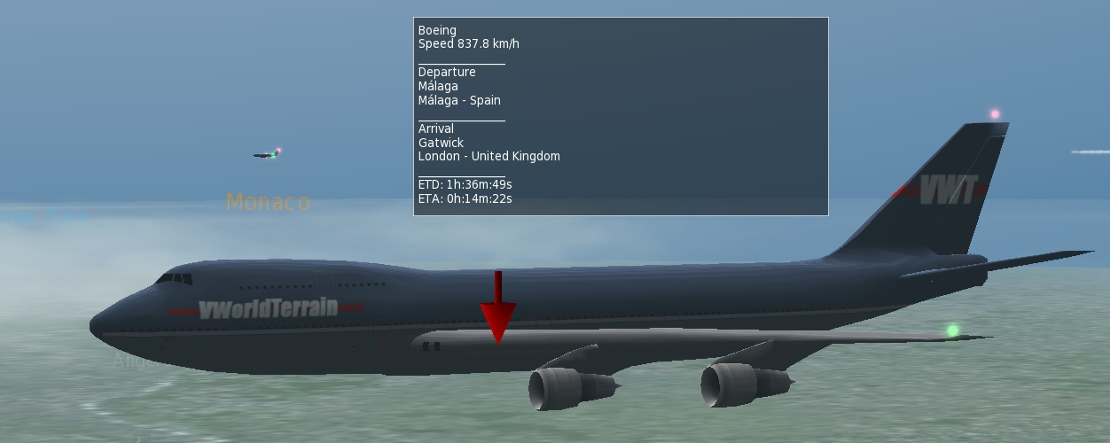
2 - Navigation and dynamic control features
2.1 - Navigating into the 3D
2.1.1 - Navigating by mouse
Put the cursor in the 3D Window:
Keep the left mouse button pressed. You can now either pull to move the camera forward or push to move the camera backward. It works the same way to go left and right.
Keep the right mouse button pressed. This rotates the camera. By moving the mouse, you can turn 360° along the horizontal or vertical axis.
Move the mouse scroll wheel, if you move it forward, the camera will move forward. If you move it backward, the camera will move backward.
Keep the middle button (scroll wheel) pressed to move the camera upward or downward.
2.1.2 - Navigating by keyboard
You can navigate in the 3D Window by using the numeric pad of your keyboard:
8: the camera moves forward
2: the camera moves backward
7: the camera rotates clockwise around the Z-axis (roll angle)
9: the camera rotates counter-clockwise around the Z-axis (roll angle)
0: resets the camera angle
Other keys:
Page Up: the camera moves upward
Page Down: the camera moves downward
Ctrl: You can use the Ctrl key in combination with any of the above mentioned keys to move faster
2.1.3 - Target function By pressing the Tab key when your mouse cursor is in the 3D Window, you activate the target function.
When you are near the surface it will display (from top to bottom):
The distance from the camera to the point you are targeting
The GPS coordinates of the point you are targeting and its altitude
The Land Cover information
The Ecoregion information

Slide 5
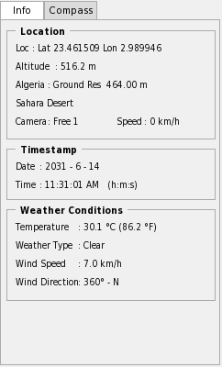
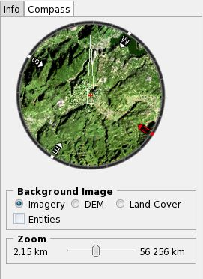
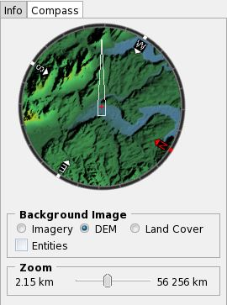
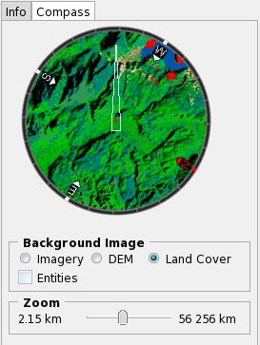
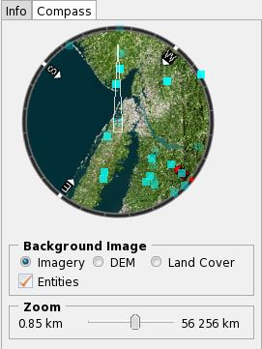
2 - Navigation and dynamic control features
2.2 - Compass, Info Tab
2.2.1 - Info Tab Page
The Info Tab Page contains precise information about where you are situated on the Globe.
It holds three panes: Location – Timestamp - Weather conditions
In the Location pane you can find the exact coordinates of your location in the 3D Window.
The Timestamp pane informs you of the date and exact hour at your current location in the 3D Window,
The Weather Conditions pane displays the temperature, weather type, wind speed and wind direction registered at this location also.
2.2.2 - Compass Tab Page
The little red cross in the compass represents the location of the camera in a 2D view from above and the needle of the compass the direction the camera is facing. When you click inside the compass and keep the left mouse button pressed, you can turn the compass left or right. By turning the compass, the camera will change the direction it is facing in the 3D Window (camera angle). When the mouse cursor is inside the compass you can:
Zoom in and zoom out by using the mouse scroll.
Press the Tab key (Target), it will display the lat/lon coordinates of the targeted location on the Globe, its altitude, the name of the country and the distance from your present location.
Press the Tab key and click, this will take you directly to the targeted location.
For the background image of the compass, you have three options. The standard background is Imagery, but you can switch to DEM or Land Cover by clicking on the radio buttons in the background pane. The Entities checkbox in the background pane allows you to switch on/off the display of entities in the compass.
If entities are displayed and you put your mouse cursor over one and press the Tab key (Target function), the compass will display its coordinates, altitude and its distance from the camera. If you left-click while doing so, you will travel immediately to the targeted entity into the 3D and the camera will attach itself to it.

Slide 6
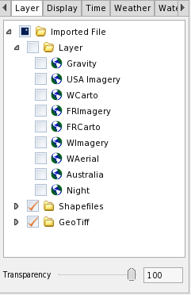
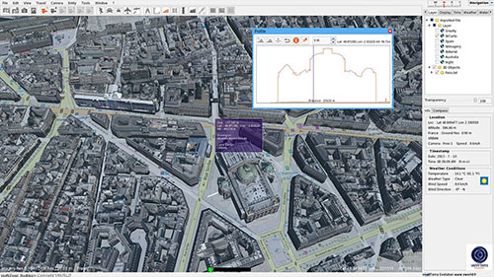
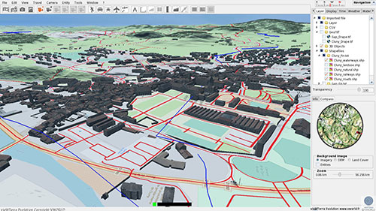
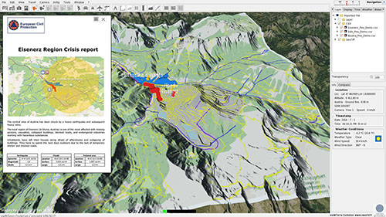
2 - Navigation and dynamic control features
2.3 - Layer Tab
The Layer Tab Page contains a tree view which lists imported files, objects and types of data streams.
By default the tree view looks like this:
It contains the following checkable options, which are here only examples of the various layers you might choose to use:
Imported File
- Layer : OGC WM(T)S stream
- Objects like: shapefiles, GeoTIFF, CSV, 3D objects, KML/KMZ
You can show/hide each layer with the check box
You can right-click on any of these items and see the following options: Go to, Edit properties, save or remove

Slide 7
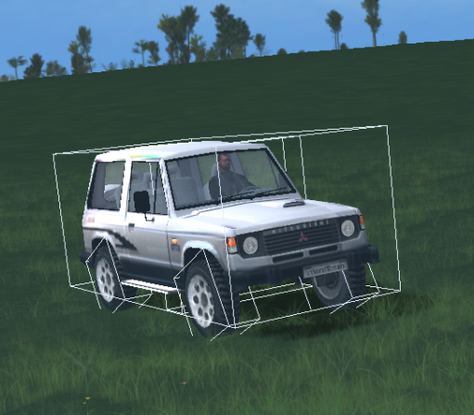
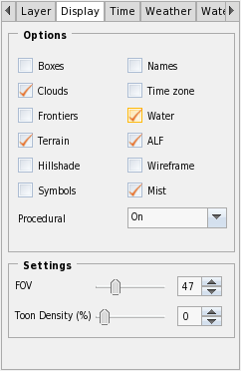
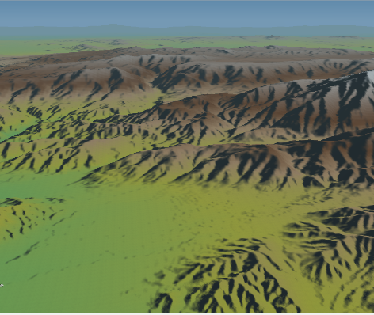
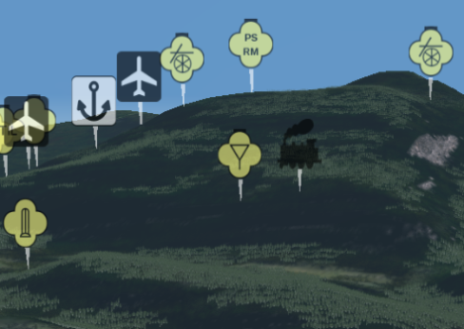
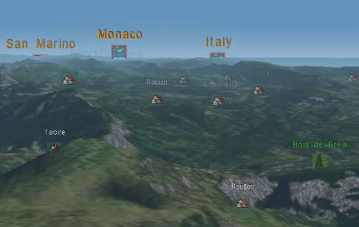
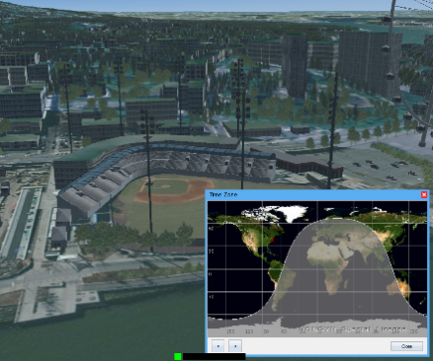
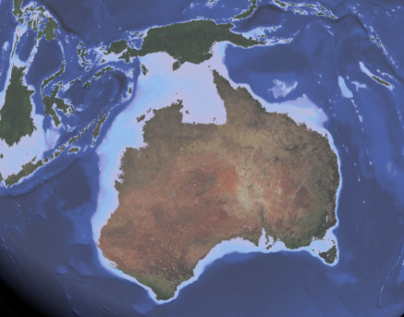
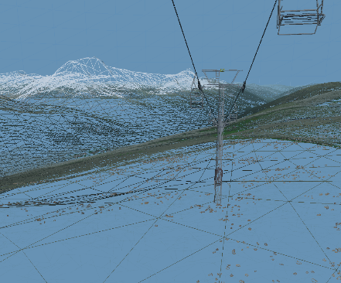
2 - Navigation and dynamic control features
2.4 - Display options
The Display Tab Page consists of two panes: Options and Settings. The Options pane allows you to choose which characteristics you would like to be displayed in the 3D Window.
1. Boxes: bounding boxes of objects
2. Clouds: Toggles on/off the display of clouds
3. Frontiers: Toggles on/off the display of frontiers between countries worldwide
4. Terrain: Toggles on/off the user-modified terrains (i.e. buildings)
5. Hillshade: visualization of illumination of the Earth’s surface draped over the 3D Elevations, using colours
6. Symbols: Toggles on/off the display of symbols.
7. Names: Toggles on/off the display of place names
8. Time zone: Shows a pop-up window with a planar view of the world. The clear part receives sunlight, it is night on the other part of the world
9. Water: Display on/off the water bodies on Earth. When deactivated, it shows underwater topography.
10. ALF: ALF stands for Autonomous Life Forms. There are animals present according to their natural habitat all over the Globe, and also moving entities following a random trajectory (human avatars, planes, balloons, tanks)
11. Wireframe: When you check this option your 3D Window will be in wireframe mode, showing the outlines of the polygons composing the terrain and objects into the 3D scene
12. Procedural: The vieWTerra Evolution Globe’s surface is created thanks to procedural functions (creating different ground texture types thanks to the Land Cover data), depending on a mixed latitude, altitude, orientation, slope degree, Land Cover, Ecosystems, or other possible type of information.
On: display ground textures and vegetation
Off: the Earth’s surface will consist of Imagery and DEM only
Half: display vegetation no ground textures
13. Fov: Modify the FOV (Field Of View). The FOV is expressed in degrees.
14. Toon density: Change the percentage of humans roaming the Earth. These humans are animated and not controllable.

Slide 8
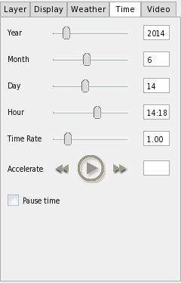
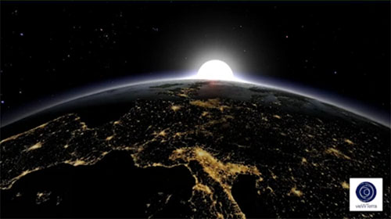
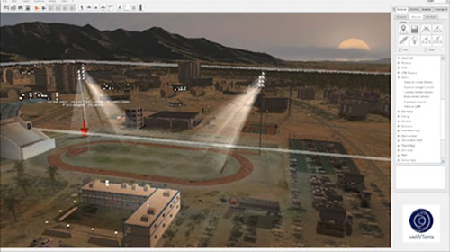
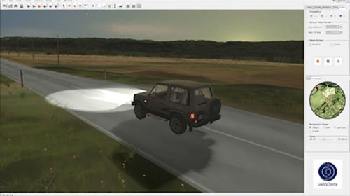
2 - Navigation and dynamic control features
2.5 - 4D system: management of time and continuous time of day
The Time Tab Page allows you to manage the “T” (time) parameter in vieWTerra Evolution. This means more than just changing the date or hour.
The system takes into account the Earth’s rotation around its axis and the revolution of the Earth around the Sun; it therefore makes sure the position of the Sun and the shadows cast by each and every building, tree or mountain are accurate according to date, hour and location, just as in real life.

Slide 9
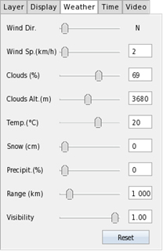
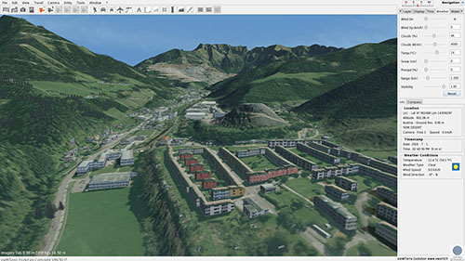
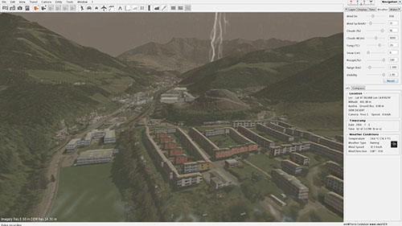
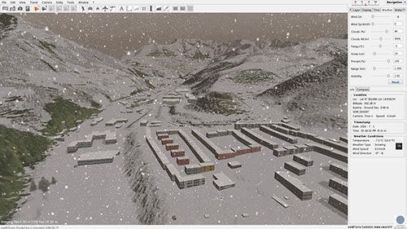
2 - Navigation and dynamic control features
2.6 - Dynamic weather system
The Weather Tab Page allows you to control the weather at your current location.
Weather conditions by default are based on real data, and change through time, as vieWTerra Evolution is a 4D system, taking into account the “t” parameter.
However it is possible to change the weather dynamically, for scenario creation purposes, using the parameters listed in the Weather Tab Page, as shown opposite.

Slide 10
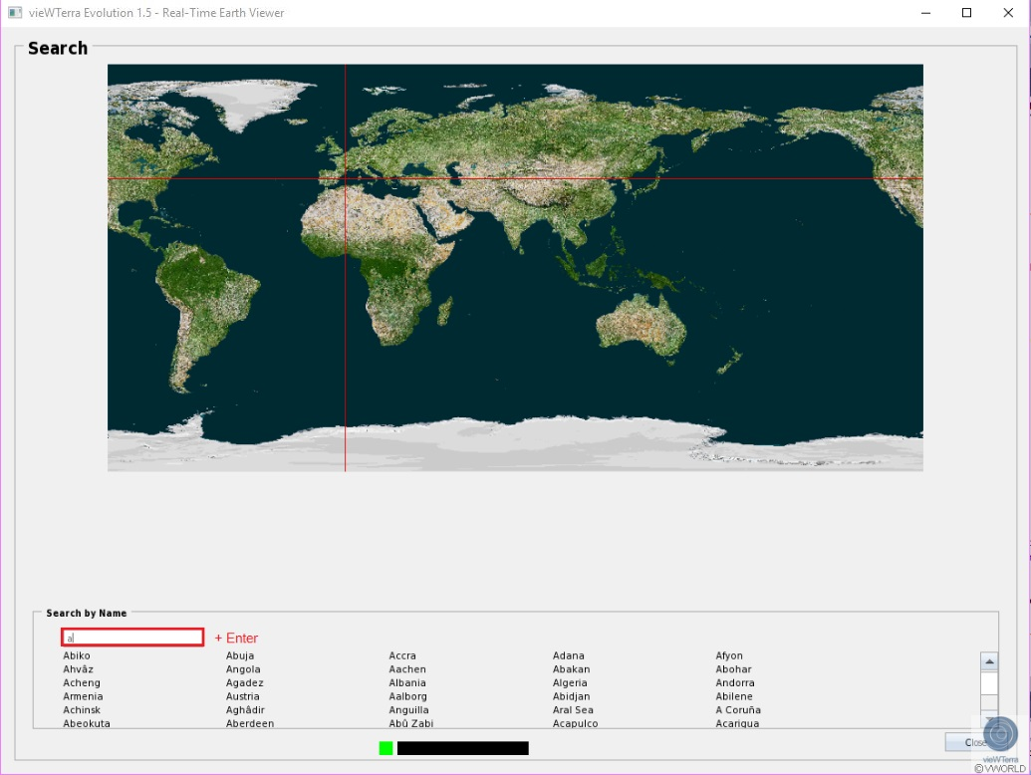
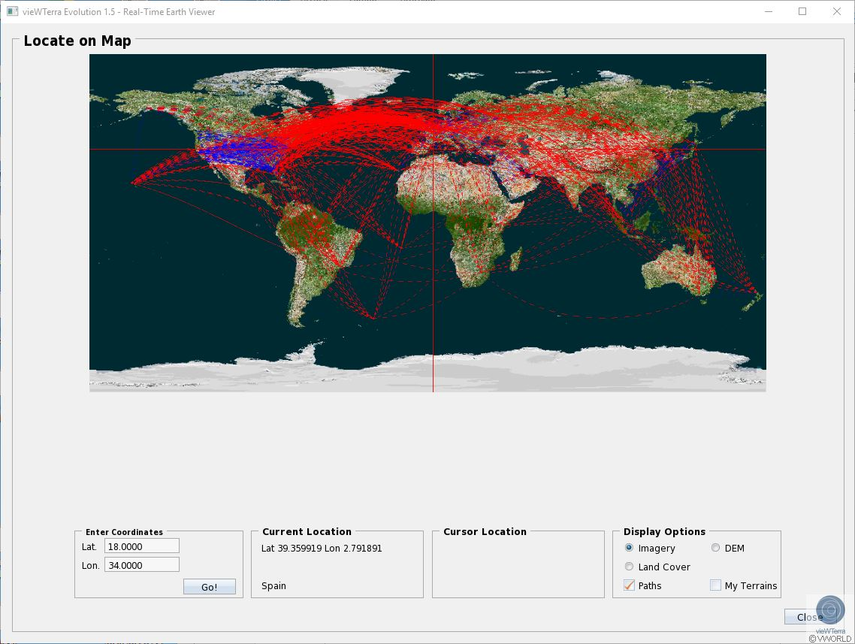
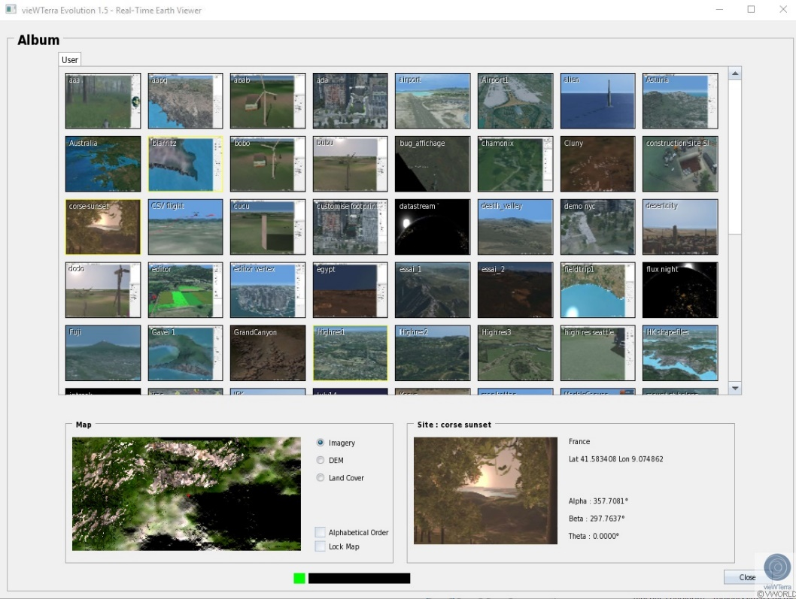
2 - Navigation and dynamic control features
2.7 - Various navigation mode
The Travel Menu allows you to quickly navigate to a location of your choice. It contains:
Search: search by name
Locate on map: navigation by clicking on Map or enter coordinates
Album: navigation by saving location (Taking photo). These parameters are saved: coordinates, time/date, weather conditions, position of camera
These navigation functions are also represented in the Toolbar:

Slide 11
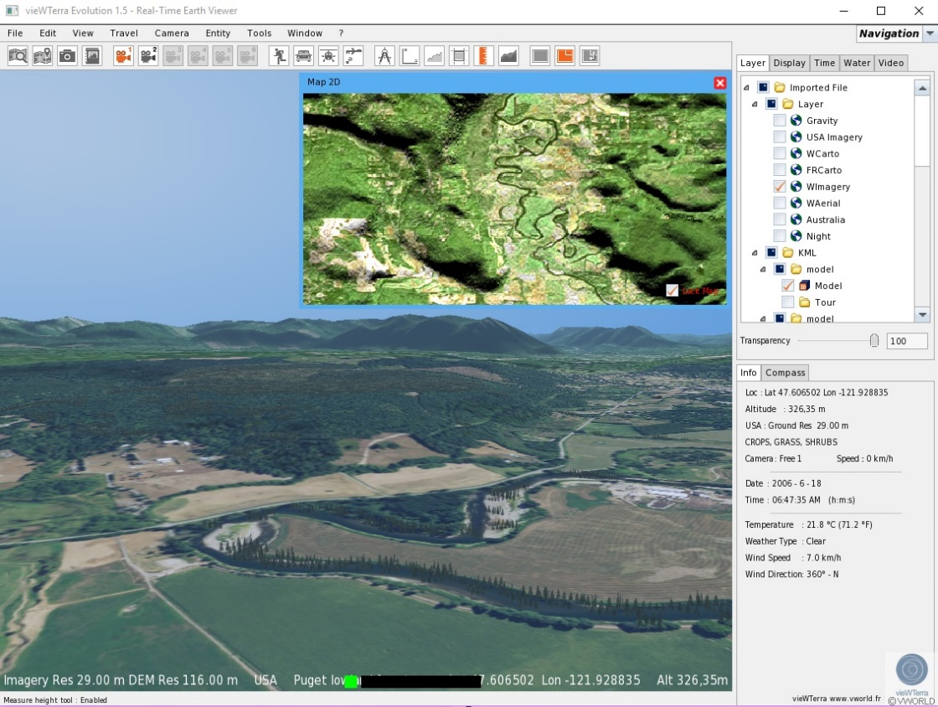
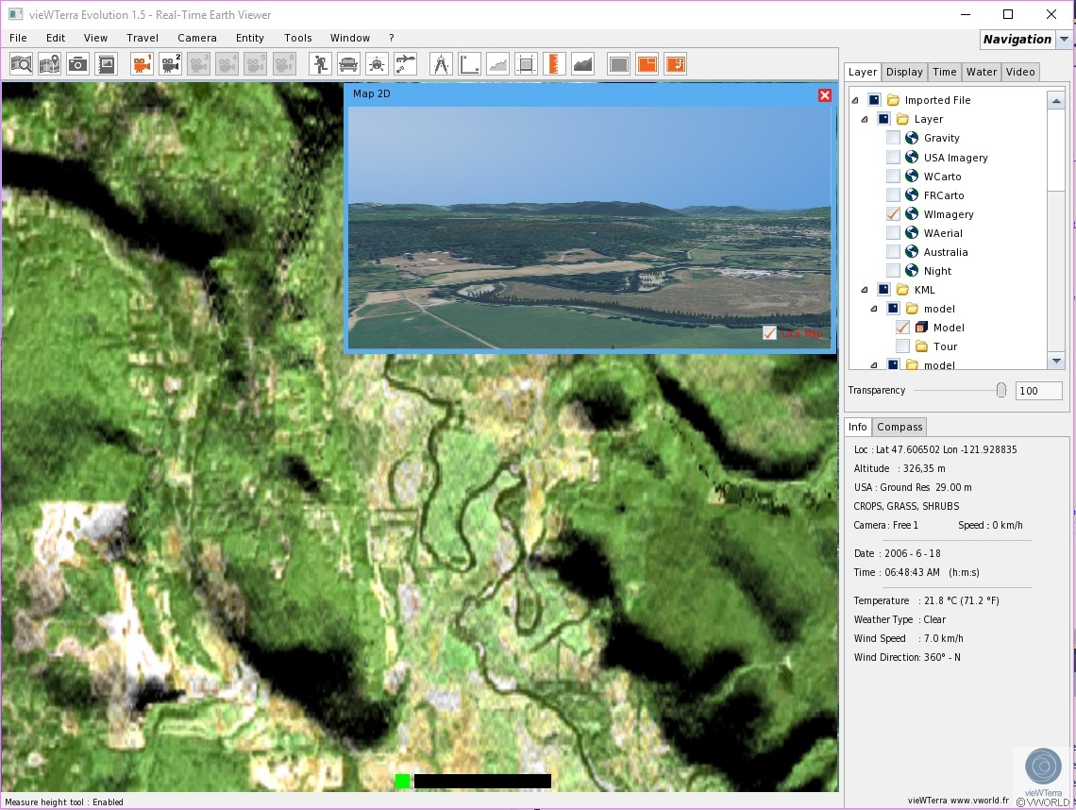
2 - Navigation and dynamic control features
2.8 - Switch 2D/3D map
The Window Menu allows you work with a 2D window inside the 3D Window. It contains:
- Insert 2D window
- Toggle 2D/3D
These functions are also represented in the Toolbar:

Slide 12
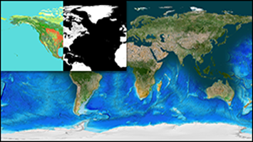
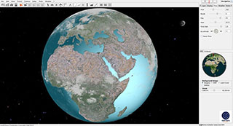
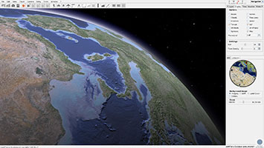
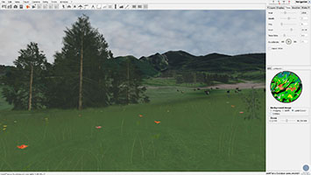
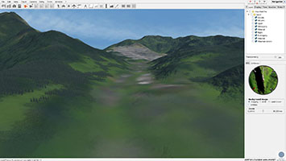
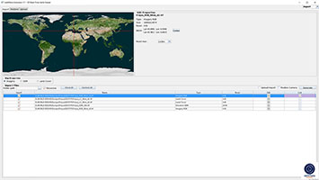
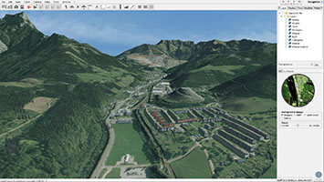
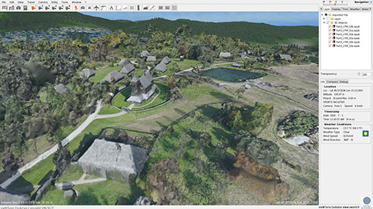
3 - Data and Assets Import
3.1 - Provided base for integration: vieWTerra Base
Provided global set of 29m cloud free Imagery, 90m DEM, 29m Land Cover mosaics as “base” resolution for the entire Earth, including Antarctica
Rapid integration of Imagery, DEM (including bathymetry), Land Cover (i.e. different ground types) up to 45 cm & photogrammetry or Lidar elevation models (Terrain) or 3D objects (e.g. buildings)
3.2 - Imagery, DEM, Land Cover import

Slide 13
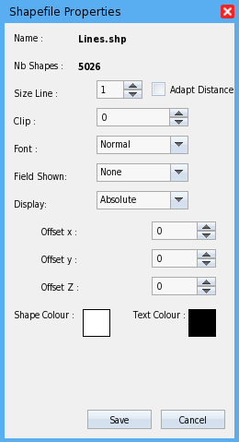
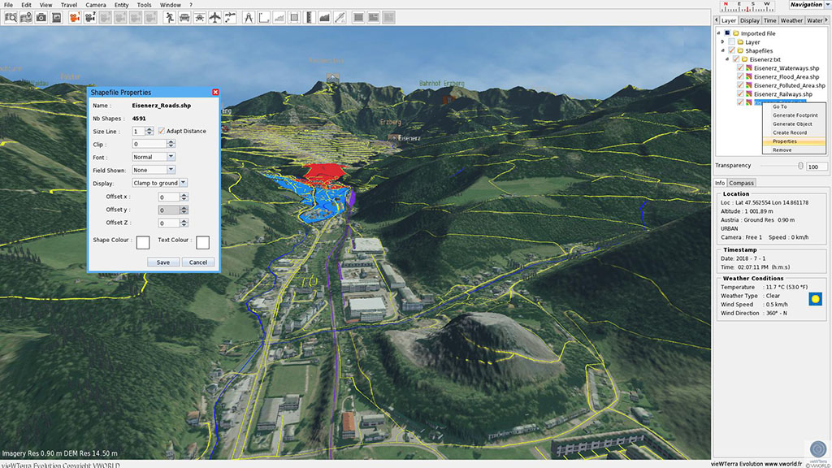
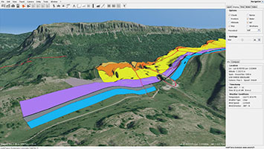
3 - Data and Assets Import
3.3 - Shapefiles import / edit
You can import shapefiles and shape scenes in vieWTerra Evolution via a simple Drag&Drop. A shape scene is a vieWTerra Evolution Shapefiles Script (a collection of shapefiles, listed in a text file): - You find the shapefiles/shapescene in the tree view which lists imported files in Layer Tab - You can right-click on any of these items and see the following options: Go to, Generate Footprint, Create a record, Edit properties or remove Properties : Line Size: Line thickness of the shapes
Adapt Distance: The line size of the shapefiles will adapt itself in proportion to the distance of the camera.
Font
Field shown: You can select an attribute of the shapefile to display it
Display: - Absolute - Adapt to ground - Adapt to sea - Clamp to ground -Clamp to sea
Shape Colour
Text Colour

Slide 14
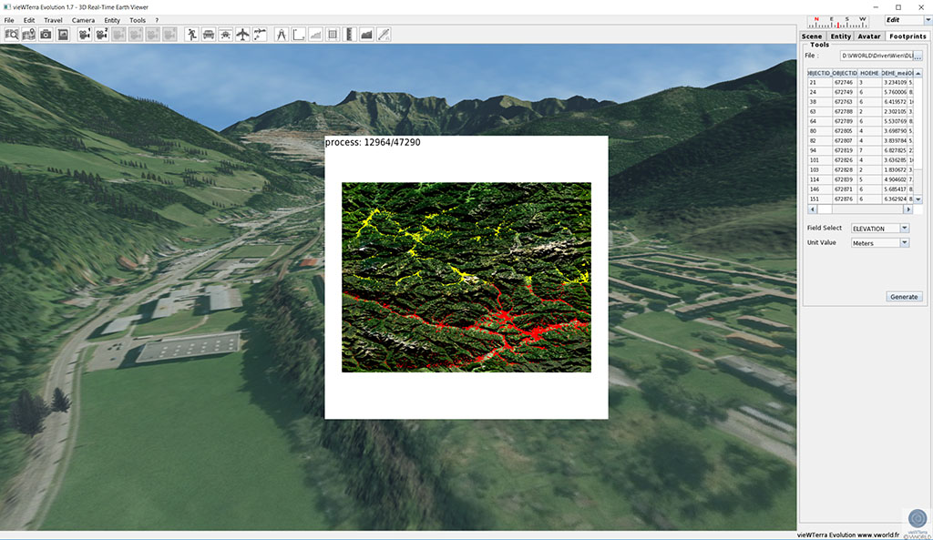
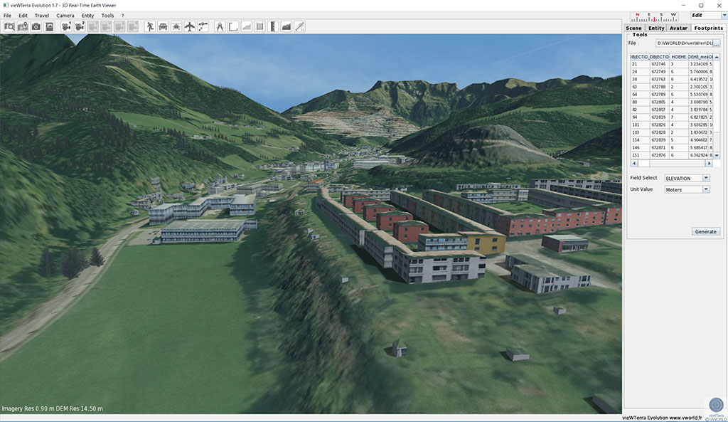
3 - Data and Assets Import
3.4 - Auto-extrusion of buildings based on footprints
If you have shapefiles in your possession that contain building footprints and their heights, the Footprint Tool can auto-extrude these buildings automatically in a very short amount of time.
Press Open you will the see the series of values displayed in columns. Move the scrollbar to see the different columns. In the bottom of the Tool pane you can select the column that represents the height of your buildings and underneath its unit of measure. In this example, Elevation and Feet. These extracted buildings are customizable (Size, style, roof, textures...)

Slide 15
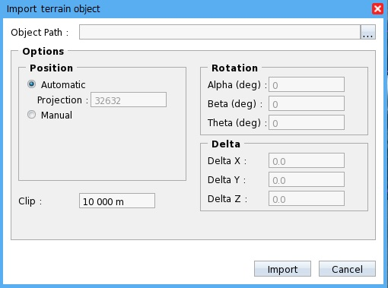
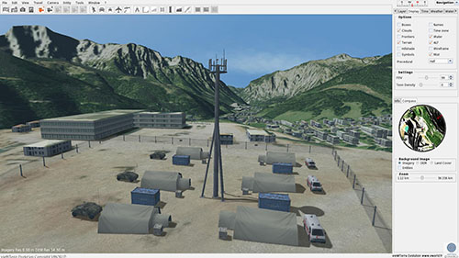
3 - Data and Assets Import
3.5 - 3D Objects and Terrain Objects (eg. photogrammetry)
You can import any 3D object through the File/Import/3D Object or simply by drag and dropping it,
if it has one of the following extensions:
*.3ds, *.dae, *.blend, *.obj, *.dxf, *.lwo, *KML/KMZ
- You can right-click on any of these items and see the following options: edit properties, remove or export (3D scene) You can import Terrain Objects through the File/Import/Terrain Objects (only OBJ files – UTM Local Projection)
- You can right-click on any of these items and see the following options: edit properties or remove

Slide 16
3 - Data and Assets Import
3.6 - OGC WMS-WMTS data streams & draping of Local Maps
This process allows you to display streaming data as a layer over the Globe. You need an Internet connection to use this functionality.
Click on File/Import/WM(T)S:
- Enter a valid data stream URL and press the Connect button.
- You can right-click on any of these items in Layer Tab and see the following options: edit properties, set on roof, remove or save
You can import GeoTIFF as Layer through the File/Import/GeoTIFF or simple Drag&Drop - You can right-click on any of these items and see the following options: edit properties, Go to, import into DB, remove or save

Slide 17
4 - 3D Editor Tool (3D scene & scenario building)
4.1 - Provided Bank of 3D Objects
The Expandable Bank of Objects contains a lot of different categories that all contain various objects (+500) - Place object into 3D
- Move, rotate and scale
- Integrated easy-to-use painting and drawing functions to create custom ground cover (forests, fields, water, sand, pebbles, etc…)
4.2 - Drawing and painting functions into the 3D

Slide 18
4 - 3D Editor Tool (3D scene & scenario building)
4.3 - Vertex tool; auto-extrusion of buildings
Vertex Editor Tools: easy creation of buildings (e.g. visible from Imagery) without GPS and height information in input, user-defined metadata/labeling, type of building, type of roof
Texture Editor Tool allow the possibility of customizing each façade of buildings
4.4 - Texture Editor Tool

Slide 19
4 - 3D Editor Tool (3D scene & scenario building)
4.5 - Automatic creation of objects from shapefile
In case of fill a form with objects you will see that once you have completed your form, the Fill With pane will appear. Here you can select the object of your choice and the density with which the form has to be filled.
Positioning object with a line

Slide 20
5 - GIS tools
A set of sophisticated and user-friendly GIS measuring tools, including: - 2D Measuring Tool: measures the distance between 2 or more points - 3D Measuring Tool: measures the distance between 2 or more points while taking the elevation into consideration - Surface Measuring Tool: determines the surface of any area, including whole countries or continents - Height Measuring Tool: measures the height of any object or geographical feature - Profile Tool: measures the (Elevation) profile for a line drawn between 2 or more points. Results are shown as a 2D graph with detailed information. - Horizon Tool: measures the horizon, 360 degrees around a chosen point. Results are shown as a graph with detailed information and extra visualization capabilities showing 2D display of ridgelines, viewsheds, elevations, objects detection etc. - 3D Lines Tool: allows drawing of 3D lines anywhere on the surface including water, 3D Objects, footprints, dynamic entities, Terrain Objects...

Slide 21
6 - Building one’s own GIS:
6.1 - Adding custom geotagged content
VieWTerra Evolution allows you to plant information stacks and/or pins at any location of your choosing. The pins and stacks are planted at lon/lat coordinates at a certain altitude. An angle of view at a certain set of coordinates is associated with each pin. The information stacks are made out of cubes which are stacked on of top of the other if they are situated at the same set of coordinates. Each cube represents a file that can be displayed in a floating window and/or on a panel. Several documents can be opened at the same time. The different types of files that can be displayed are: - Pdf documents - Videos - Audio recordings - Photos - 3D objects Easy and fast integration of multiple assets: shapefiles, cvs files, 2D map (disaster maps, evacuation routes, tactical situation, powerlines, rivers, roads … ), geotagged photos, videos, audio recordings, via simple drag & drop

Slide 22
6 - Building one’s own GIS:
6.2 - Displaying photos into the 3D
VieWTerra Evolution allows insert a real photograph into the 3D Window Menu: Insert photo into 3D
- Blend the photograph with the 3D, thanks to the Blend slider
- Display the 3D layer including objects over the real photograph by checking the Photo mask checkbox.
- Put the camera (moving into the 3D view) back into the original photograph’s angle/position by using the Align button

Slide 23
7 - Screenshots and Video recording mode
If you click File/Screenshot, a screenshot will be taken of the 3D Window and placed in the shots folder at the root of your vieWTerra folder. You can choose either, take the screenshot with the User Interface or without, and set the quality of the screenshot. The Video Tab Page allows you to easily record videos, with or without the User Interface. First choose the desired frame rate, then select the video resolution you would like and the bit rate. If you would like the User Interface to appear in the recorded video, please check the appropriate box in the Video Options pane. By checking the Credits box, the vieWTerra Evolution Credits appear at the end of the video.

Slide 24
8 - Trial Austria assets/functions

Slide 25
8 - Trial Austria assets / functions
8.1 - Connection to the test-bed
1 - Plug the vieWTerra Evolution dongle (USB3 preferably) 2- Wait for the RestService initialization (about 20-30 sec)
Execute testbed/test_bed_service-master/executable/startTestbedRestService.bat
3 - Run vieWTerra Evolution (vieWTerraVS15.exe icon) 4- wait for the “Connection to testbed OK” message into trace window

Slide 26
8 - Trial Austria assets / functions
8.2 - Trace window AND pINS
The Trace window displays the latest received messages. The window can be moved (right click + move mouse), close or opened through the View Menu.
One 3D Pin is attached to each CrowdTasker and ASIGN message, showing the GPS location of the message. Yellow Pins define ASIGN messages (3D photos or Mission/Danger zone areas). Blue Pins define CrowdTasker messages (geotagged photos or Mission/Danger zone areas). The User can pass the mouse on every Pin into the 3D and highlight the corresponding message. By left-clicking on a Pin, the 3D view (camera) is set to the Pin location.
When passing the mouse on the CrowdTasker and ASIGN messages, the highlighted message will show the corresponding Pin into the 3D and the description of the Pin. When left clicking on the message, the user can join the corresponding Pin location into the 3D.
CrowdTasker and ASIGN messages can be erased by targeting the corresponding Pin and pressing the DEL key or by passing the mouse on the message in the Trace window and pressing the DEL Key. In both cases, a confirmation message window will secure the Erase action.

Slide 27
8 - Trial Austria assets / functions
8.2 - Trace window
All messages received during a session are saved in a Trace folder allowing to keep a set of traces and replay these. The folder name corresponds to the date of the first message received during the session. A session corresponds to a launch of vieWTerra Evolution. A .tb file is created for each session. In case of power failure of the PC running the session, the .tb file will contain all the messages received until the failure.
The « Open » button allows to load and replay a set of traces. The user can select a .tb file thanks to the file browser and load it. All messages will appear into the Trace window and the 3D View according to the message date and therefore the current vieWTerra Evolution date.
The vieWTerra Evolution date is set according to the first message date, when the .tb file is loaded. Next messages will appear according to their date and vieWTerra Evolution’s current date. The vieWTerra Evolution date can be changed or accelerated through the Time Menu.
The « Next » button allows to load the next message into the list and set the corresponding date. Therefore, all the messages of a session can be loaded and displayed in real-time (action replay), in accelerated time or in slow motion mode (analysis).

Slide 28
8 - Trial Austria assets/functions
8.3 - Display OGC Stream (DLR)
When a WMS message is received from the Technical Infrastructure (testbed) Geoserver, the information is displayed into the Trace window as an Imagery WMS message.
The stream is automatically placed into the Layer Menu and can be activated.
The user can toggle on/off this layer, change its properties (colour, opacity, caching mode) or delete this layer.
Measurements can be done (e.g. distance, height, surface), the Target Tool can be used to get GPS location, altitude, distance & ground type
Other stream layers can be combined (e.g. cartography layers such as Open Street Map)

Slide 29
8 - Trial Austria assets/functions
8.3 - Display OGC Stream (DLR)
Since the data stream is draped on the vieWTerra Evolution terrain, it is possible to use the Profile Tool to measure the slope or the accident of the area.
The Profile window informs of the slope and its min. and max. altitudes. The 2D profile is linked to the 3D View in order to allow 2D and/or 3D measurements.
The Profile Tool gives a clear real-time picture of the slope of a given area, which Imagery has been acquired just a while ago by DLR’s drone.
In the same way, the Horizon Tool can be used to get a 360° line of sight from any given location chosen by the user, including into the recently-acquired Imagery draped a layer over the 3D terrain.
It allows to measure the distance from the selected spot (which can be picked at a certain distance from the ground level) to any targetable point around that initial spot. Ground type (Land Cover) as well as GPS location and altitude are also informed for each point along the drawn horizon red line. This can be used for inter-visibility and communication/ signal coverage assessment.

Slide 30
8 - Trial Austria assets / functions
8.4 - Display Geotagged photo (Crowd Tasker)
A CrowdTasker photos contains the GPS location coming from the device (smartphone, camera) used on-site. Several photos can have the same GPS location.
CrowdTasker photos are displayed as always facing the user so as to allow easy viewing. Each photo has its own Pin allowing the user to set the location by clicking left on the Pin. To avoid to overload the 3D view, photos are automatically displayed into the 3D terrain based on the vieWTerra camera location.
In the case when several photos are taken at the same location, the system will automatically separate them side by side in order to avoid overlay.

Slide 31
8 - Trial Austria assets / functions
8.5 - Display Geo-oriented (3D) photo (ASIGN)
Photos coming from ANSUR, taken out in the field, contains various information:
GPS location, including accuracy information, expressed in meters
Altitude of the photo
Orientation of the photo, when available
Field-of-view (FOV) of the photo, when available
Optional regions in higher definition
Other information such as date, description, camera type
Photos are displayed into the 3D according to their GPS location, altitude, orientation and FOV. A Pin is attached to each photo. The user can reach a photo location (into the 3D) by left-clicking on its Pin or by left-clicking on the corresponding message into the Trace window.
The user can target the photo itself into the 3D using the mouse. The targeted photo border will be shown in yellow and the date of the photo will be displayed, as well as various information such as camera type, date, description. A green circle will also be displayed on the ground, so as to inform the user of the orientation of the photo. The size of the circle informs on the accuracy of the GPS location.
When a photo is targeted by the user, it can be moved by using CTRL+ arrows keys (CTRL + RIGHT-LEFT-UP-DOWN). The original location and the edited location of the photo are saved during the session. On the same way, the FOV can be changed (UP and DOWN keys) and the orientation of the photo (RIGHT and LEFT Keys). All these information are saved during the session.
This is useful to correct the geolocation of the photo when given inputs are not precise enough (e.g. GPS location with a 20m accuracy only)
The user can also press SPACE BAR on a targeted photo in order to place the camera at the location which the photo has been captured, so as to get the corresponding 3D view of what has been captured into the photo. To that aim, orientation of the camera and its FOV are also set in that case.

Slide 32
8 - Trial Austria assets / functions
8.5 - Display Geo-oriented photo (ASIGN)
An ANSUR photo can be composed of several regions defined in higher resolution for a better analysis of a situation. These regions can be updated at any time (update sent from the terrain).
On the same way the photo can be target into the 3D, each region can be targeted by the user. The camera can be set on a photo region location by using SPACE BAR on a target region.
vieWTerra Evolution Editor Tool can be used to remove already existing 3D objects which could hide a part of the photo taken on-site. For instance, trees can be removed or on the contrary added to get a 3D view better fiting with the photo.
Weather menu can be also used to set the vieWTerra Evolution weater condition according to the photo, for instance to add snow. On the same way, the time menu can be used to set the same date and time informed in the photo.

Slide 33
8 - Trial Austria assets / functions
8.5 - Display Geo-oriented 3D photo (ASIGN)
Opacity can be changed by using SHIFT+UP or DOWN keys on the targeted photo. This can be useful when moving a photo into the 3D or when the user wants to have a better view of the terrain behind the photo.
The vieWTerra Evolution Target feature can be used to target a given spot appearing into the photo. The user will therefore be informed of:
distance from the vieWTerra Evolution camera
GPS coordinates and altitude
type of ground (Land Cover)
Ecoregion
These feature can be useful to rapidly geolocate any event visible from the photo (e.g. determing the location of an incident, pin-pointing injured persons…)

Slide 34
8 - Trial Austria assets / functions
8.6 - Display Danger zone (CrowdTasker - ASIGN)
Danger areas or mission zones coming from CrowdTasker or ANSUR are displayed directly on the terrain into the 3D view, as a layer. The opacity of the area can be changed by using the dedicated slide into the Layer Menu. The area can be composed of a triangle, a rectangle or even a polygon, namingly any shape, whether convex or concave.
A Pin is attached to each area. Its location is automatically calculated on the center of the area. When the user highlights the Pin (using the mouse into the 3D or the Trace window message), the available information of the area is displayed above the Pin.

Slide 35
CONTACT
Vincent Pourieux: vpourieux@vworld.fr
Florence Lévèque: fleveque@vworld.fr
Jean-François Lévigne: jflevigne@vworld.fr
REACH US

