Slide 1
Crowdtasker Mobile
APP Handbook
Sebastian Sippl (Technical Expert) & Daniel Auferbauer (Scientific Advisor)
Eisenerz, Austria, 2019

Slide 2
Crowdtasker Mobile
Overview - Strategy
CrowdTasker will periodically notify you about new events if you qualify for them. Possible qualifiers for a CrowdTasker event are:
Being in the area of the event (or having been there while the event is active).
You possess all necessary skills (languages and / or medical skills).
Please note that the operator decides if and which restrictions are applied to an event.

Slide 3
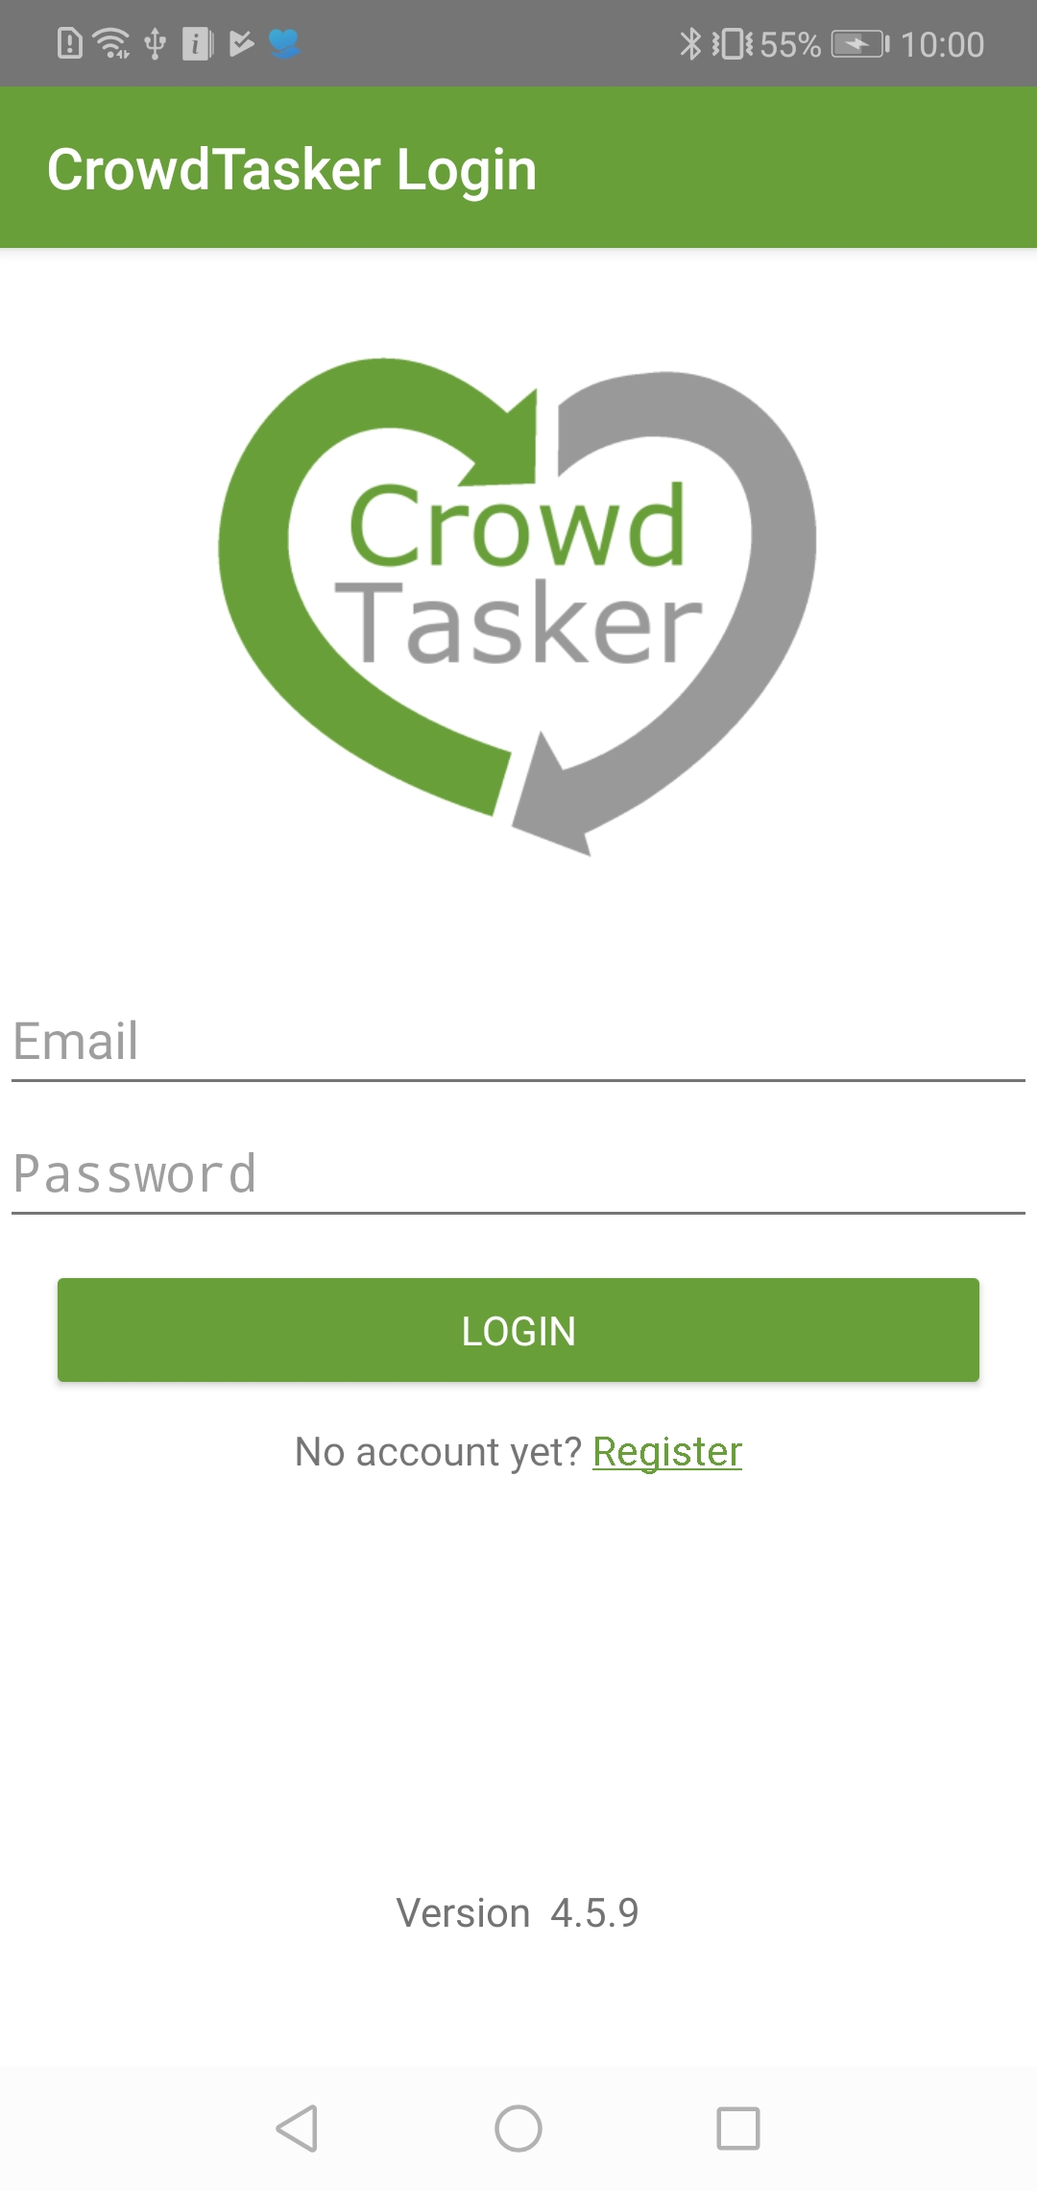
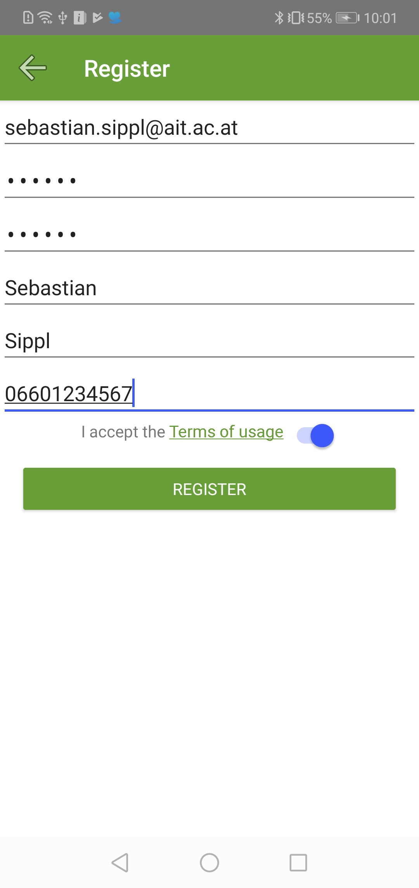
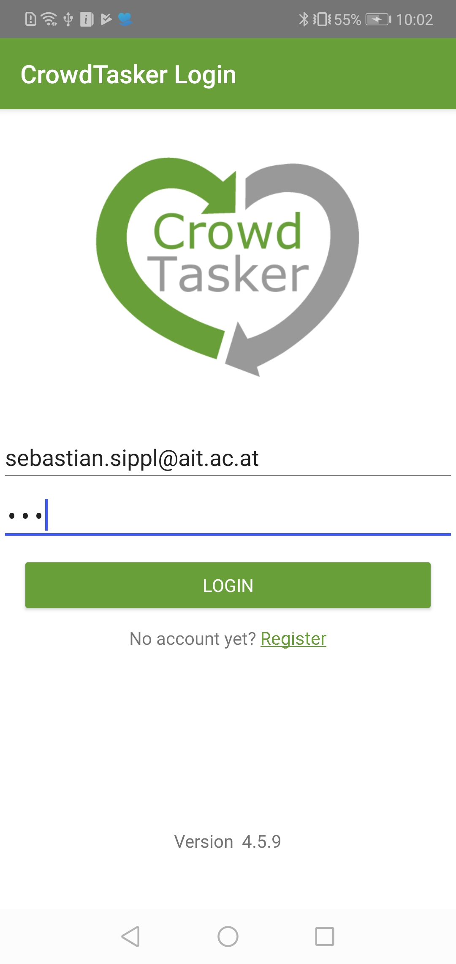
Crowdtasker Mobile
Registration and login
To use CrowdTasker mobile you need to register first. To activate your account you need to click the activation link in the Email you will receive. When logging in, please accept all demanded permissions:
Click link in Email

Slide 4
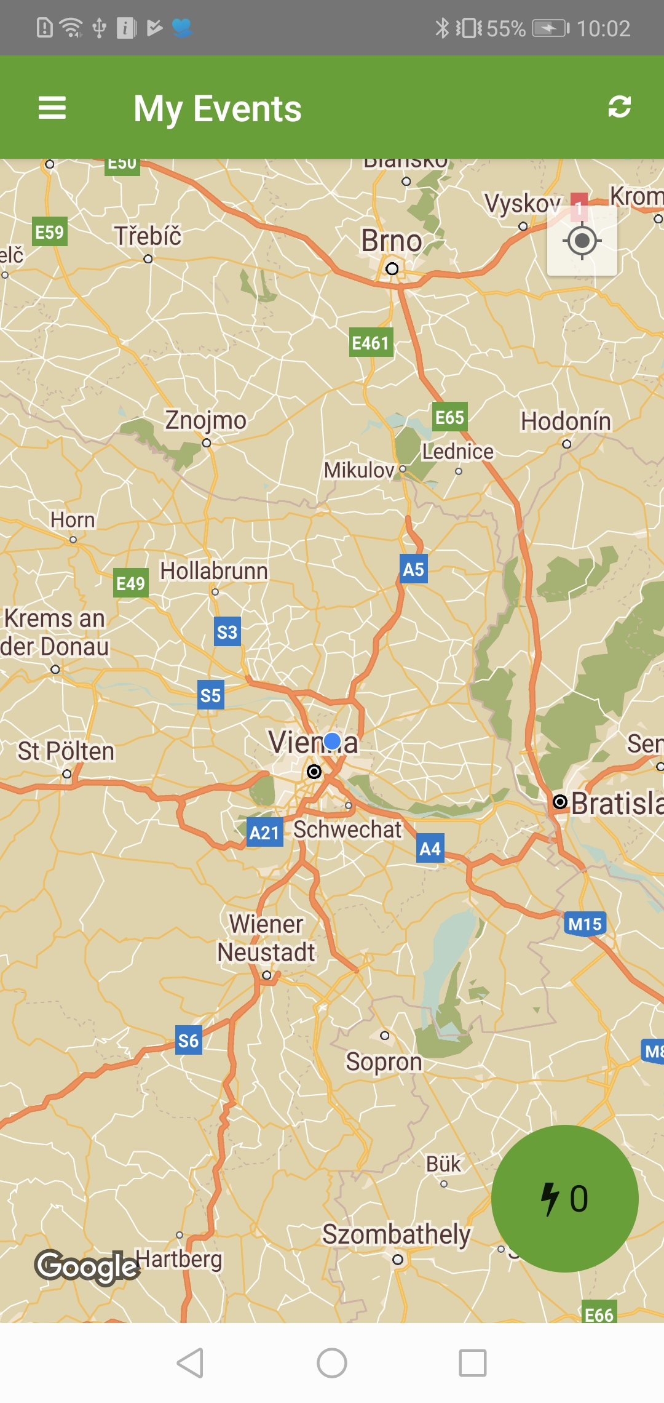
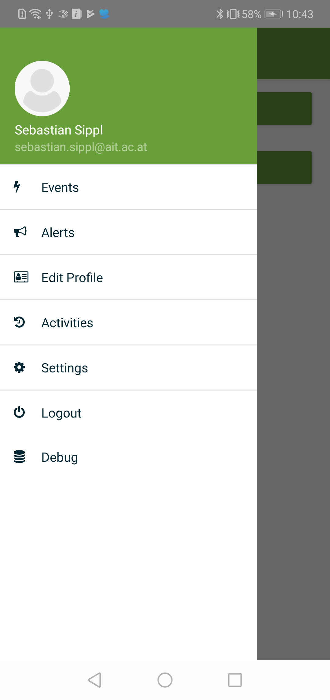
Crowdtasker Mobile
Main Screen + Main Menu
After logging in you will be redirected to the event overview screen.
To access the main menu swipe from the left side, or press the top left menu button.

Slide 5
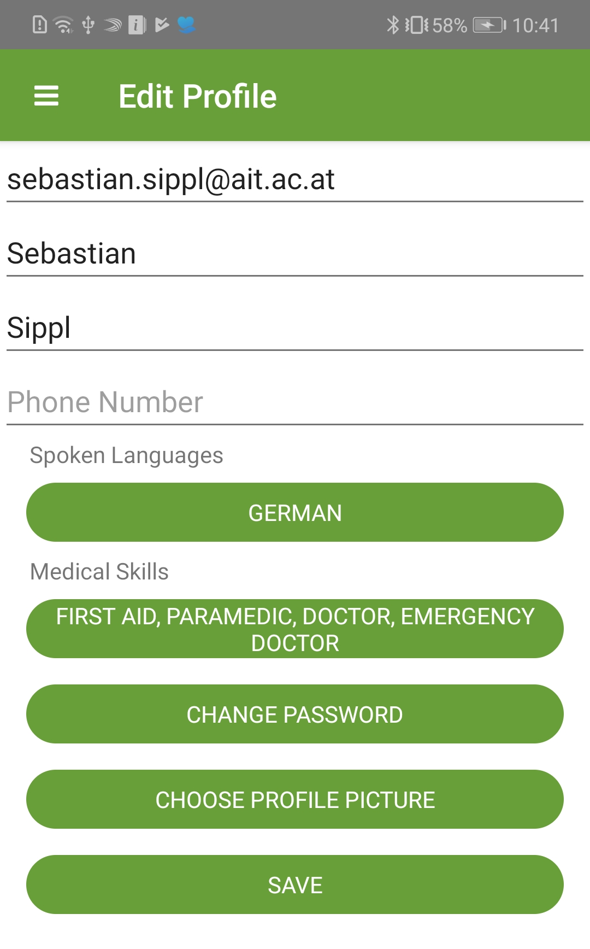
Crowdtasker Mobile
PROFILE
After registering you should enter your profile information. To do so select the „Profile“ option in the main menu. Enter your contact information as well as your possessed skills and spoken languages.
Those will be used later on to decide, if you will receive an event or not.

Slide 6
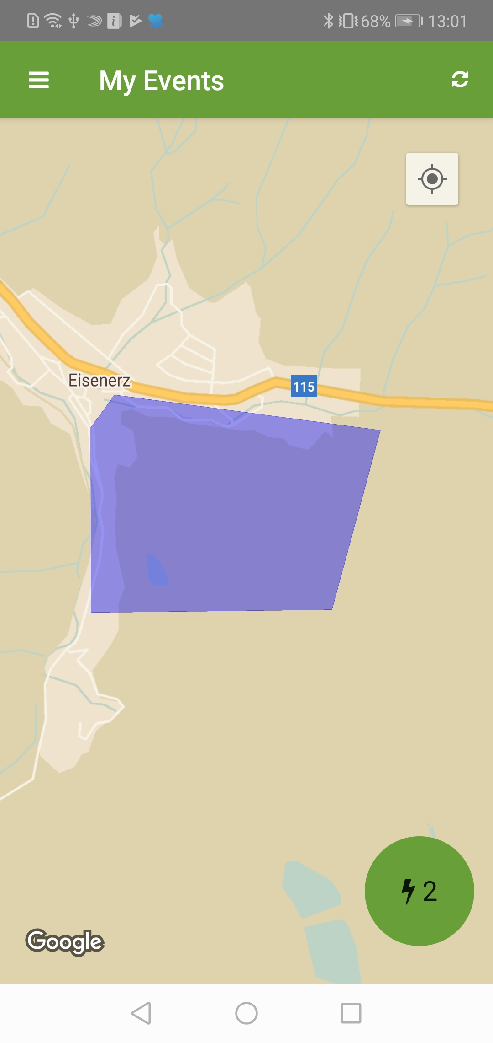
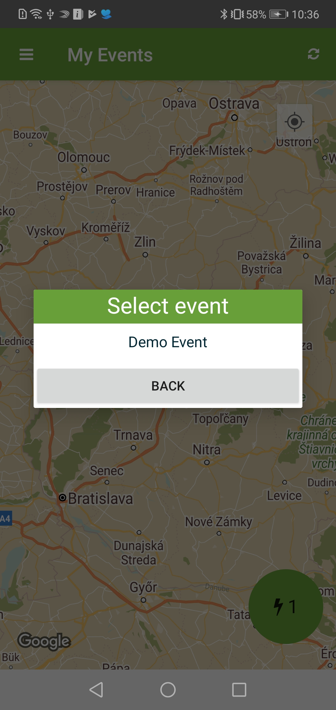
CROWDTASKER MOBILE
Events screen
When the app is started you will see the event overview page that contains a list of open events as well as their area on the map. To select an event open the event menu or tap a polygon on the map.

Slide 7
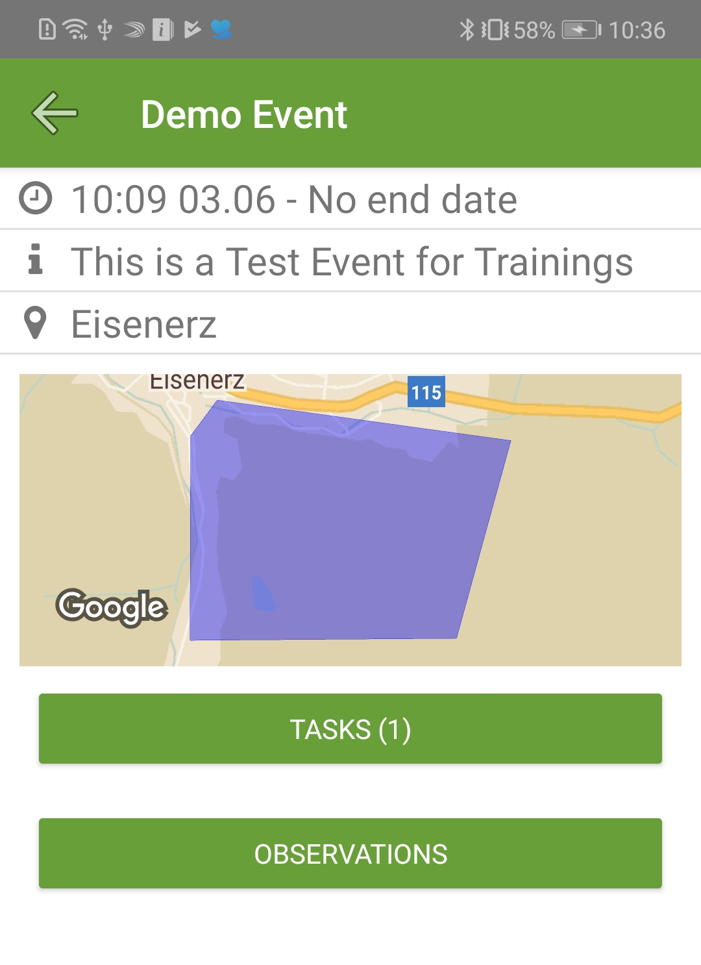
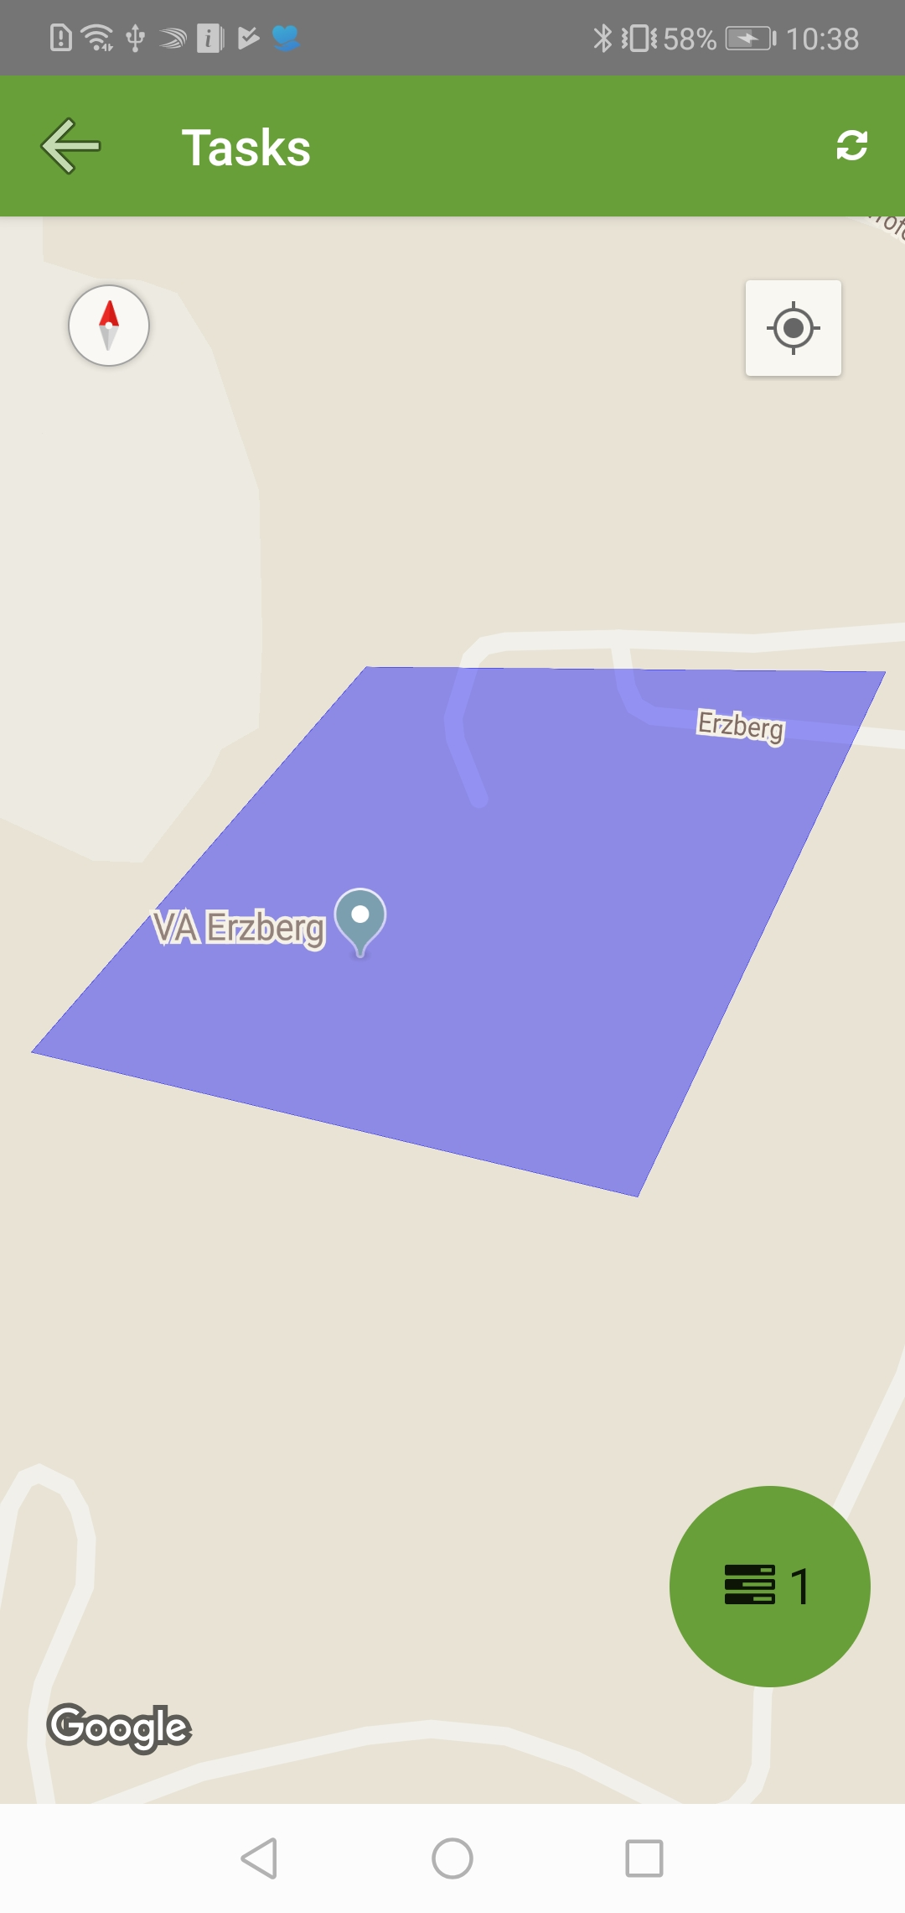
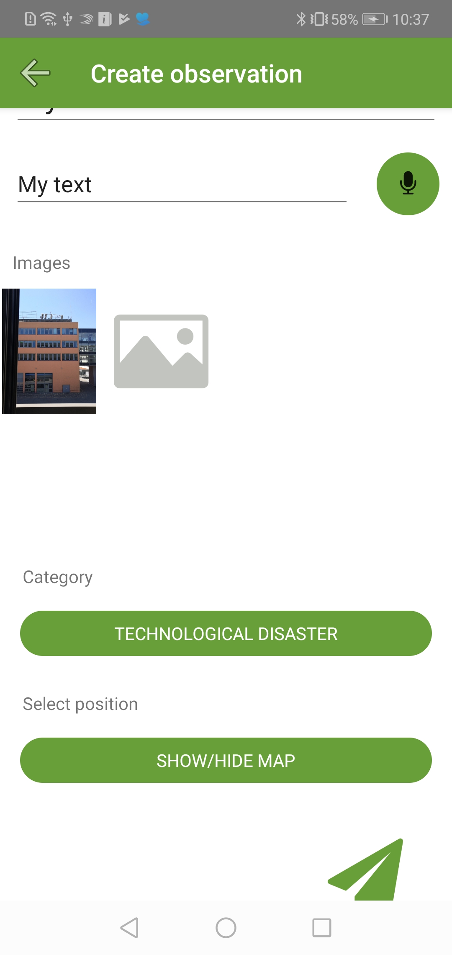
CROWDTASKER MOBILE
Event Details
The event detail screen shows a description of the event and allows you to navigate to the task overview screen of this event. You can also post observations that are automagically linked to the event from here. Note that it depends on the configuration of the event which (if any) of these options (tasks, observations) are available.

Slide 8
CROWDTASKER MOBILE
Observation screen
To post an observation, navigate to an events observation screen, fill in the observation details and press the button on the lower right to send your observation. Images are created with the image icon (camera will open).
You can use voice input by pressing the microphone button.
You can change the position of the observation by clicking the Show/hide map button.

Slide 9
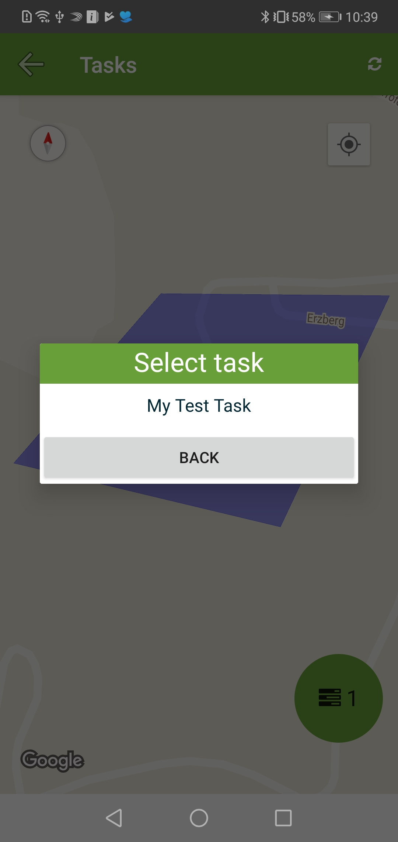
CROWDTASKER MOBILE
Tasks Screen
Similar to the event overview page you will see a list of all open tasks as well as their area on the map. To select a task open the task menu or tap a polygon on the map.

Slide 10
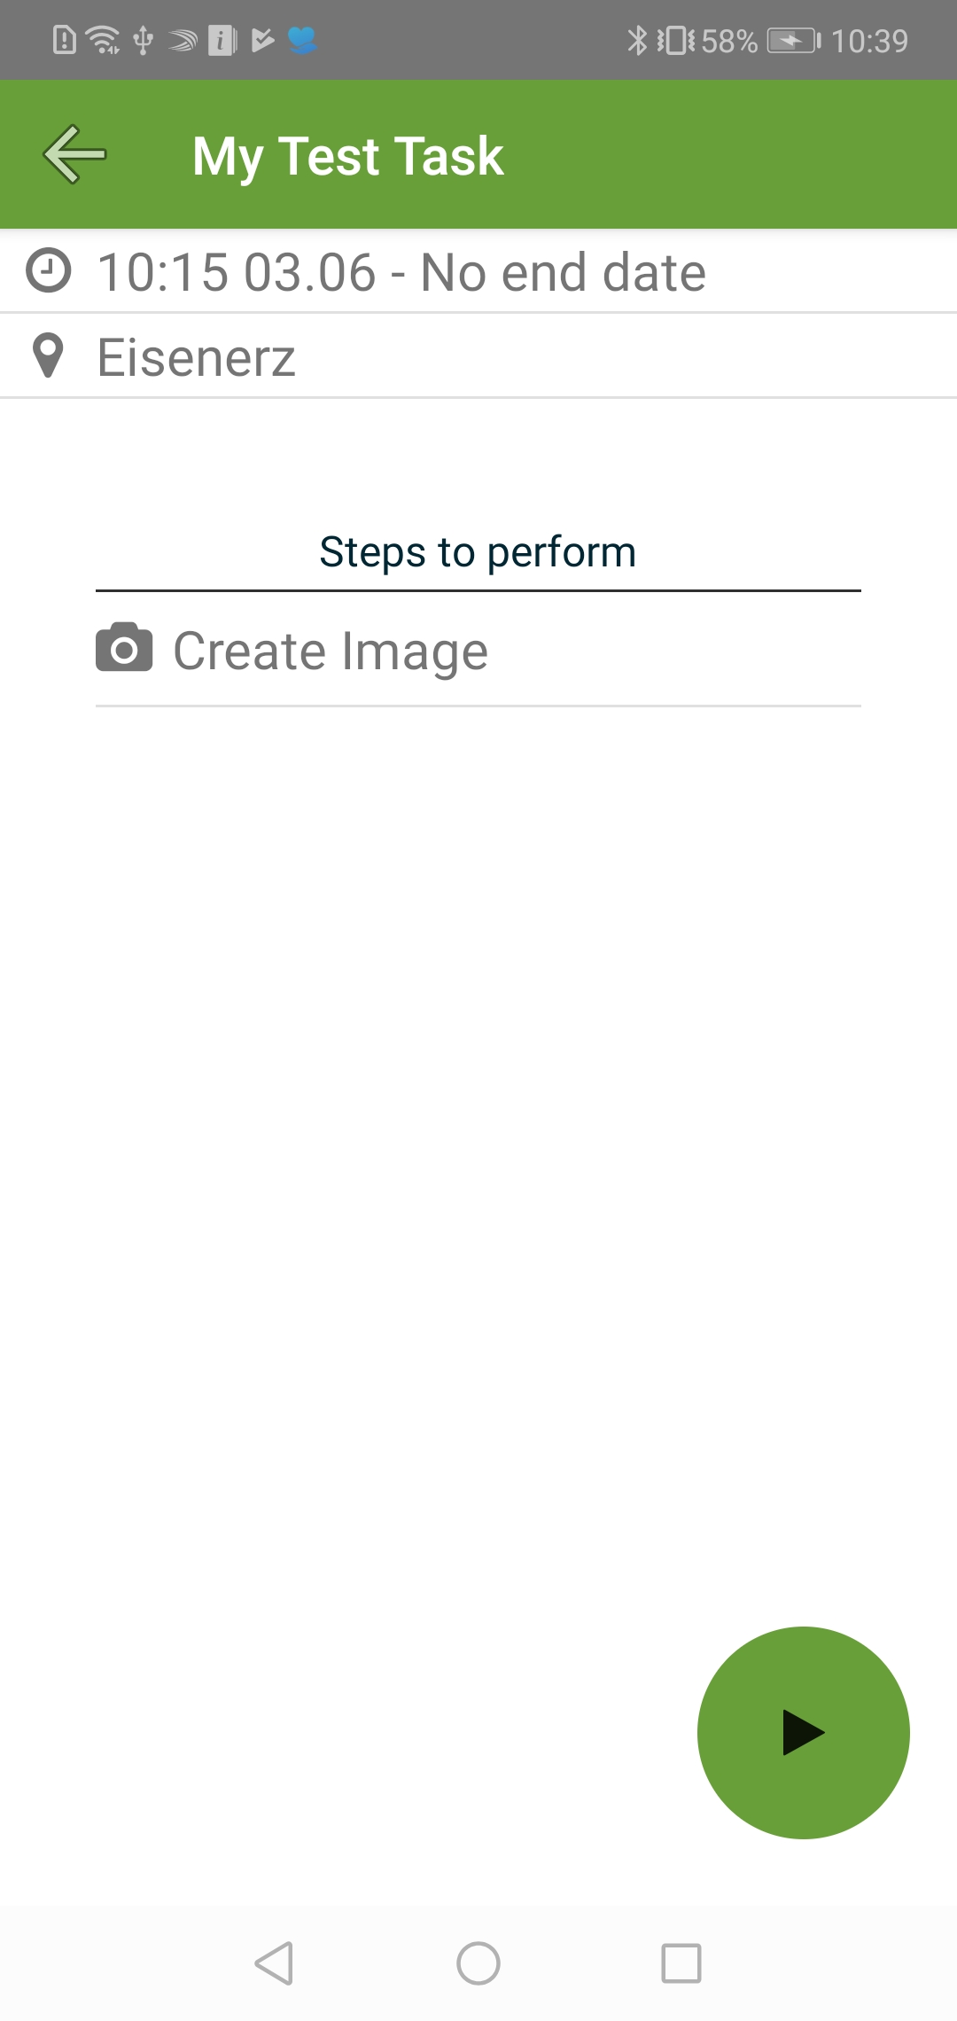
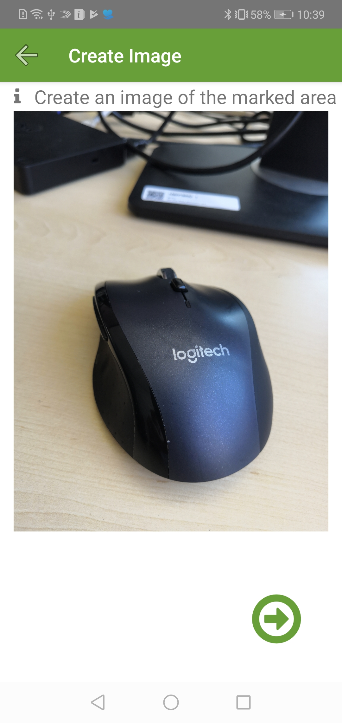
CROWDTASKER MOBILE
TASK DETAILS/Execution
The task details screen shows an overview of the steps that are needed to complete each task. To start a task you need to press the button on the lower right. To complete a task, each step needs to be executed. After executing each step click the send button on the lower right to transmit your task report.

Slide 11
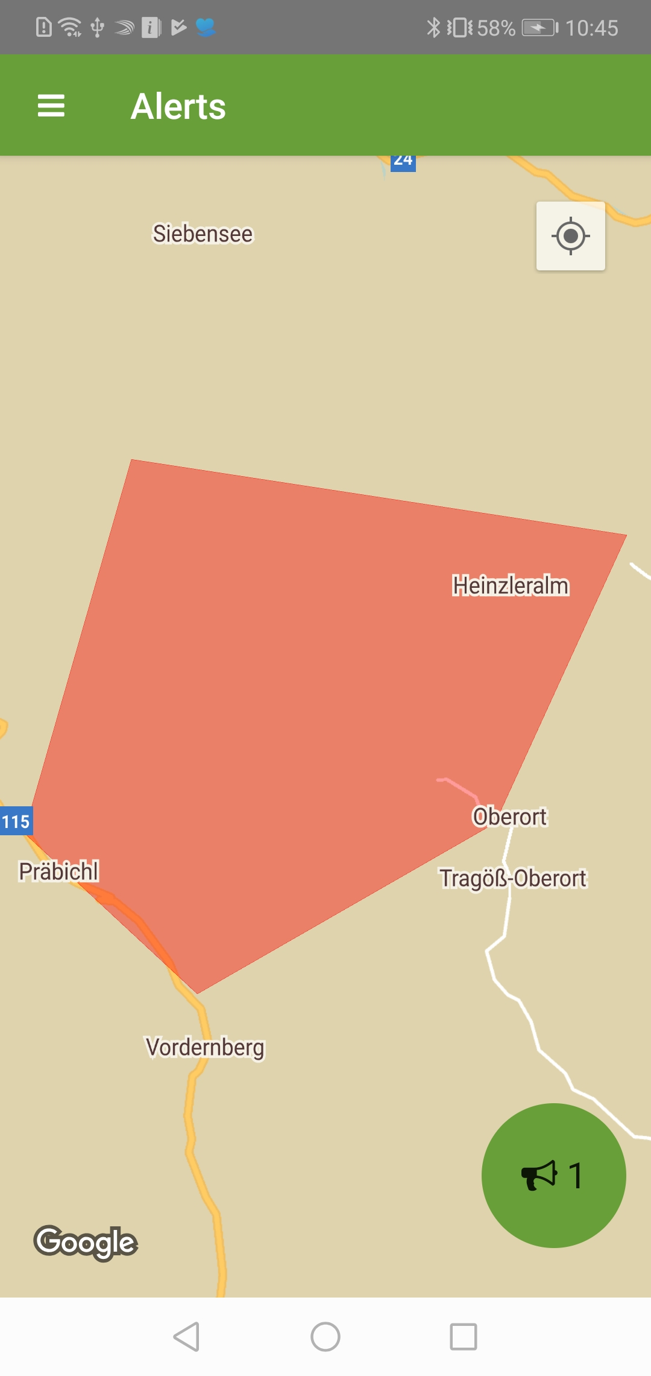
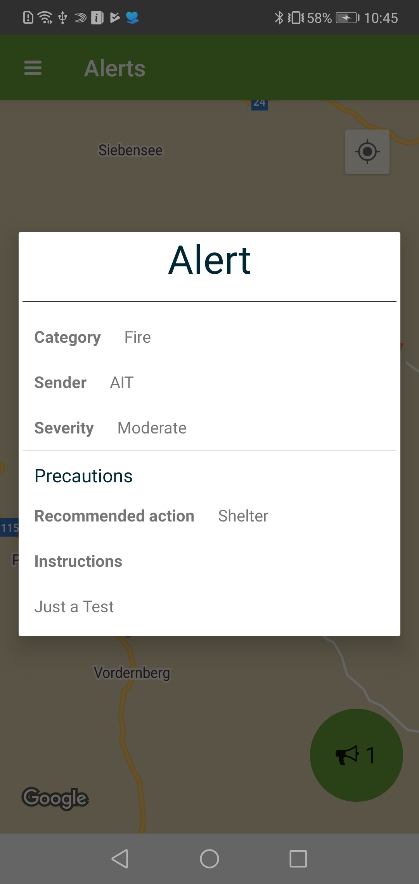
CROWDTASKER MOBILE
ALERTS
To view all active alerts tap the alerts option in the apps main menu. The menu works similar to the event or task overview. When an alert is selected (via menu or tapping), the app will show the details of the alert.

Slide 12
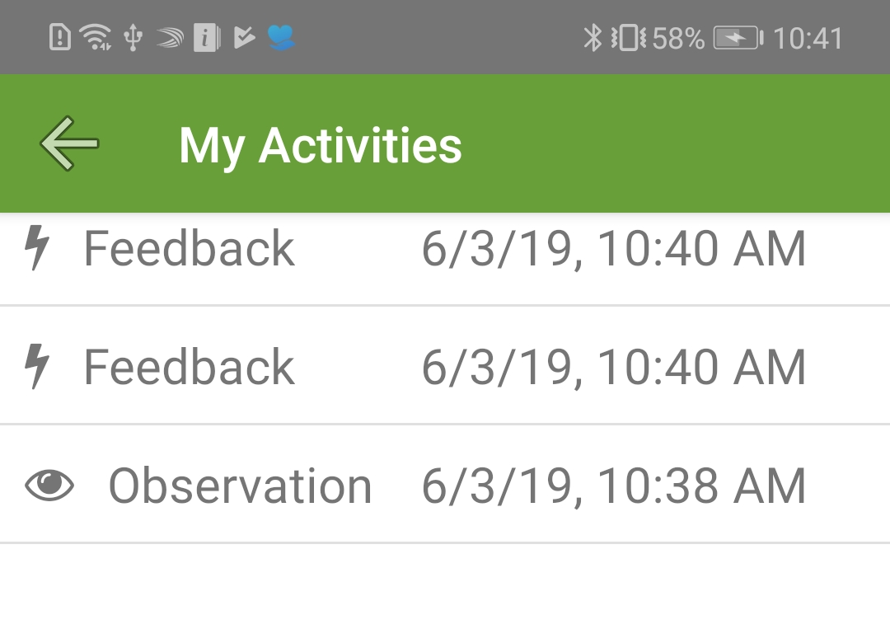
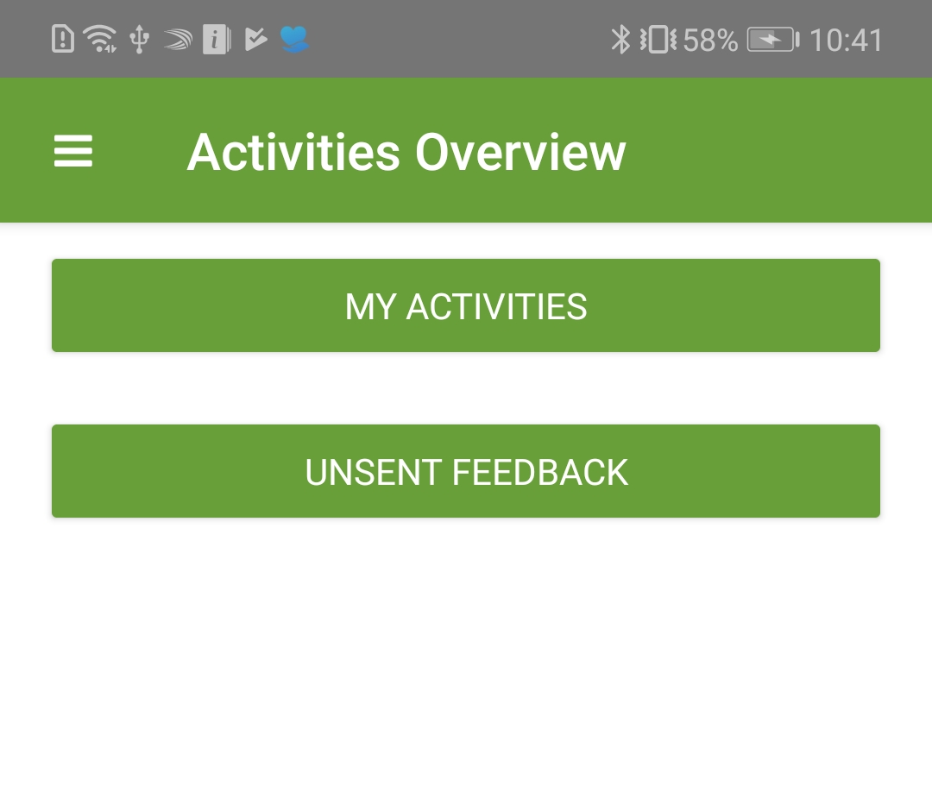
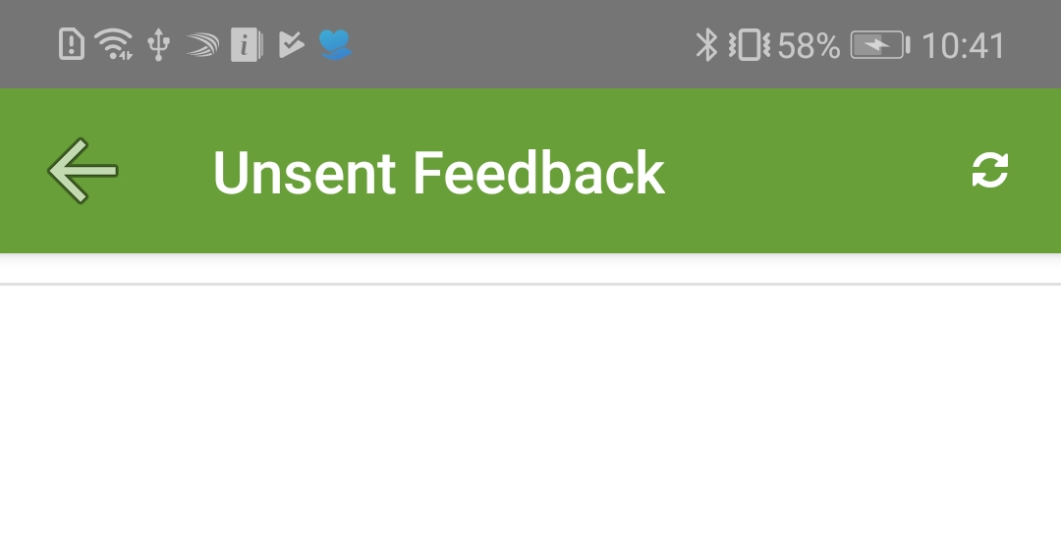
Crowdtasker mobile
Activities
The „activities“ option allows you to view which of your feedbacks have already been sent to the CrowdTasker operator and which are still waiting to be sent (due to bad connection or server unavailability). „My activities“ shows completed activities, unsent feedback shows which feedback is still waiting to be sent.

Slide 13
Crowdtasker Mobile
Notifications
Whenever a event, task or alert is created updated or closed, you will receive a notification on your phone. To go to the updated entity you can simply touch the notification. The app will automagically open and show the respective screen(Event detail, Task detail, or alert detail)

