Slide 1
Crowdtasker
Hands-On Training: Prelude
Sebastian Sippl (Technical Expert) & Daniel Auferbauer (Scientific Advisor)
Eisenerz, Austria, 2019

Slide 2
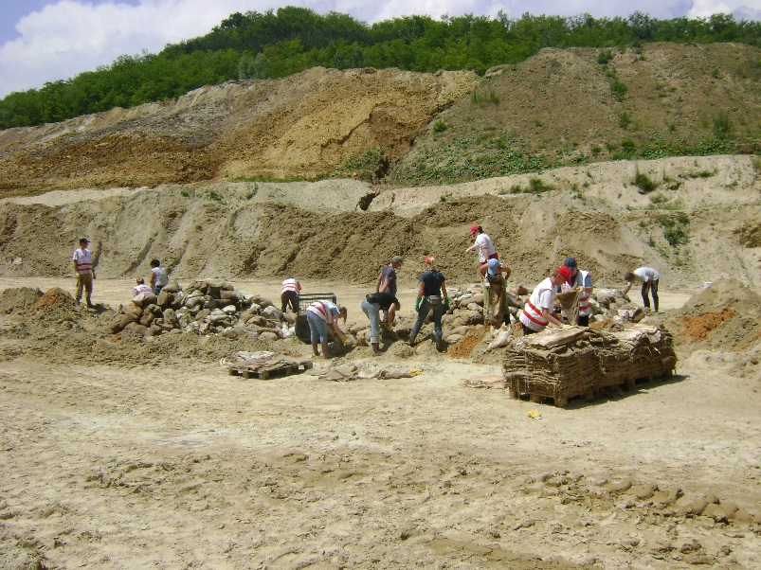
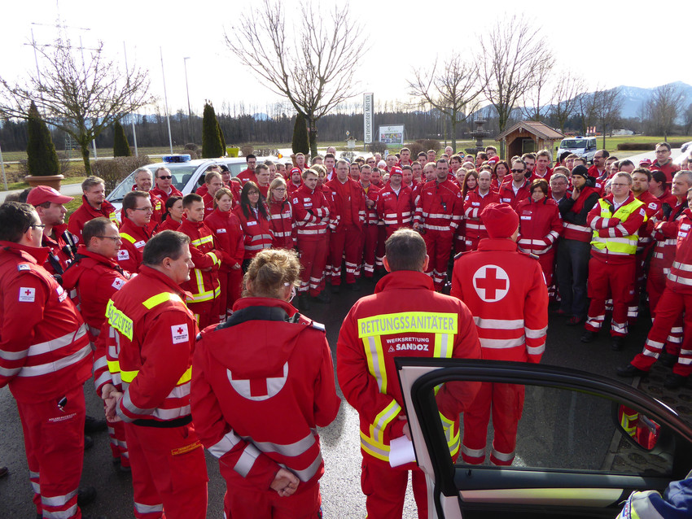
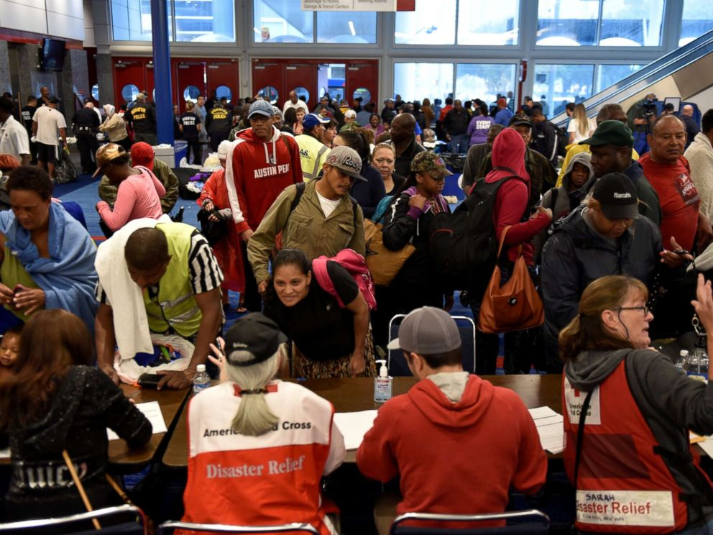
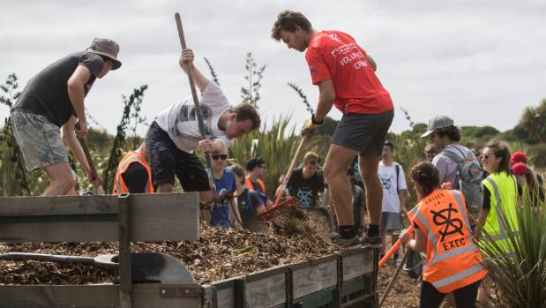
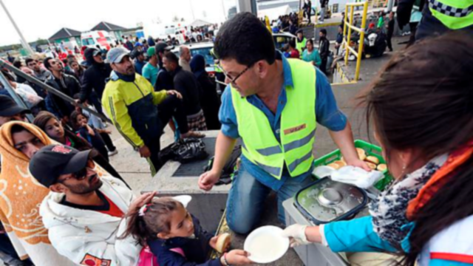
Crowdtasker
Motivation
Photo: Lisa Kühhaas, Austrian Red Cross
Photo: Austrian Red Cross, Bezirksstelle Schwaz
Photo: Long Island Volunteer Center
Photo: George Heard, 2017
Photo: Austrian Red Cross, Bezirksstelle Schwaz
Photo: APA / NÖN, 2015

Slide 3
Crowdtasker
How CrowdTasker May Support you, the crisis manager – Part 1

Slide 4
Crowdtasker
How CrowdTasker May Support you, the crisis manager – Part 2

Slide 5
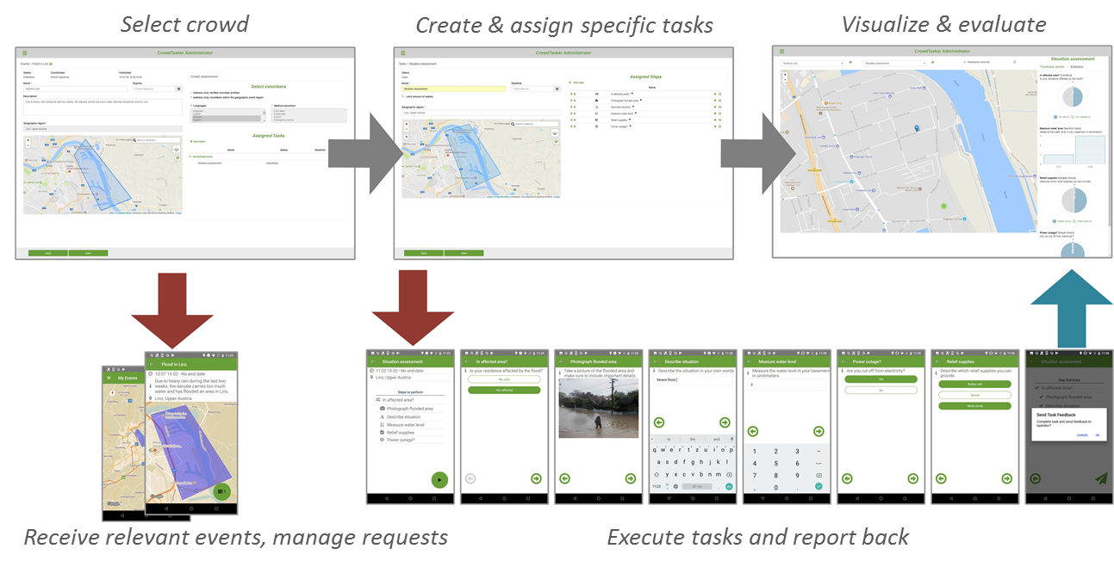
Crowdtasker
Structure and Workflow

Slide 6
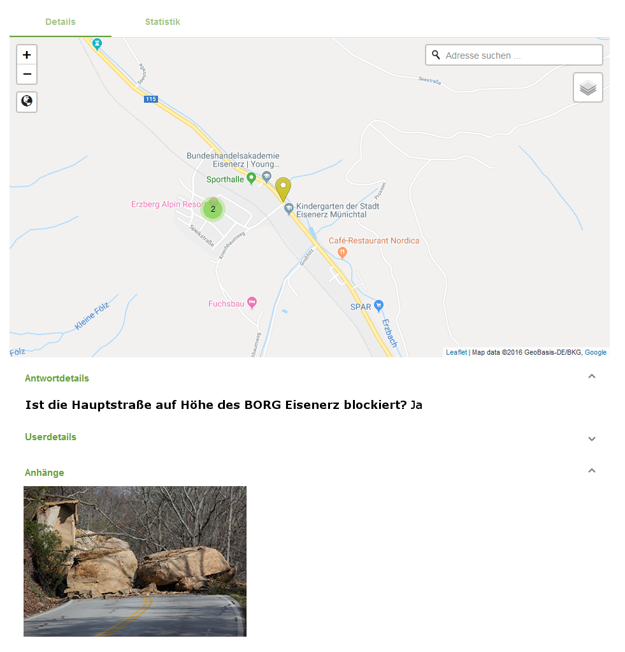
Crowdtasker
Examples and Use Cases – Part 1
Is the main street blocked around BORG Eisenerz?
If yes, send a picture of the blockage.

Slide 7
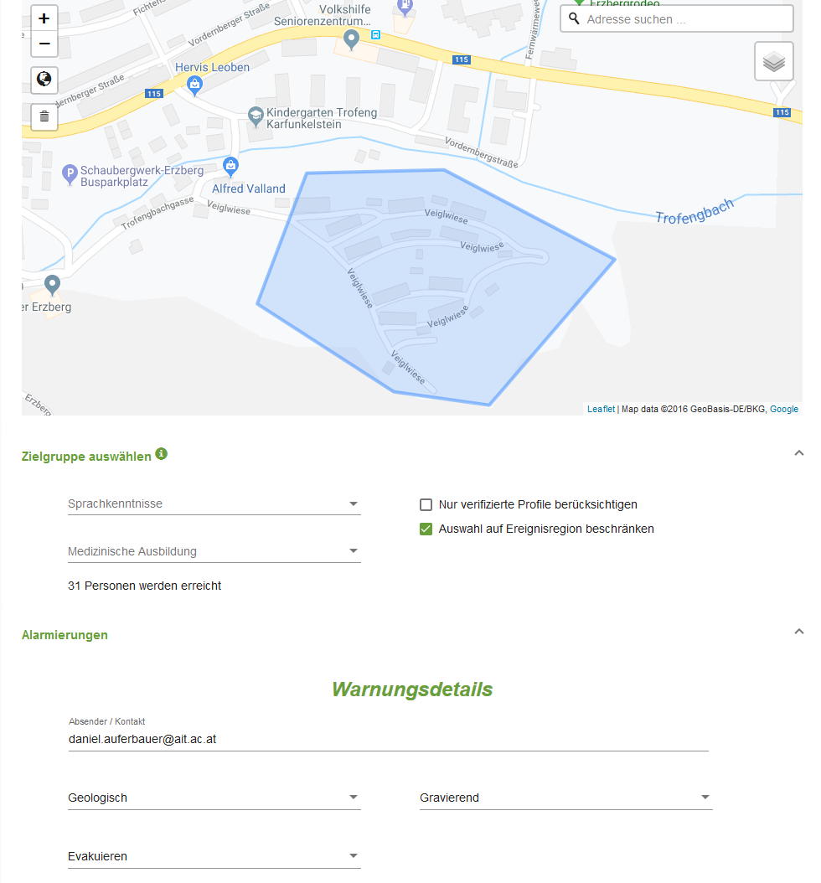
Crowdtasker
Examples and Use Cases – Part 2
Danger of landslide around Veiglwiese, leave area immediately. Move towards main street, gather at Seniorenzentrum Eisenerz.

Slide 8
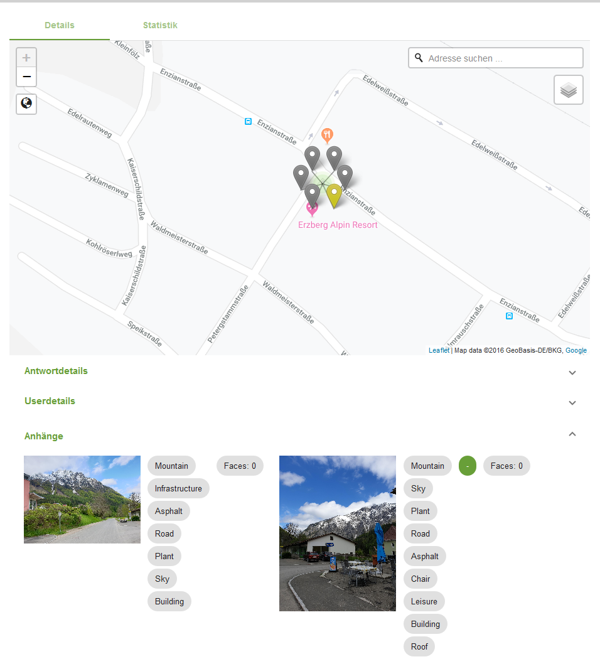
Crowdtasker
Examples and Use Cases – Part 3
Local population submits reports about streets they have cleared themselves or worsening weather.

Slide 9
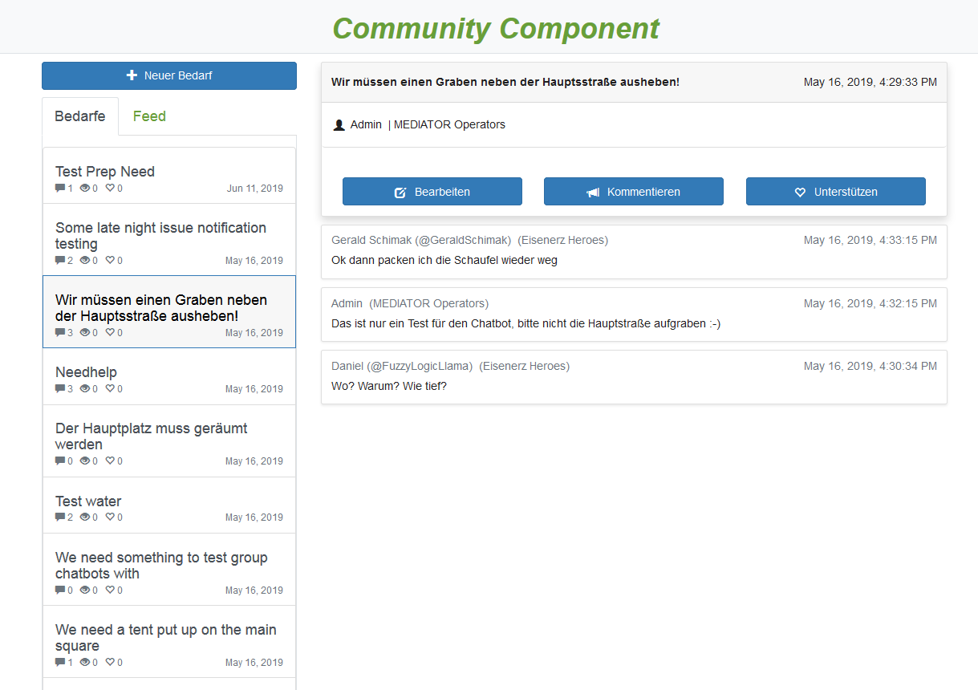
Crowdtasker
Examples and Use Cases – Part 4
Have a direct channel to self-organized efforts of the local population that are targeting larger issues, such as clearing the main square or roads.

Slide 11
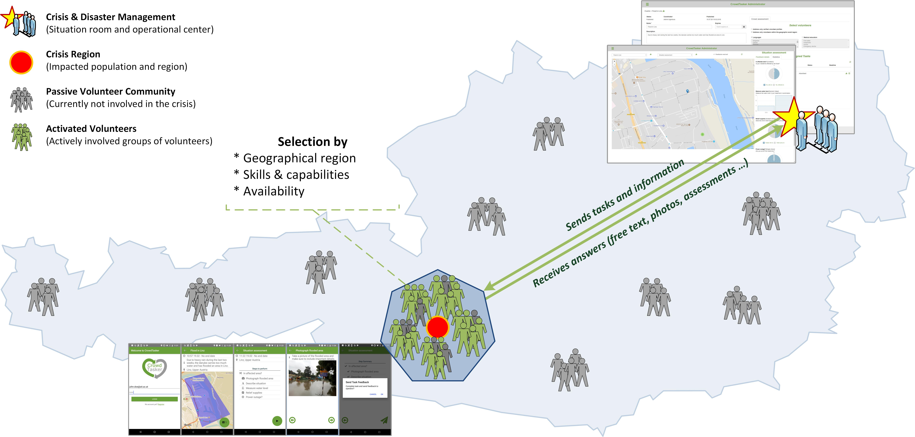
Crowdtasker
Use and Function

