Slide 1
Crowdtasker
Solution overview
Sebastian Sippl (Technical Expert) & Daniel Auferbauer (Scientific Advisor)
Eisenerz, Austria, 2019

Slide 2
=
+
+
Chatbot
(Telegram)
APP
(Android + IOS)
Operator Backend
(Web based)
CrowdTasker is a web based multi-platform and multi-media solution for volunteer-management during crisis-situations

Slide 3
Crowdtasker
Big picture

Slide 4
Crowdtasker
features
Instruct large numbers of volunteers with:
Customizable tasks
Contextual information
Warnings and alerts
Receive, visualize and evaluate feedback to:
Get a detailed overview of the situation
Trigger adequate disaster relief services.

Slide 5
Crowdtasker
Advantages
When working with the volunteers that are already at a disaster site, CrowdTasker helps the crisis manager to:
reduce the time and effort needed to exchange information with on site volunteers
differentiate between volunteers based on their profiles (e.g. skills, health) and positions
address the people that potentially possess local knowledge
alleviate the workload for emergency and response organizations

Slide 6
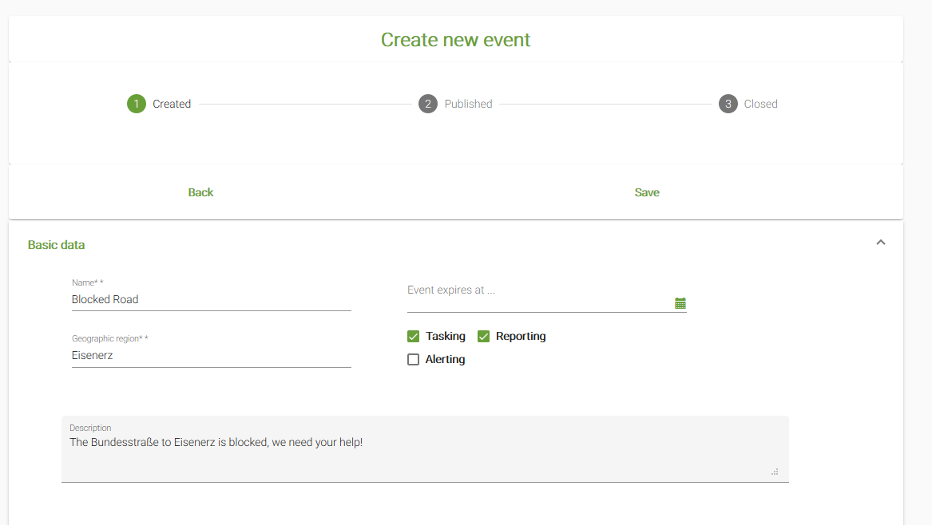
Workflow
Workflow – Create EVENT

Slide 7
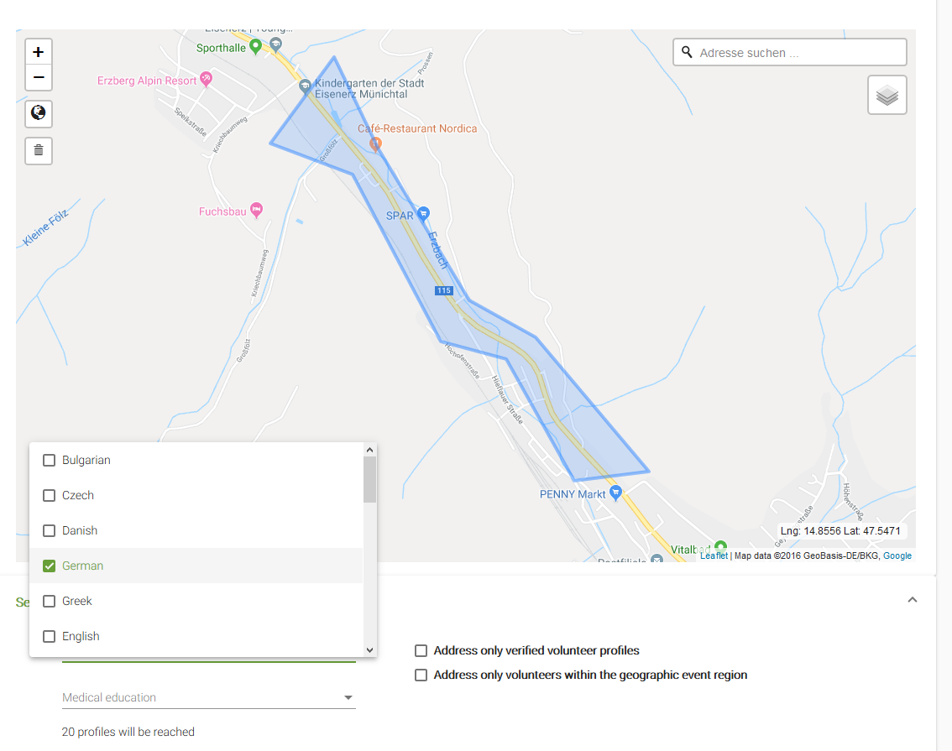
Crowdtasker
WORkflow – create event

Slide 8
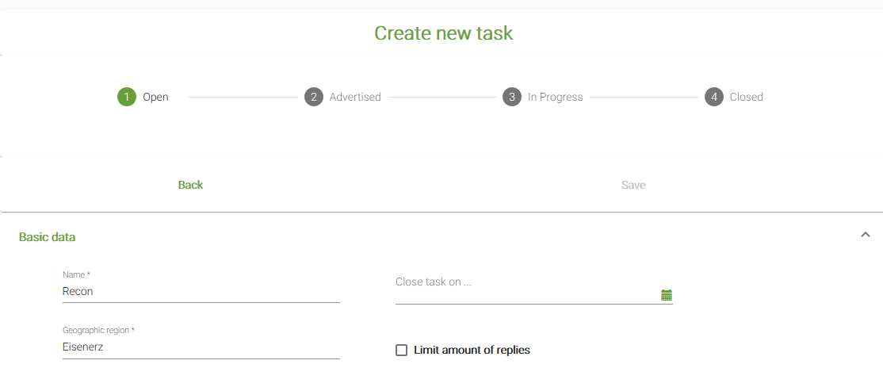
crowdtasker
Workflow - Create and Assign tasks

Slide 9
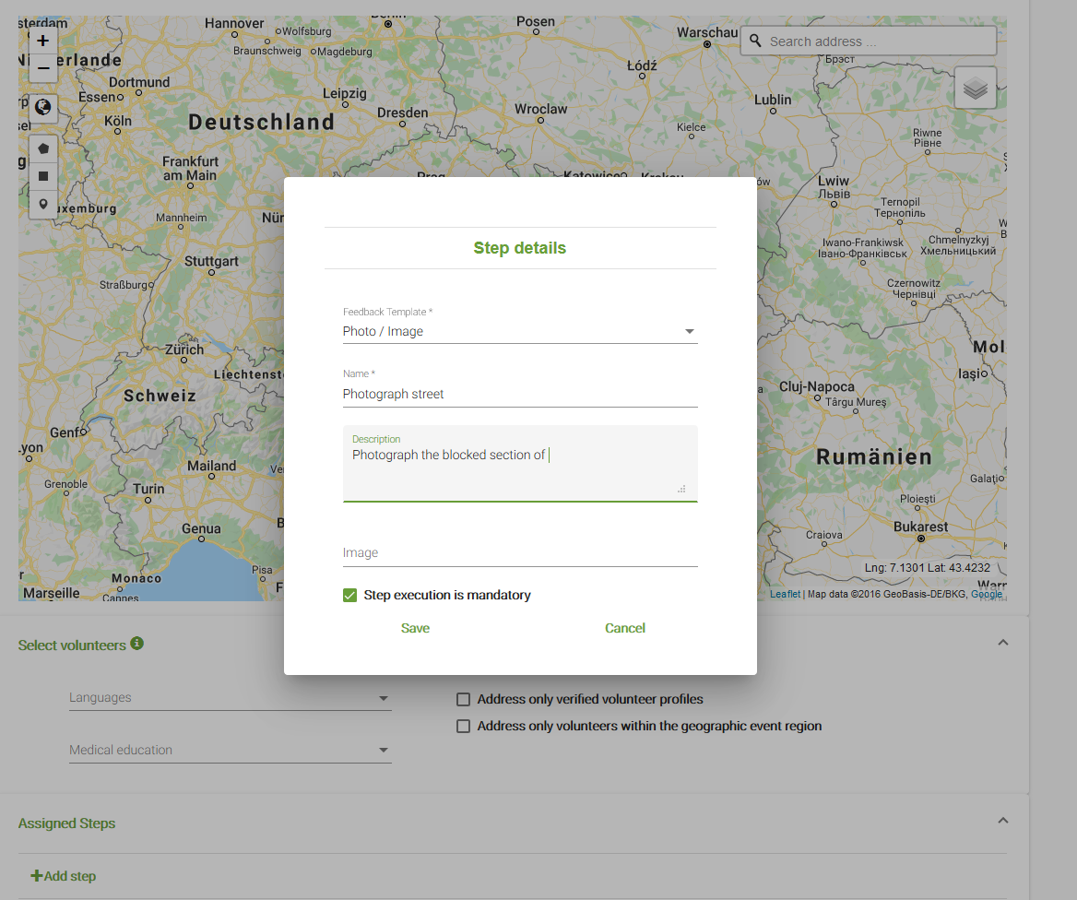
crowdtasker
Workflow - Create and Assign tasks

Slide 10
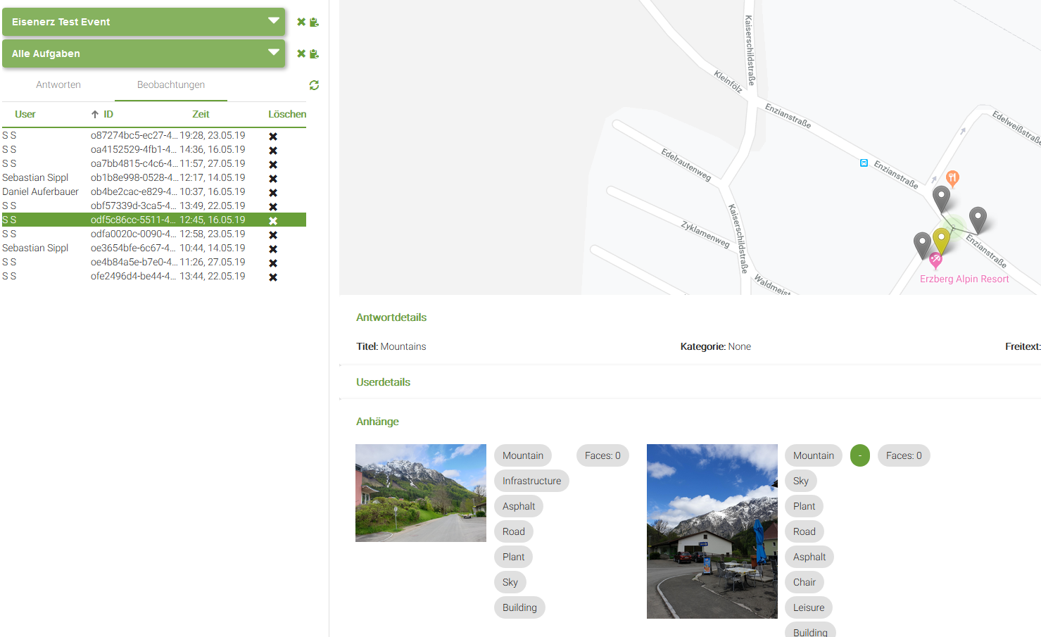
Crowdtasker
Workflow – Analyze Results

