Slide 1
Airborne and Terrestrial Situational Awareness
Trial – Austria: Solution Training Presentation
DLR
DLR
September 2019, Eisenerz, AUSTRIA

Slide 2
Part 1
AIRBORNE AND TERRESTRIAL SITUATIONAL AWARENESS
DLR
General information
references
Notes:
5 Minuten

Slide 3
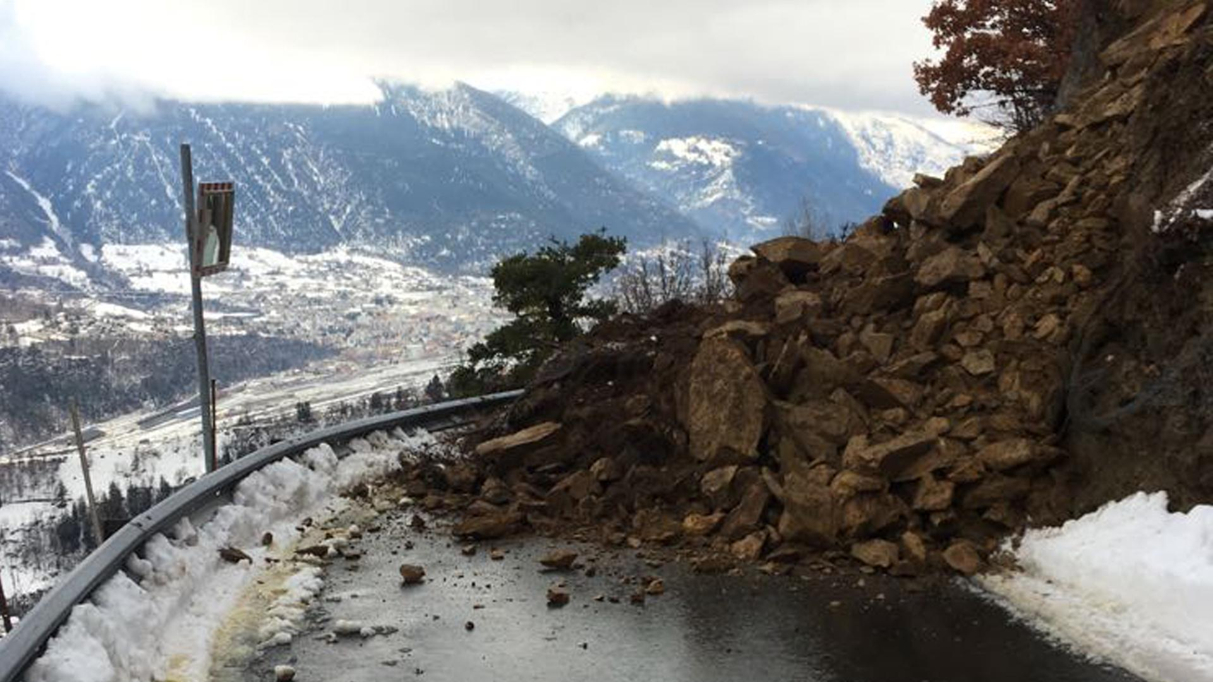
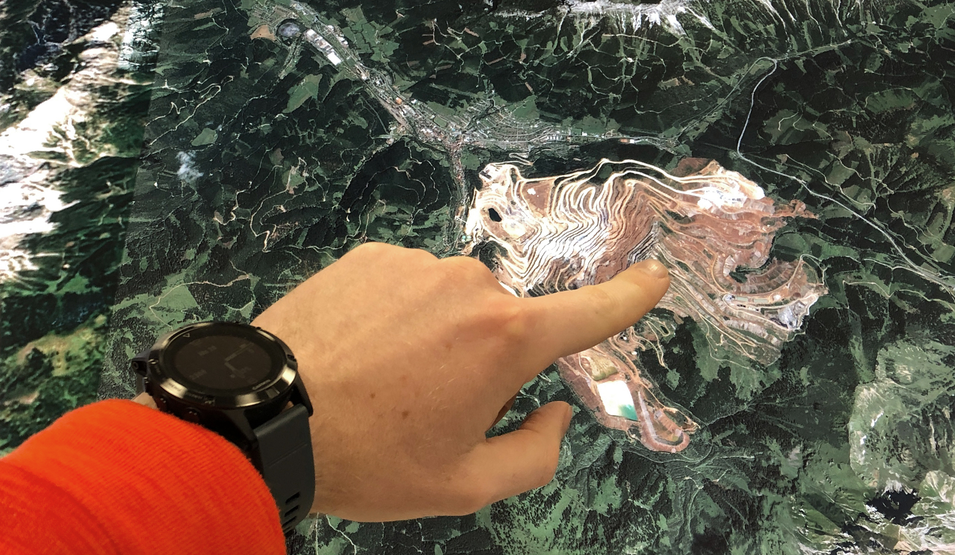
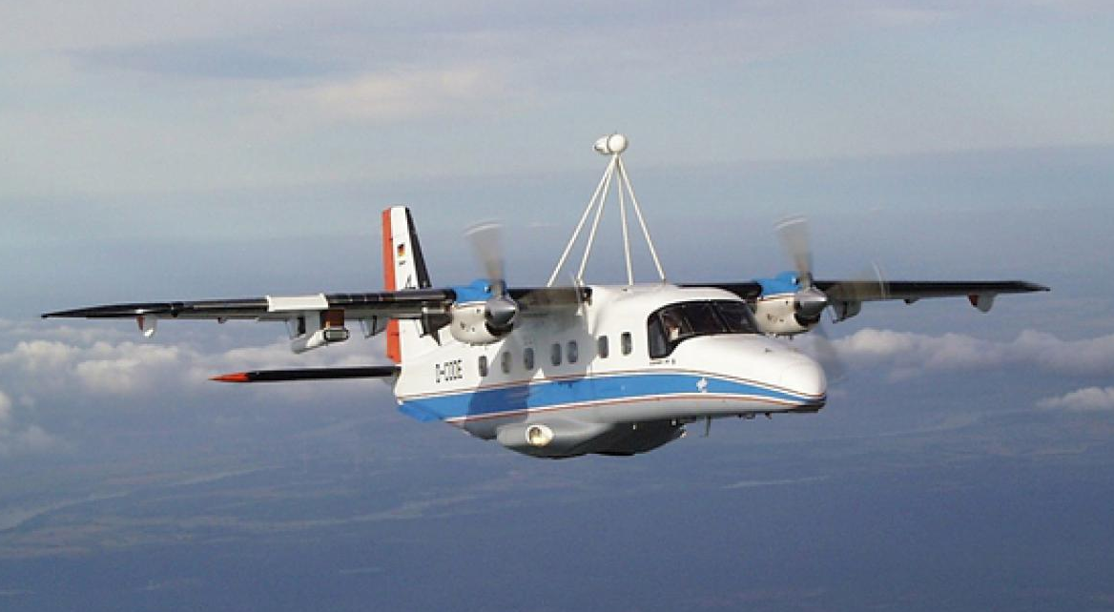
Airborne and Terrestrial Situational Awareness
DLR

Slide 4
Airborne and Terrestrial Situational Awareness
DLR
Main features
Up-to-date aerial imagery to support decision-makers to get a better picture of the situation
Aerial photos from the aircraft sent to the ground by data link, where they are made immediately available to the emergency services in standardized data format.
Solution can provide 3D reference maps, usable for strategic planning, resource allocation and detection of landslides.
Flexible deployment of the solution
React individually to the wishes of the operational command, prioritize certain areas or fly repeatedly.
Full-size drone demonstrator Dornier Do-228 reaches remote and inaccessible areas not hindered by strong winds, rain or long flying distance.
Notes:
Feature #1 [Should clearly show how the solution (A) contributes to crisis management, (B) who is its direct beneficiary and (C) which particular issue solution is addressing];

Slide 5
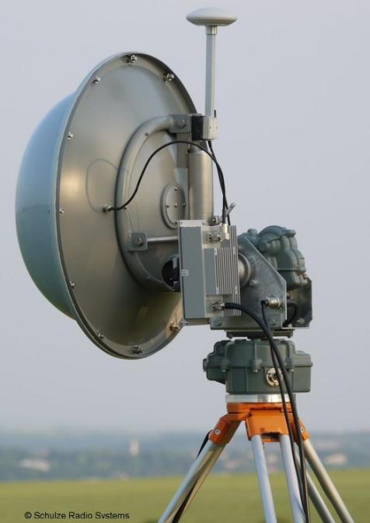
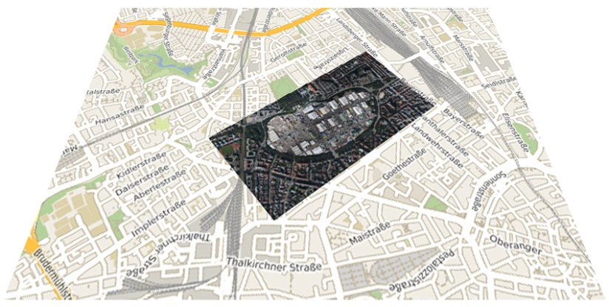
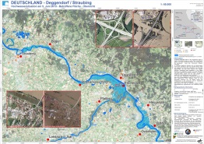
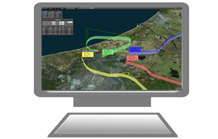
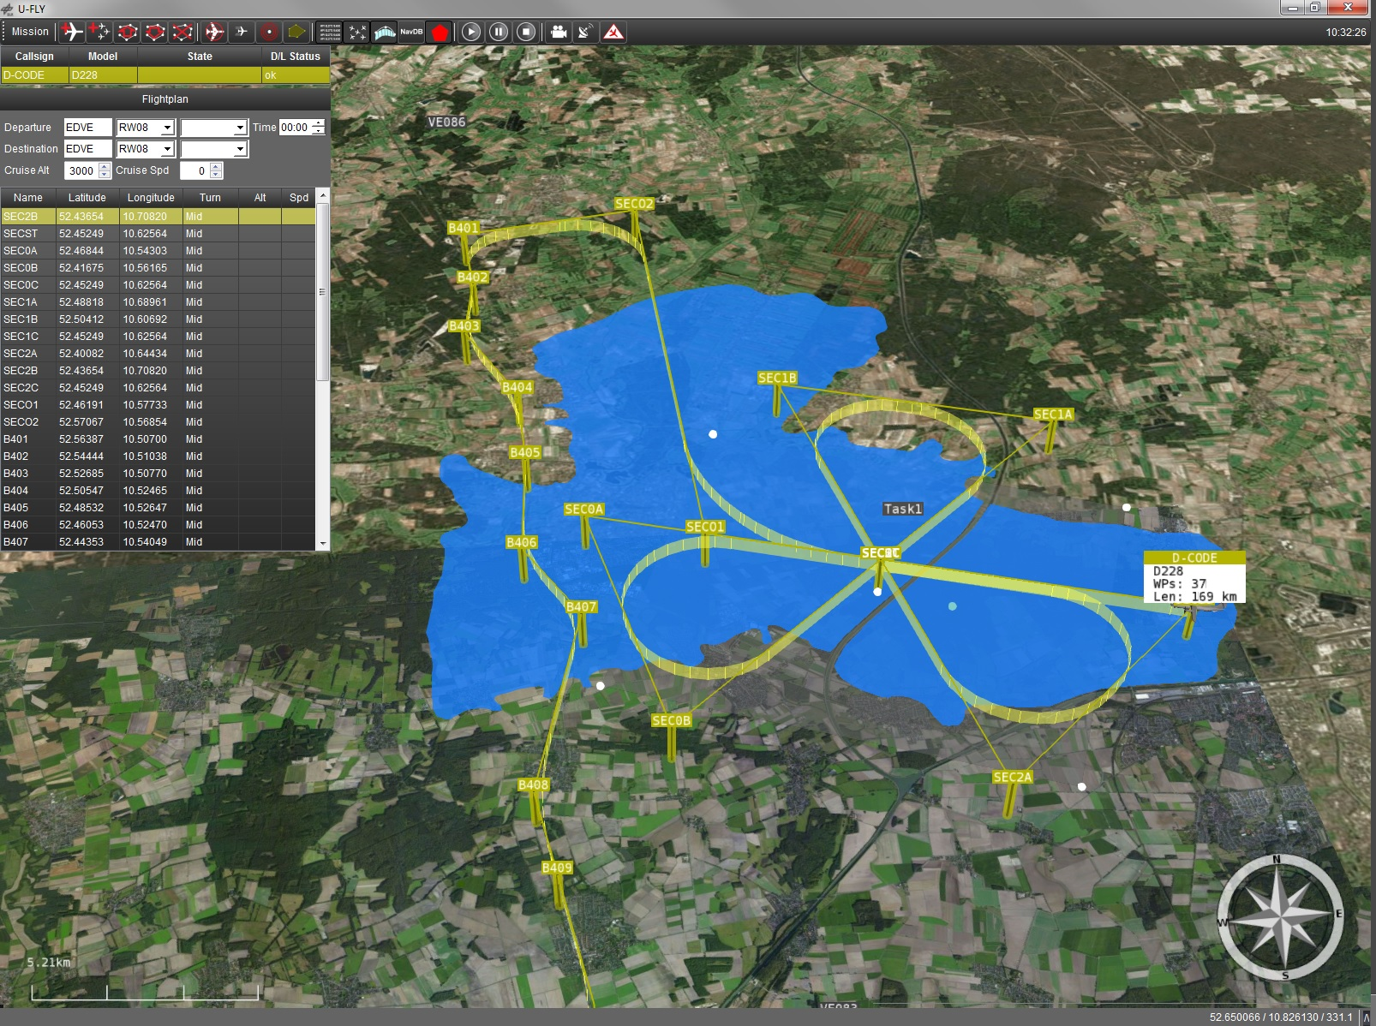
Airborne and Terrestrial Situational Awareness
DLR
Module "Aircraft"
Module "Camera System"
Module "Reference Map"
Command & Control
Camera System
C³ Data Link
Image Data Link
New Imagery
Reference Products
Ground Control Station U-Fly
Ground Station &
Processing Unit
Notes:
Tool for flight planning and operation
Tool for accessing eo based information layers and products
Tool for assessing traffic situation and exploiting

Slide 6
Part 2
Airborne and Terrestrial Situational Awareness
DLR
Trial “AUSTRIA“ oriented user story
Notes:
5 Minuten

Slide 7
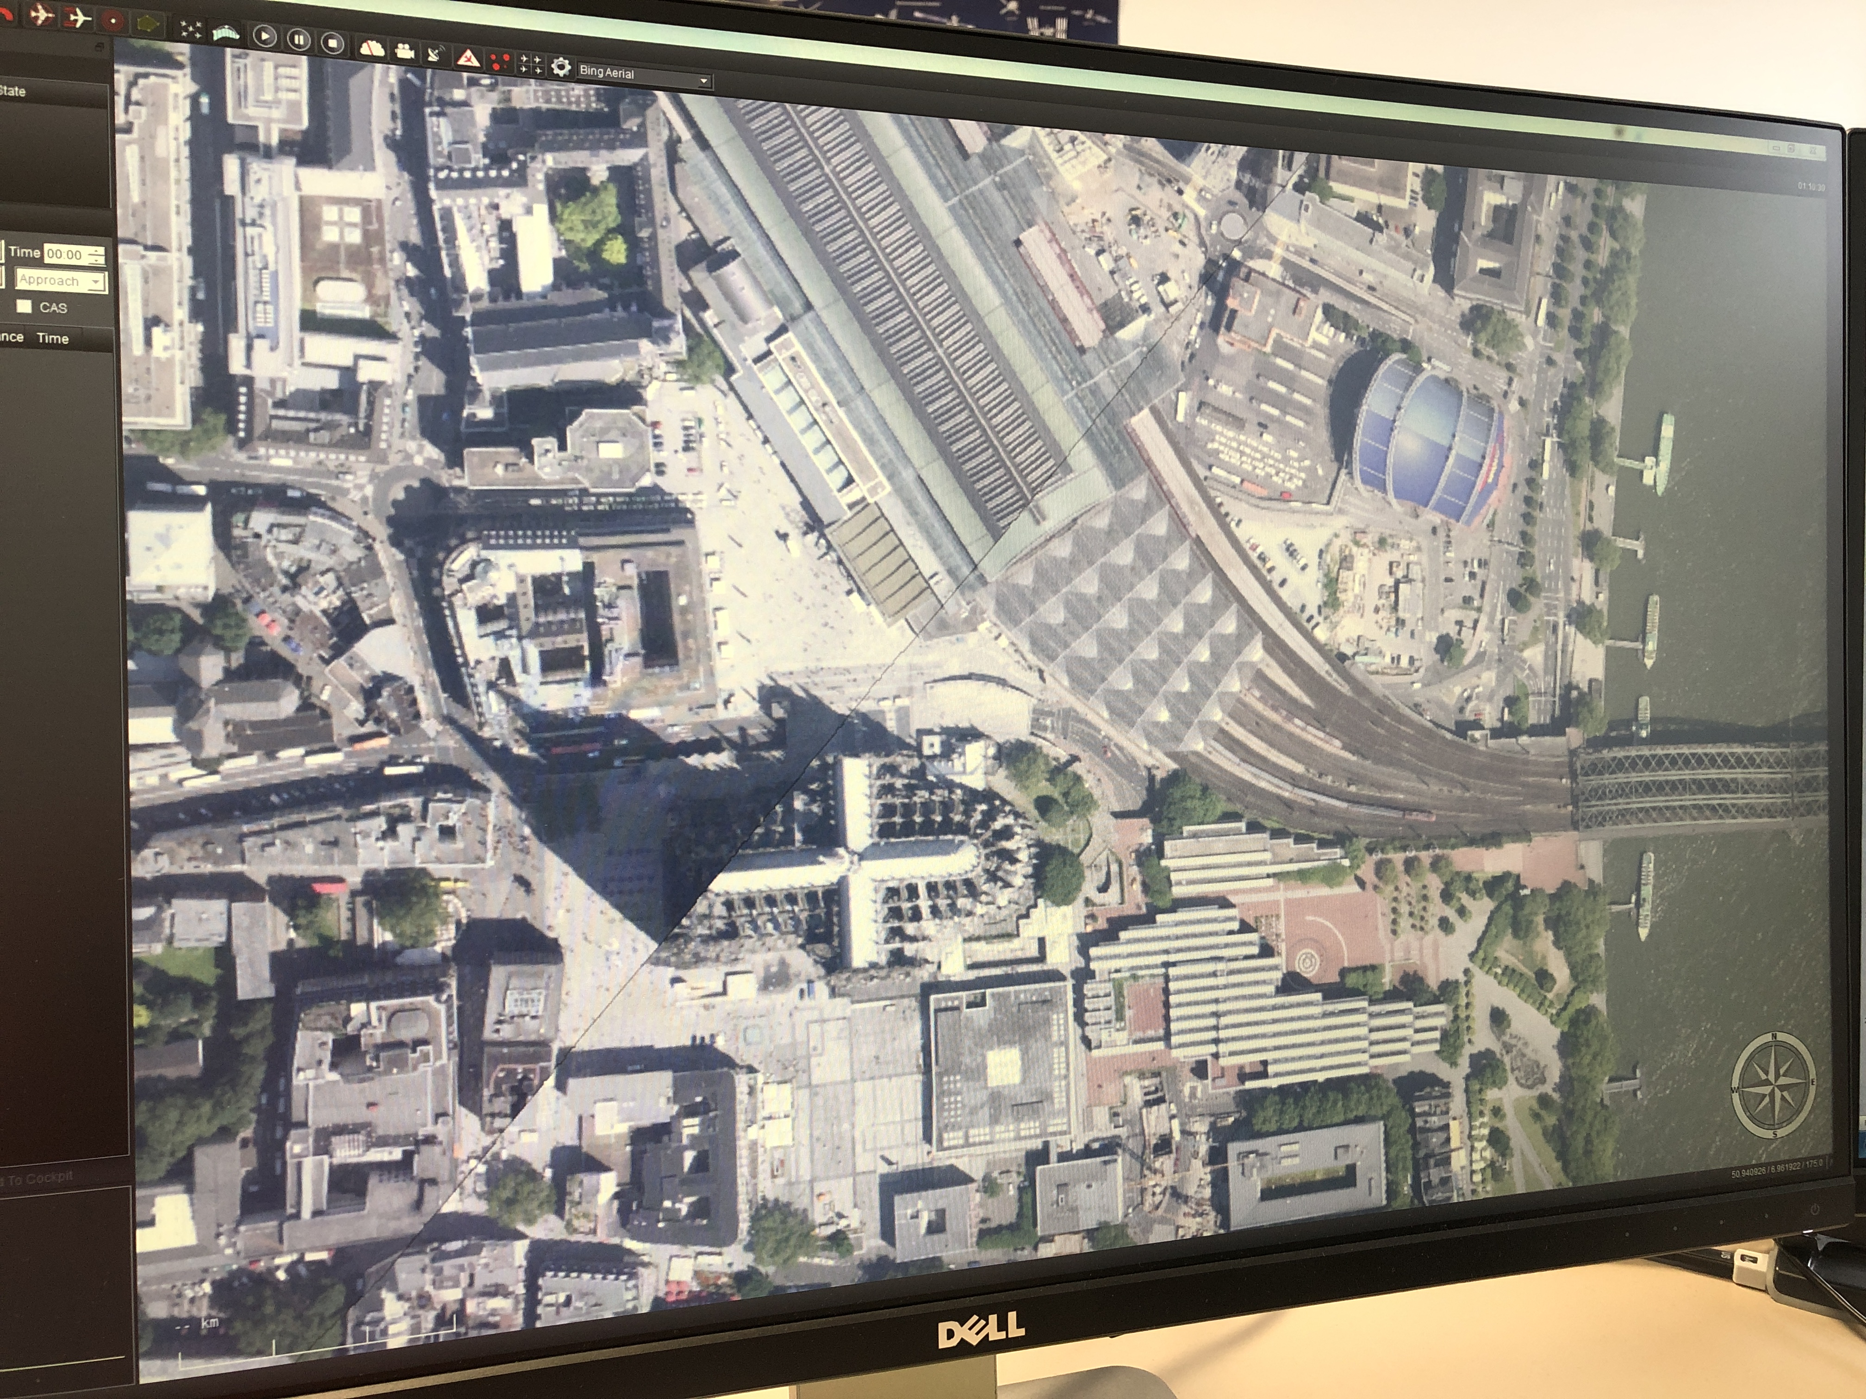
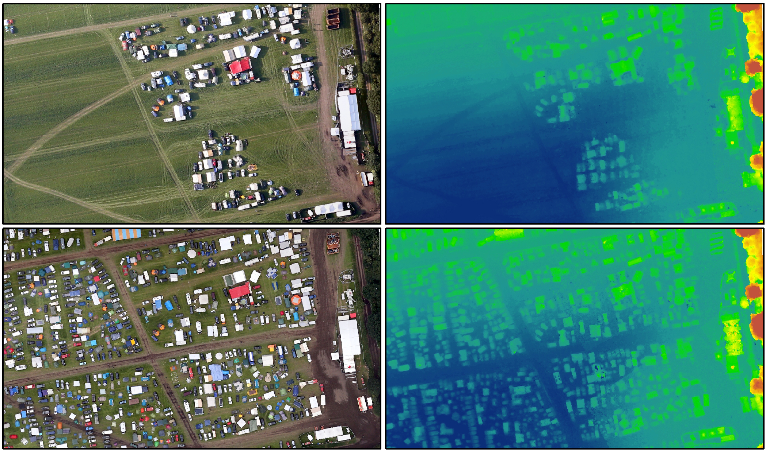
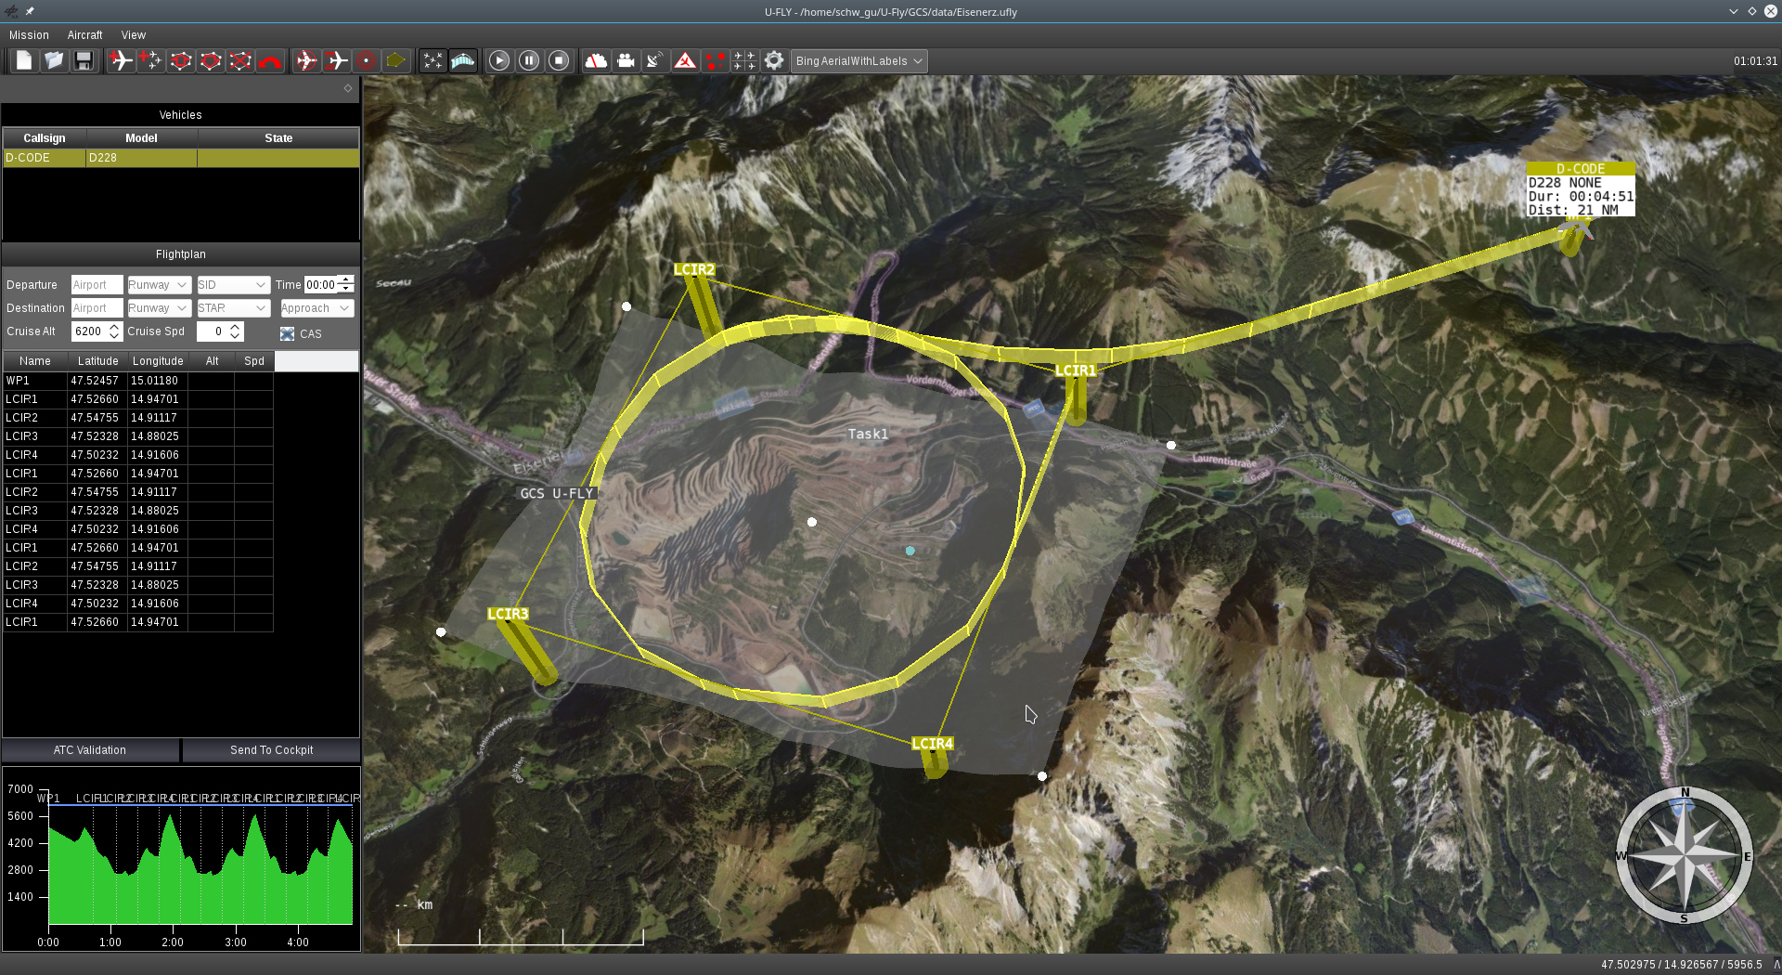
Airborne and Terrestrial Situational Awareness
DLR

Slide 8
Airborne and Terrestrial Situational Awareness
DLR
User Story
Information for situation assessment in near real-time: damage assessment, identification of access routes, planning of rescue forces and equipment and localisation of volunteers without endangering personnel.
Information for situation monitoring in near real-time: identification of changes, monitoring of relief actions.
Tailor-made data acquisition according to the requirements of the responsible parties.
Provision of aerial imagery (GeoTIFF) and reference map products (JPG, GeoPDF).

Slide 9
Part 3
Airborne and Terrestrial Situational Awareness
DLR
Solution demonstration
Notes:
20 Minuten

Slide 10
Airborne and Terrestrial Situational Awareness
DLR
Module “Aircraft”
Live demonstration

Slide 11
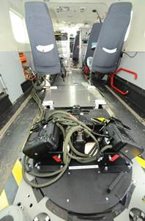
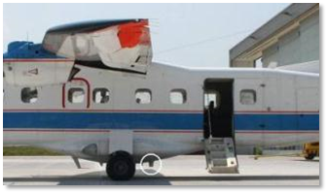
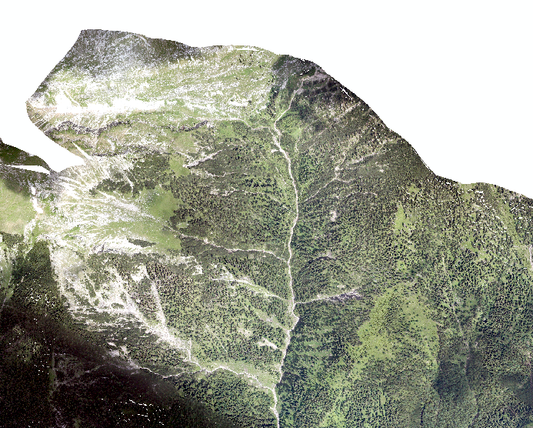
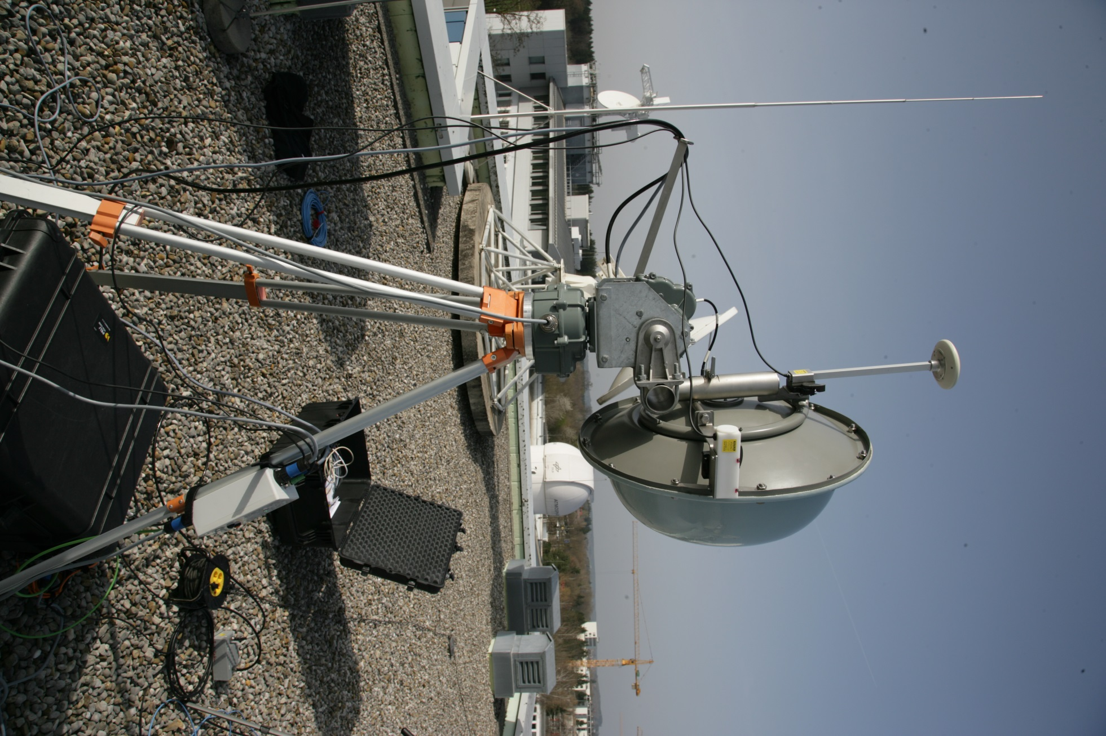
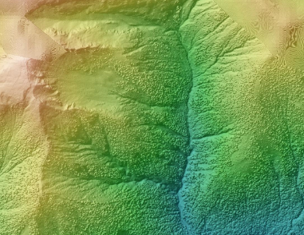
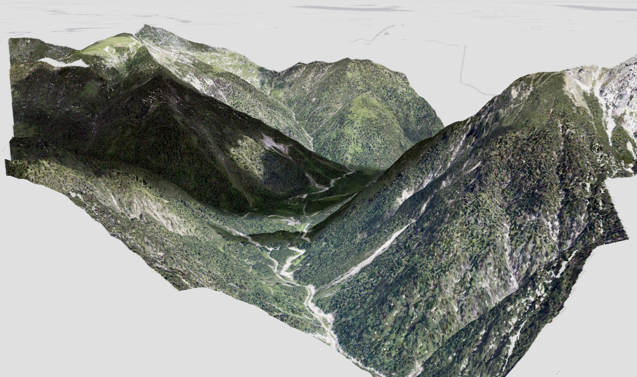
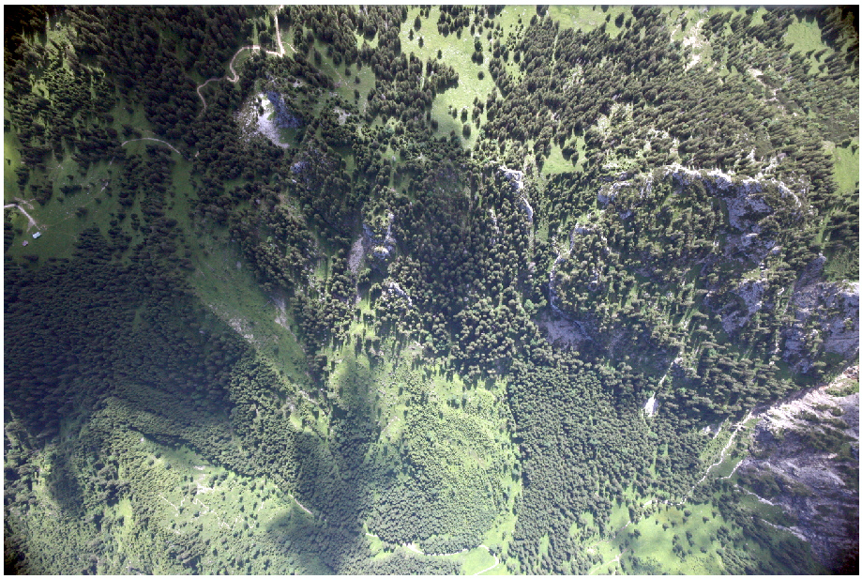
Airborne and Terrestrial Situational Awareness
DLR
Module "Camera System”
Data Transmission
Data Reception
&
Ground Station
Camera System

Slide 12
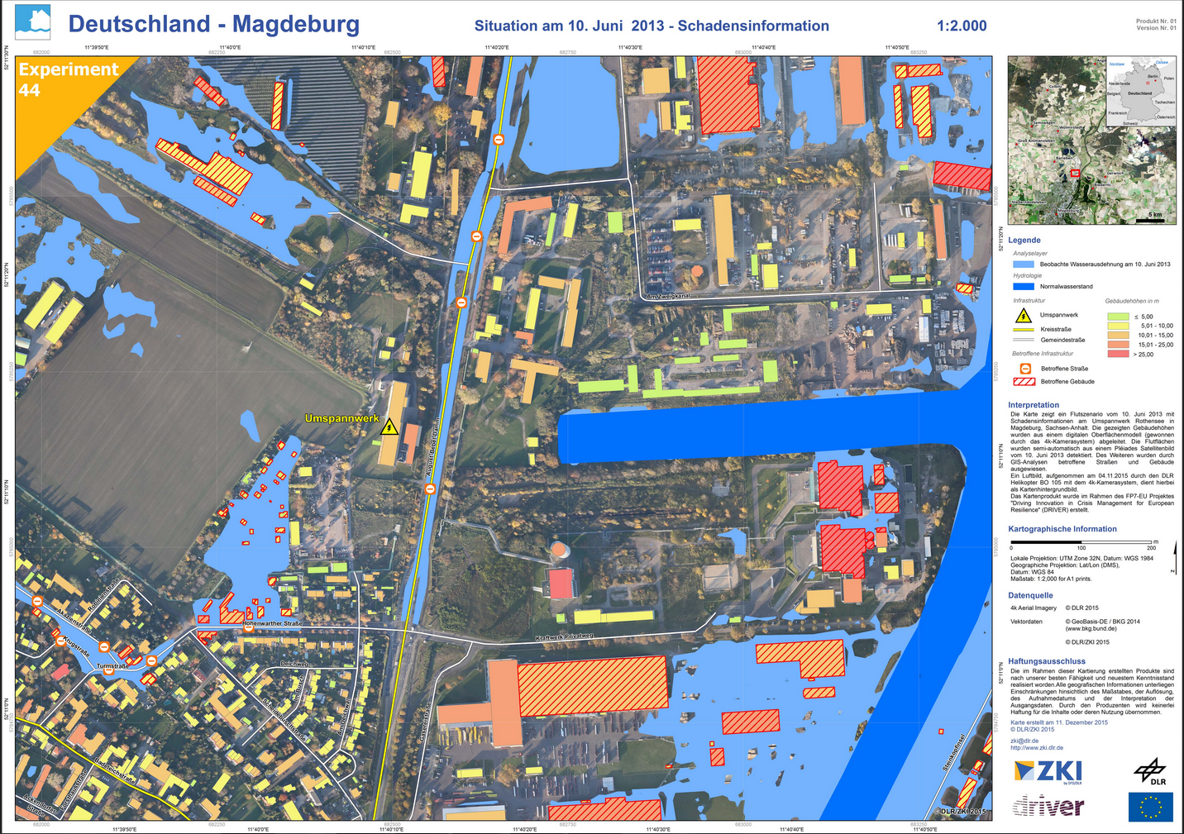
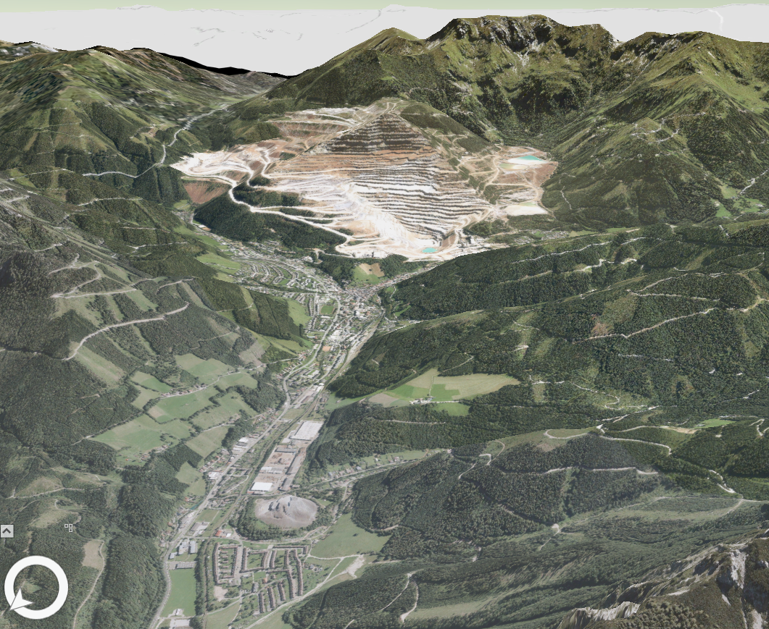
Airborne and Terrestrial Situational Awareness
DLR
Module “Reference Maps”
Reference Maps
3D PDF
Explore 3D View
Measure
Comment

