Slide 1
MDA Command & control
Practical training
Chaim Rafalowski, MDA
23rd of October 2018

Slide 2
About us – mda’s roles and activities
National blood service
National EMS (Emergency Medical Service)
RCRC National Society
AUXILIARY TO THE IDF AND CIVIL DEFENSE DURING CONFLICT AND LARGE SCALE EMERGENCIES
First Aid training

Slide 3
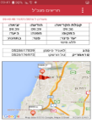
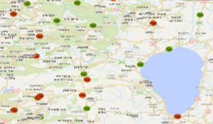
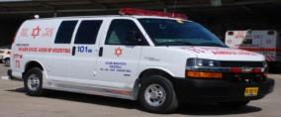
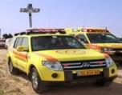
The EMS System overview
Collecting as much information as possible
Automated Resource Identification
Decision support multiple tier resource allocation
Support and supervision

Slide 4
Role of MDA command and control
A command and control system to manage response for emergency incidents
The system is built to cope with the management of thousands of different operational events in real time, while putting an emphasis on the optimal use of the organization's resources.
Managing the vehicle fleet
Locating incident location and dispatching rescue vehicles
Marking the arrival status of rescue vehicles
Receive input from the field (video conference calls, pictures)
Sending relevant information to the hospitals

Slide 5
Main functions
(That are In use in trial 2)
Create a new incident
Dispatch a unit to an incident
Mark time of arrival
Receive input from the incident location
Send data to hospitals
The solution answers the following CM functions (Trial KPIs):
Collect information from deployed sources (5.2.2.1)
Conduct coordinated tasking and resource management (5.2.3)

Slide 6
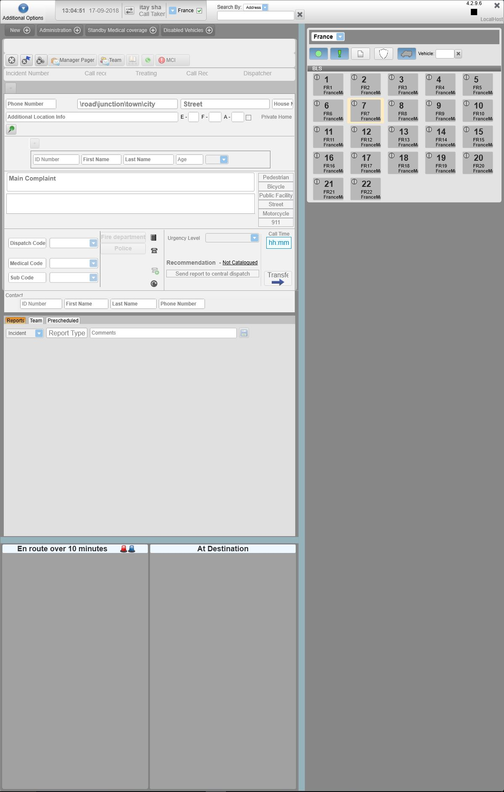
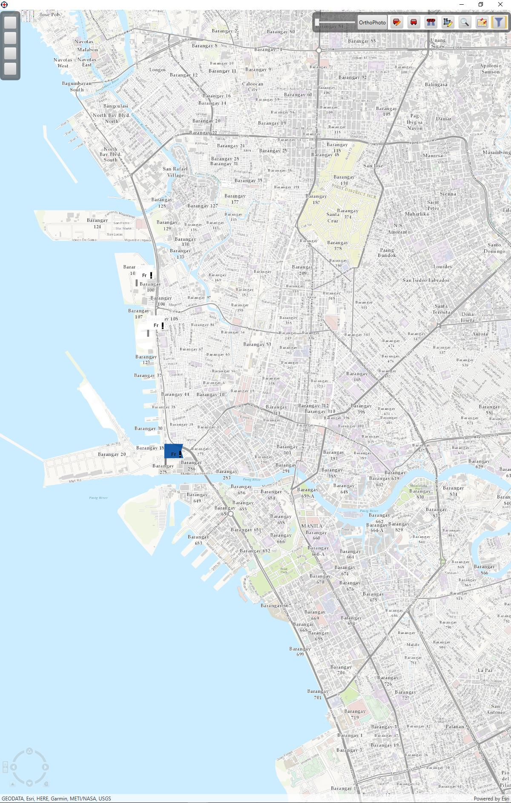
The screens
New incident screen
Map screen
Active incidents screen

Slide 7
How to use the tool?
Create a new incident

Slide 8
How to use the tool?
Dispatch a unit To
an incident
3
Road Accident
3021
injury - severe

Slide 9
How to use the tool?
Mark time of arrival

Slide 10
How to use the tool?
Receive input from incident location

