Slide 1
ZKI
Introduction
Elisa Schröter, Ralph Kiefl
10.04.2019 – The Hague

Slide 2
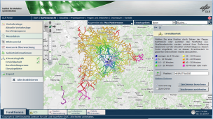
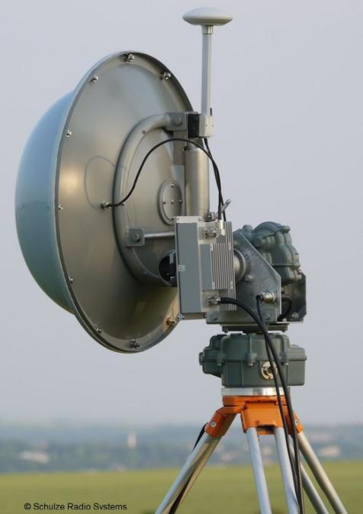
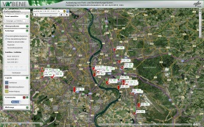
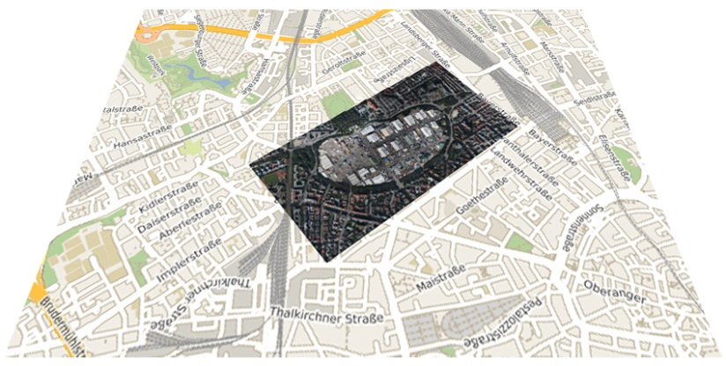
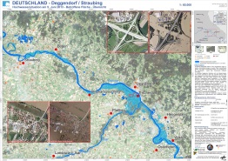
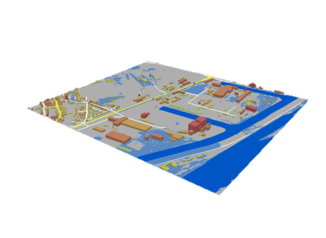
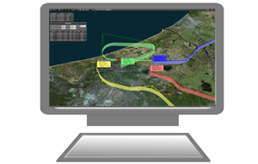
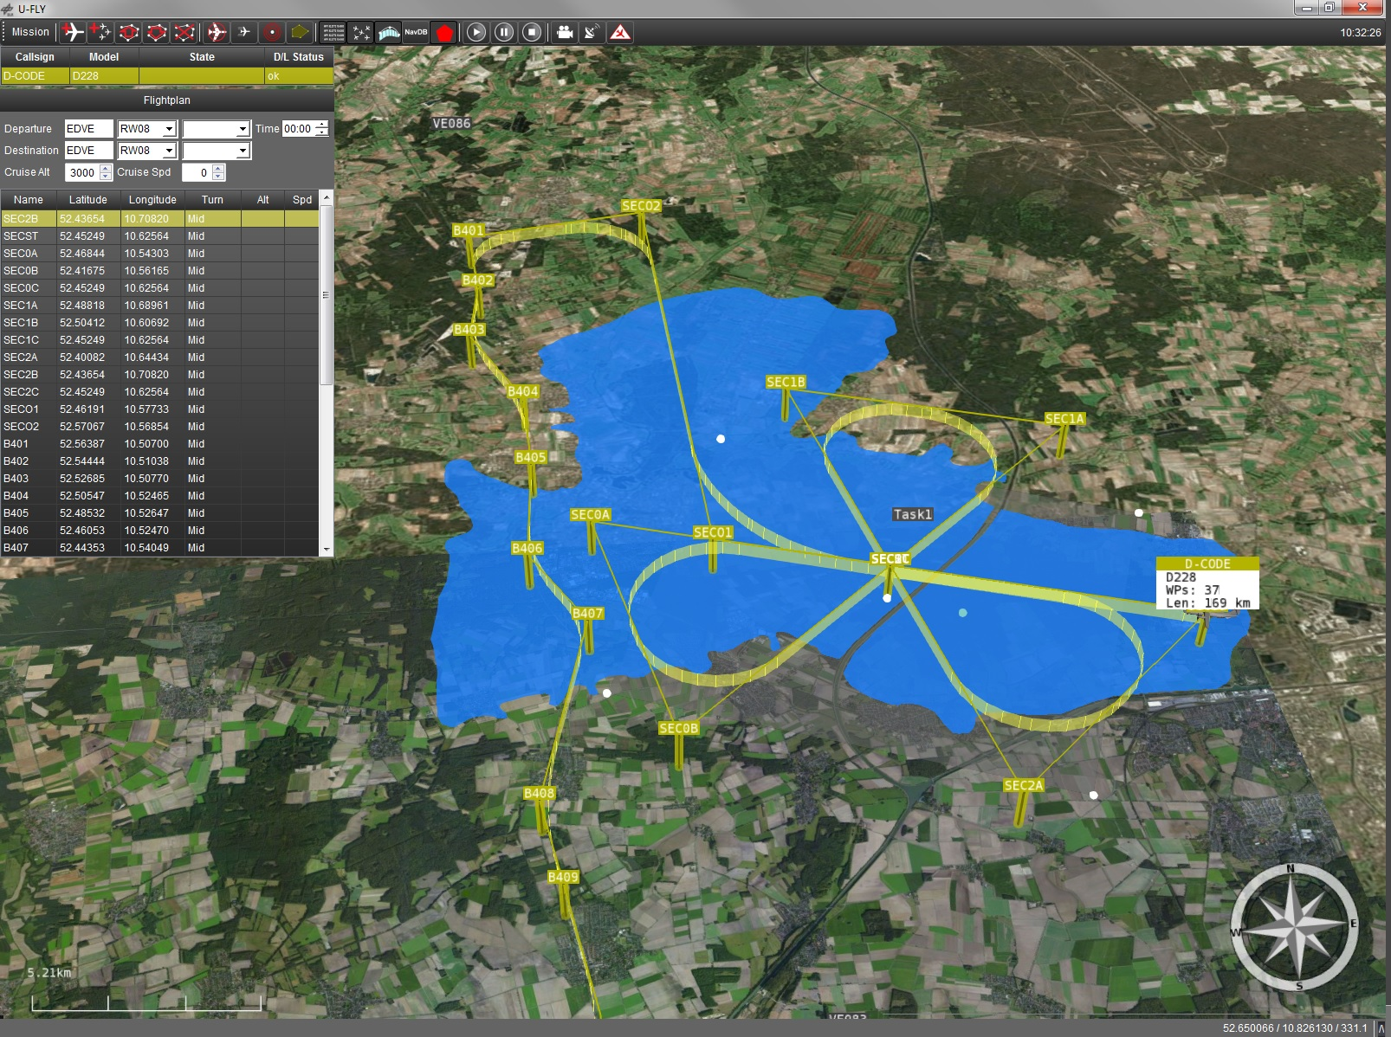
Airborne and Terrestrial Situational Awareness
BackgrounD DLR Solution
Module: KeepOperational
Trial 4
Command & Control
Camera System
C³ Data Link
Image Data Link
Dissemination, Visualisation & Interaction
Ground Control Station U-Fly
Terrestrial Traffic Sensors
Ground Station &
Processing Unit
Module: ZKI

Slide 3
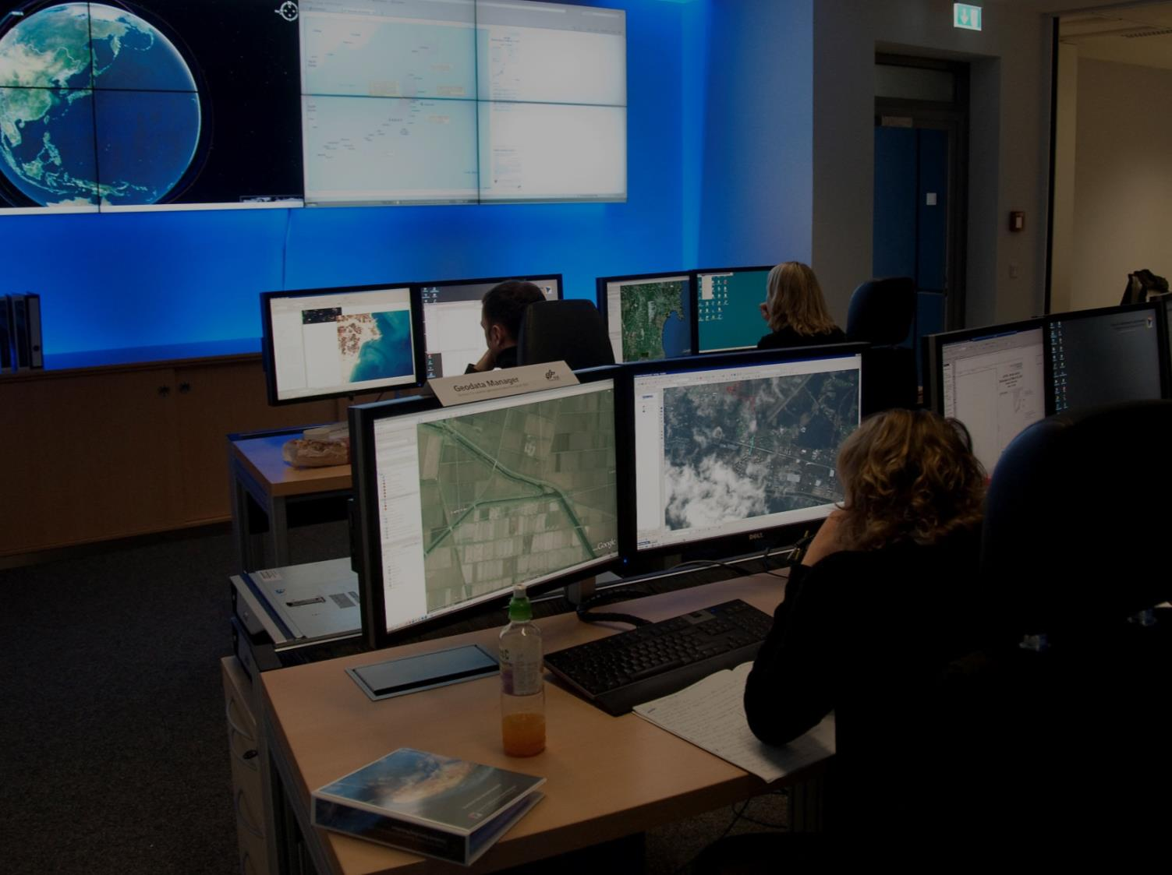
Center for Satellite Based Crisis Information
Provides a 12/7 service for
Provision of satellite and airborne imagery
Rapid mapping and damage assessment
Monitoring crisis situations
Has a substantial focus on research and development
Consulting and training
Since 1999
Over 400 activations and trainings
More than 1000 products

Slide 4
Involvement on national & international level
GERMANY
Emergency Mapping Service Provision within a national mandate for the German Federal Ministry of Interior
EUROPE
Contribution through research projects, pre-operational and operational services
GLOBAL
DLR as member of the International Charter ‚Space and major disasters‘

Slide 5
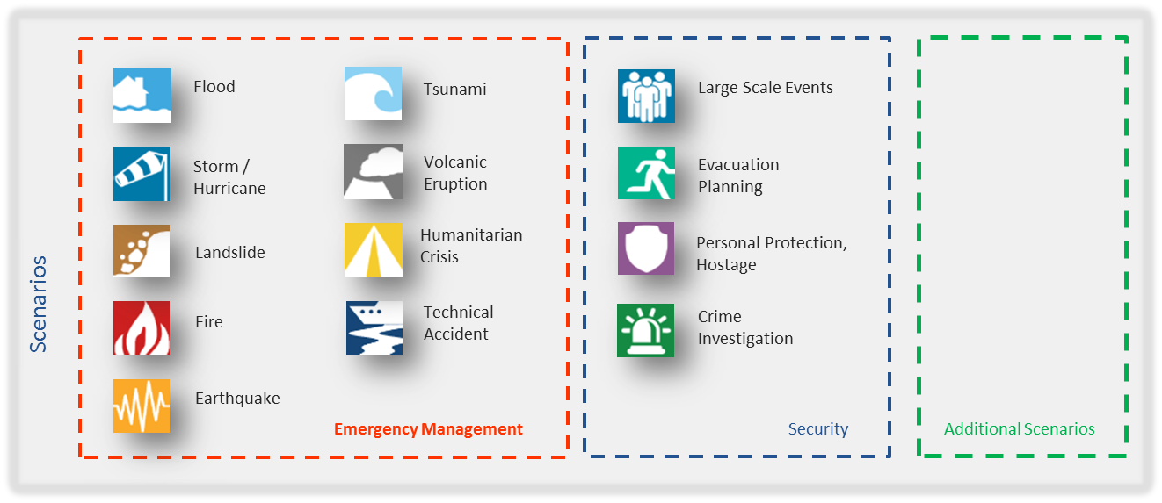
ZKI
Portfolio

Slide 6
Flood Mapping based on Satellite Imagery

Slide 7
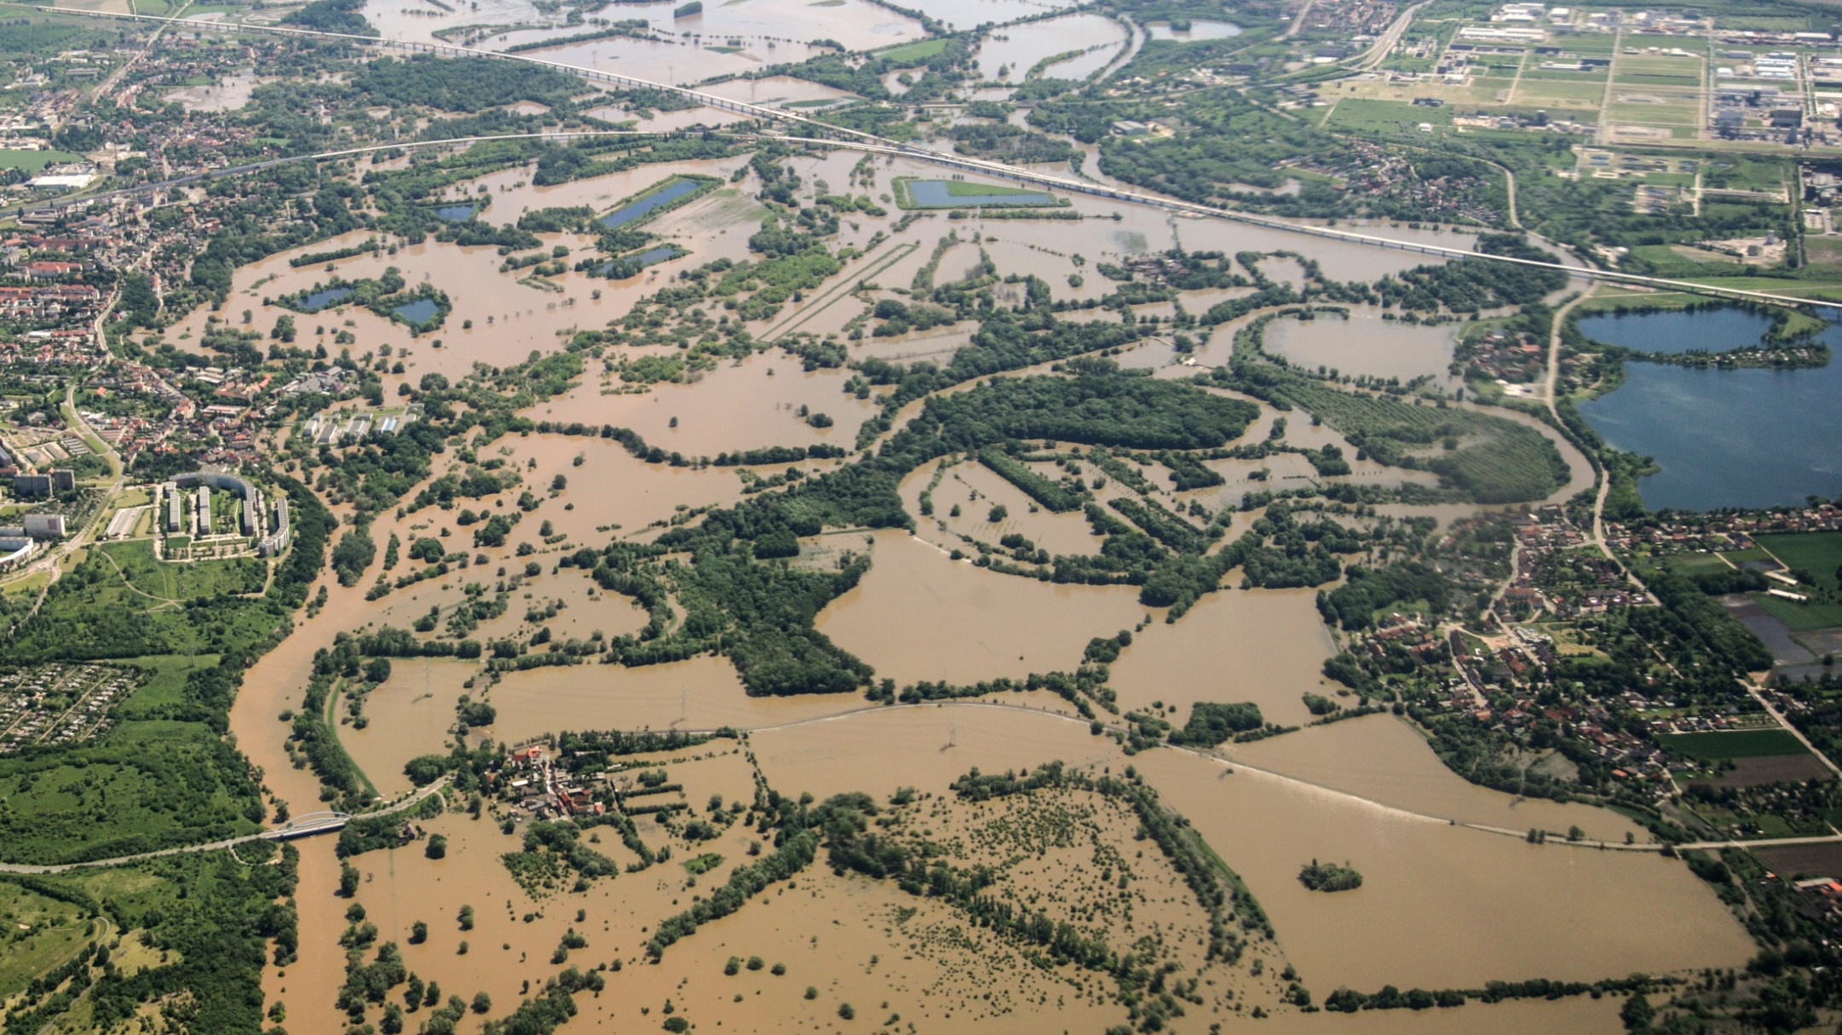
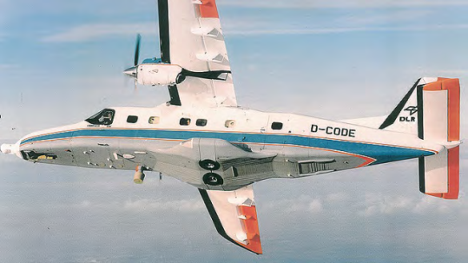
Aerial Imagery of flood situation
Flood in Germany, 05. June 2013, © DLR

Slide 8
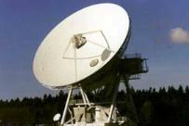
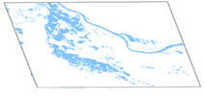
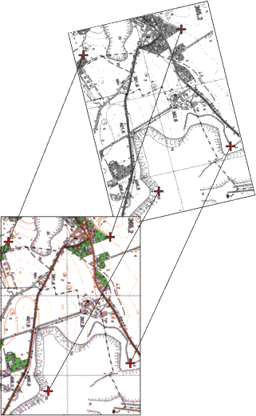
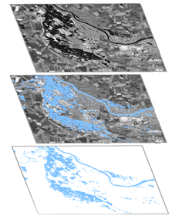
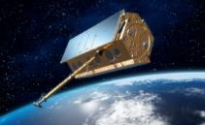
ZKI Rapid Mapping Workflow
German Red Cross
Federal Agency for
Technical Relief
National
authorities
EC
International
Charter
or
Activation
Data acquisition
Data processing
Data analysis
Product generation & dissemination
12h / 7d
Satellite: 12-48h
Airborne: 1-2h
2-8h ~1h, largely on-board
1-16h ~1h
ca. 4-16h

Slide 9
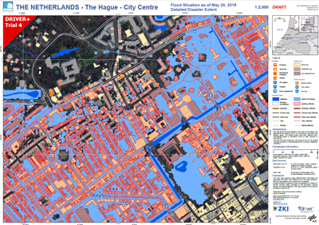
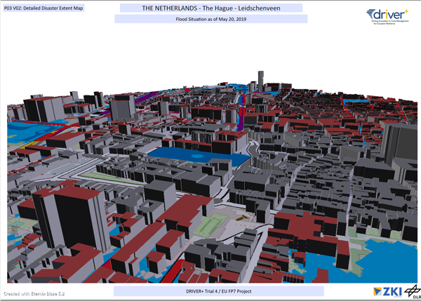
ZKI
Services & Products for TriAl 4
Preparation of crisis related information
water mask derived from remote sensing data
In this Trial: simulated water mask, as if derived from aerial imagery and
processed based on DLR user service ZKI processing facilities
Web based Product Dissemination
OGC WMS / WFS web services for water mask
Download service for ready to use map products
Generation of ready to use maps
2D GeoPDF
3D PDF

Slide 10
zki@dlr.de
www.zki.dlr.de

