Slide 1
psychological first aid (pfa) training
Trial AUSTRIA
DRC – IFRC psychosocial centre
Martha Bird
September 2019, Eisenerz, AUSTRIA

Slide 2
psychological first aid (PFA) training
DRC
WHY?
PFA is about providing emotional and practical support to people in distress to help them manage and understand their stress reactions better and support their coping strategies in an overwhelming and chaotic situation
Our solution prepares spontaneous volunteers responding to a crisis to enhance their awareness of psychological stress of those affected by the crisis
It is particularly relevant to volunteers in a disaster like AUSTRIA trial because many of the volunteers (affiliated and spontaneous) are also personally affected by the disaster.
Notes:
Our solution contributes to crisis management by providing knowledge and skills within psychosocial support to first responders - staff, volunteers and team leaders. Our solution is a training package that enhances our existing PFA (Psychological First Aid) training by using virtual reality based scenarios.
PFA is about providing emotional and practical support to people in distress as this will help them manage and understand their stress reactions better and support their coping strategies in an overwhelming and chaotic situation.
The objective of the training package is twofold:
1) To qualify a pool of staff and volunteers to be able to recognize and support people that require immediate psychological first aid during and in the aftermath of a crisis.
2) To reduce the stress of first responders (staff/volunteers) by increasing self confidence in providing PFA to affected population, increase awareness on self-care strategies as well as training of team leaders in recognising stress reaction in team members and applying PFA to staff and volunteers who may display stress reactions after responding to a crisis event
The training package consists of a one-day training for first responders (staff/volunteers) and a one-day training for team leaders/volunteer managers.
Our solution prepares first responders/volunteers to enhance their awareness of psychological stress of those affected by the crisis. It is particularly relevant to volunteers in a disaster like the scenario in D+ 4th Trial because many of the volunteers (affiliated and spontaneous) are also personally affected by the disaster.
The solution prepares the first responders /volunteers by increasing their confidence, knowledge and skills to provide PFA in crisis situations. The training is suitable for all first responders and/or others providing direct care and support to people in distress (affected population/staff/volunteers).

Slide 3
psychological first aid (PFA) training
DRC
WHAT?
First responders
1 day training
Team leaders
1 day training
Staff and volunteers can recognize and support people with PFA during and after a crisis
Increased self confidence in providing PFA to affected population
Increased awareness on self-care strategies
Team leaders recognise stress reactions in team members
Team leader apply PFA to staff and volunteers who may display stress reactions after responding to a crisis event
Notes:
The objective of the training package is twofold:
1) To qualify a pool of staff and volunteers to be able to recognize and support people that require immediate psychological first aid during and in the aftermath of a crisis.
2) To reduce the stress of first responders (staff/volunteers) by increasing self confidence in providing PFA to affected population, increase awareness on self-care strategies as well as training of team leaders in recognising stress reaction in team members and applying PFA to staff and volunteers who may display stress reactions after responding to a crisis event
The training package consists of a one-day training for first responders (staff/volunteers) and a one-day training for team leaders/volunteer managers

Slide 4
Scenario enabled psychological first aid (PFA) training
DRC
WHO?
Staff:
First responders – incl. Spontaneous volunteers
Team leaders at field level
Notes:
Our solution contributes to crisis management by providing knowledge and skills within psychosocial support to first responders - staff, volunteers and team leaders. Our solution is a training package that enhances our existing PFA (Psychological First Aid) training by using virtual reality based scenarios.
PFA is about providing emotional and practical support to people in distress as this will help them manage and understand their stress reactions better and support their coping strategies in an overwhelming and chaotic situation.
The objective of the training package is twofold:
1) To qualify a pool of staff and volunteers to be able to recognize and support people that require immediate psychological first aid during and in the aftermath of a crisis.
2) To reduce the stress of first responders (staff/volunteers) by increasing self confidence in providing PFA to affected population, increase awareness on self-care strategies as well as training of team leaders in recognising stress reaction in team members and applying PFA to staff and volunteers who may display stress reactions after responding to a crisis event
The training package consists of a one-day training for first responders (staff/volunteers) and a one-day training for team leaders/volunteer managers.
Our solution prepares first responders/volunteers to enhance their awareness of psychological stress of those affected by the crisis. It is particularly relevant to volunteers in a disaster like the scenario in D+ 4th Trial because many of the volunteers (affiliated and spontaneous) are also personally affected by the disaster.
The solution prepares the first responders /volunteers by increasing their confidence, knowledge and skills to provide PFA in crisis situations. The training is suitable for all first responders and/or others providing direct care and support to people in distress (affected population/staff/volunteers).

Slide 5
Scenario enabled psychological first aid (PFA) training
DRC - Concept
1-day trainings First responders Team leaders

Slide 6
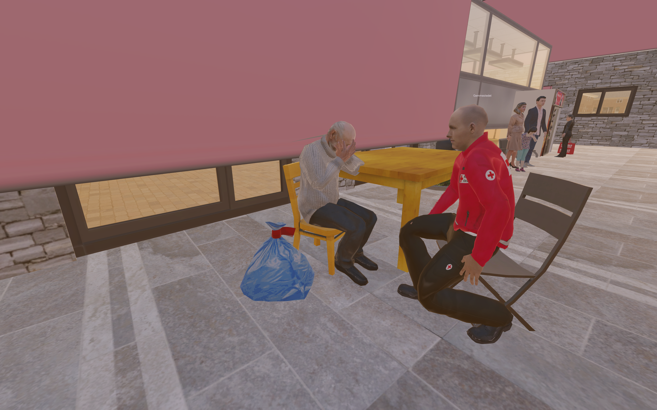
Scenario enabled psychological first aid (PFA) training
DRC

Slide 7
Scenario enabled psychological first aid (PFA) training
DRC

