Slide 1
HumLogsim
Training
Michael Middelhoff, University of Münster

Slide 2
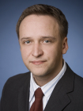
Michael Middelhoff
Adam Widera
Felix Hummel

Slide 3
anitarian
istics
ulation
Simulation of Humanitarian supply chains

Slide 4
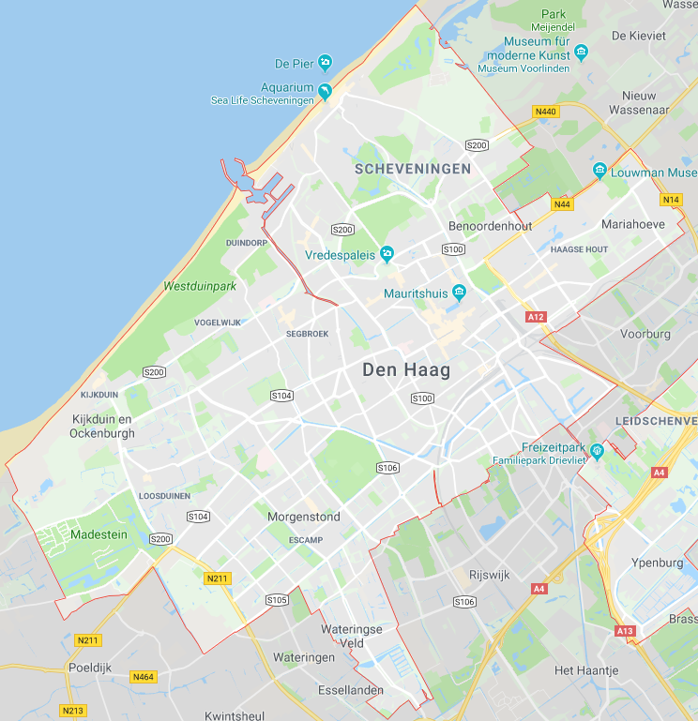
Evacuation of population
Urban area threatened by flood

Slide 5
Evacuation of population
Urban area threatened by flood
Send forces to affected area. - Police, medical, military ...
Evacuate affected population. - Cars, busses, trains ...
Setup camps to rescue people - Supplies, forces ...
Assess and compare strategies - Time & resources needed

Slide 6
Information on the Relieve network
Master Data – „What we know“
Supply Locations
Evacuation Sites
Public Transports
Fire Departments
Hospitals & Ambulances
Police Departments
Cross Docking Ports
Statistics on Transport Types
Statistics on Population by Area

Slide 7
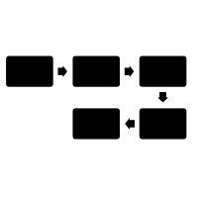
Simulation Environment
Specialized to the Humanitarian Domain
Agent-based Simulation
Simulates actions and interactions of autonomous agents.
Each agent (bus, ambulance, hospital, person, …) has own behaviours and objectives in a shared environment.
Dynamics of the humanitarian network are depicted.
Discrete-event Simulation
Simulates actions and interactions according to events.
At discrete moments in time, an action is performed or a change to the shared environment is recorded.
Procedures in the network are described in detail.

Slide 8
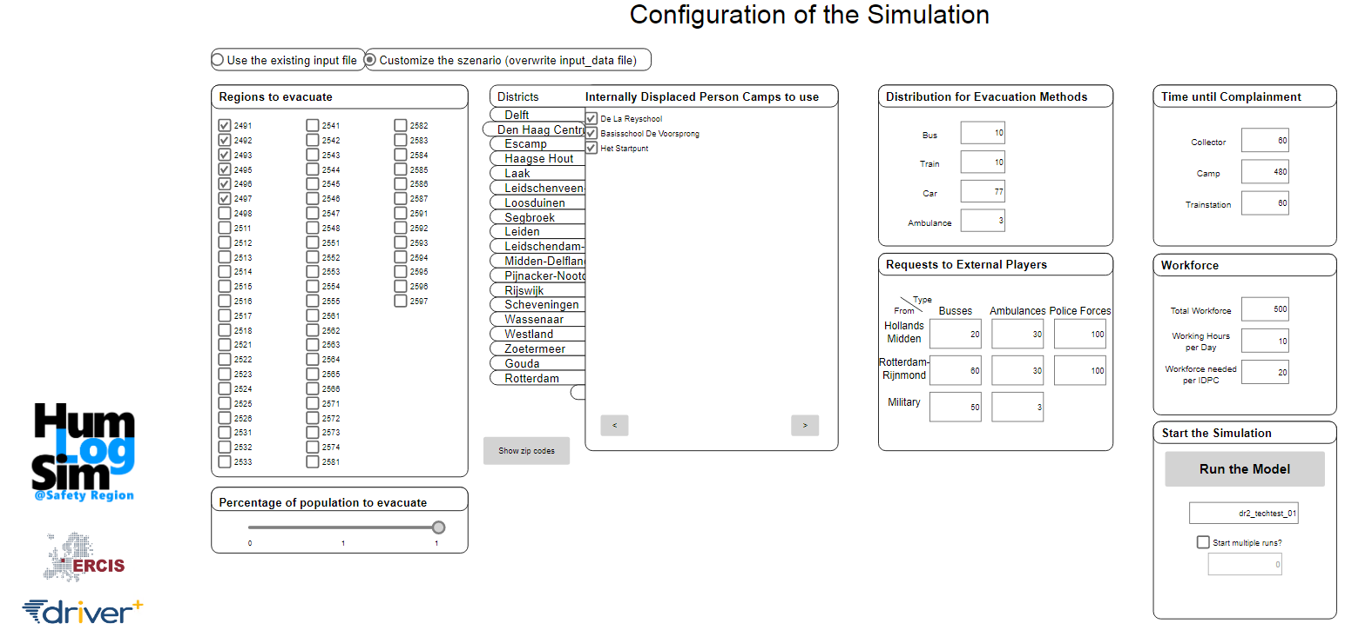
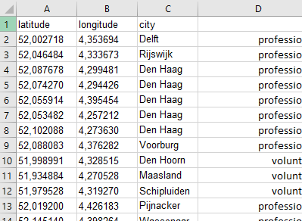
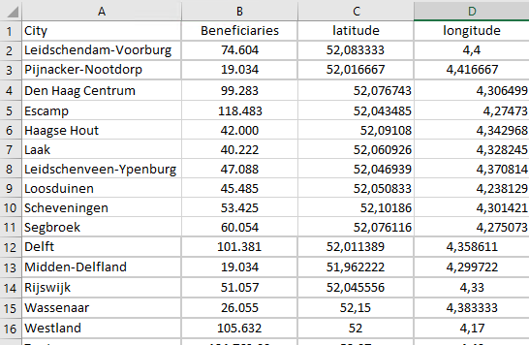
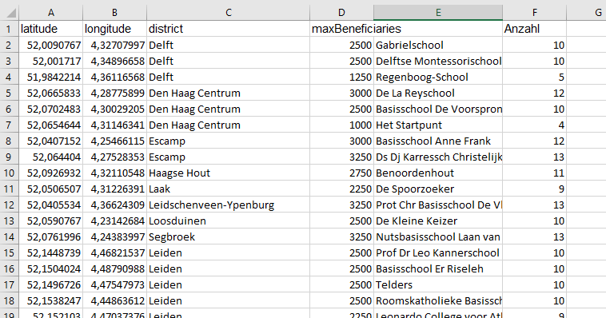
Setup different evacuation strategies

Slide 9
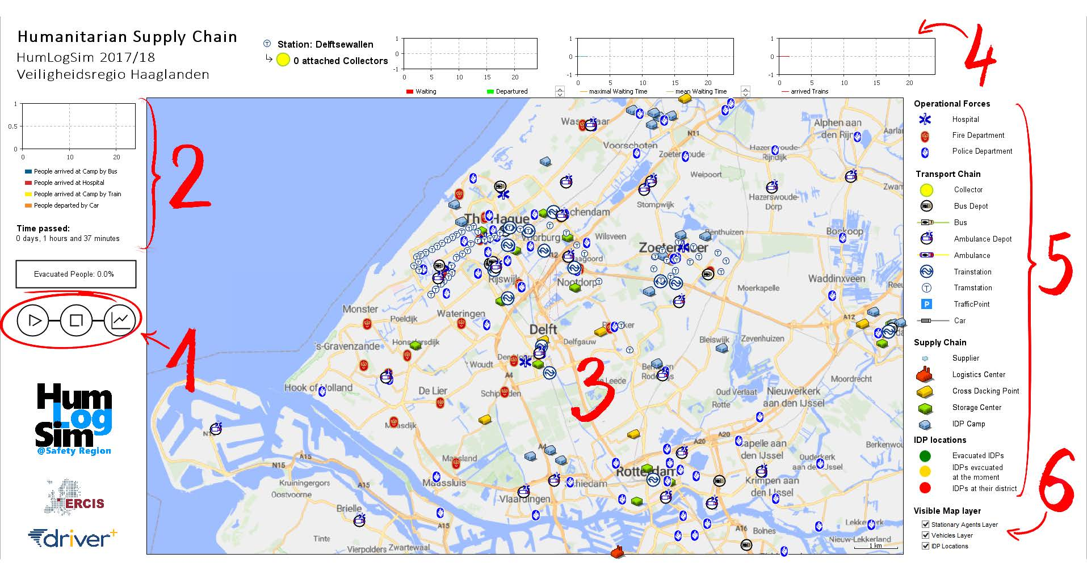
Observe the simulation at runtime

Slide 10
Testing of Evacuation strategies
Possibility to try and compare different scenarios
Best case
Less people affected, long time until flooding, many resources
Worst case
Many people affected, short time until flooding, limited resources
Likely case
People affected by prediction, one day until flooding, regular resources

Slide 11
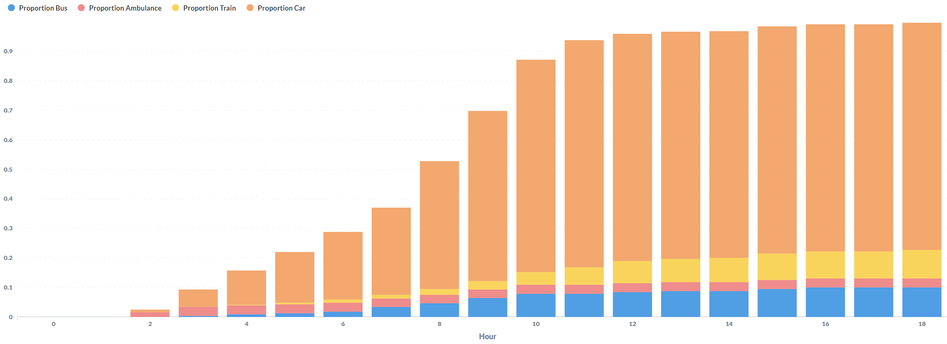
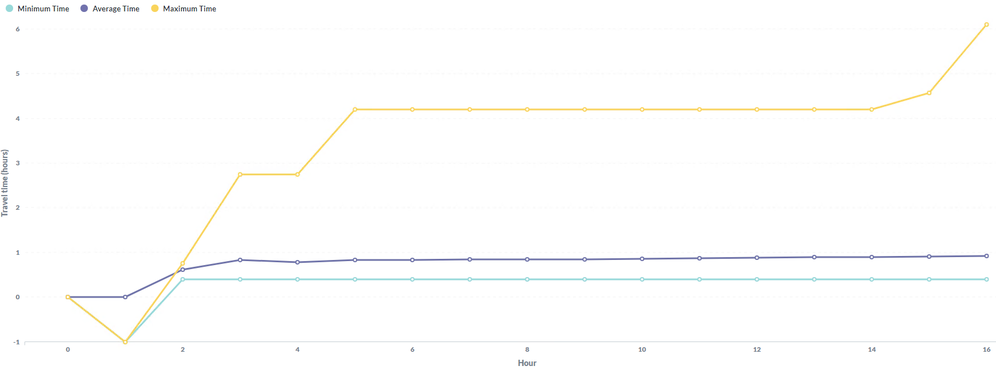
Comparison of Evacuation Scenarios
e.g. distribution over means of transportation over time
e.g. Duration of evacuation missions over time
Progression over Time
Cost Estimation
Resource Consumption
Geographical Distribution

