Slide 1
Socrates OC
DRIVEr+ - Final Demo
GMV

Slide 2
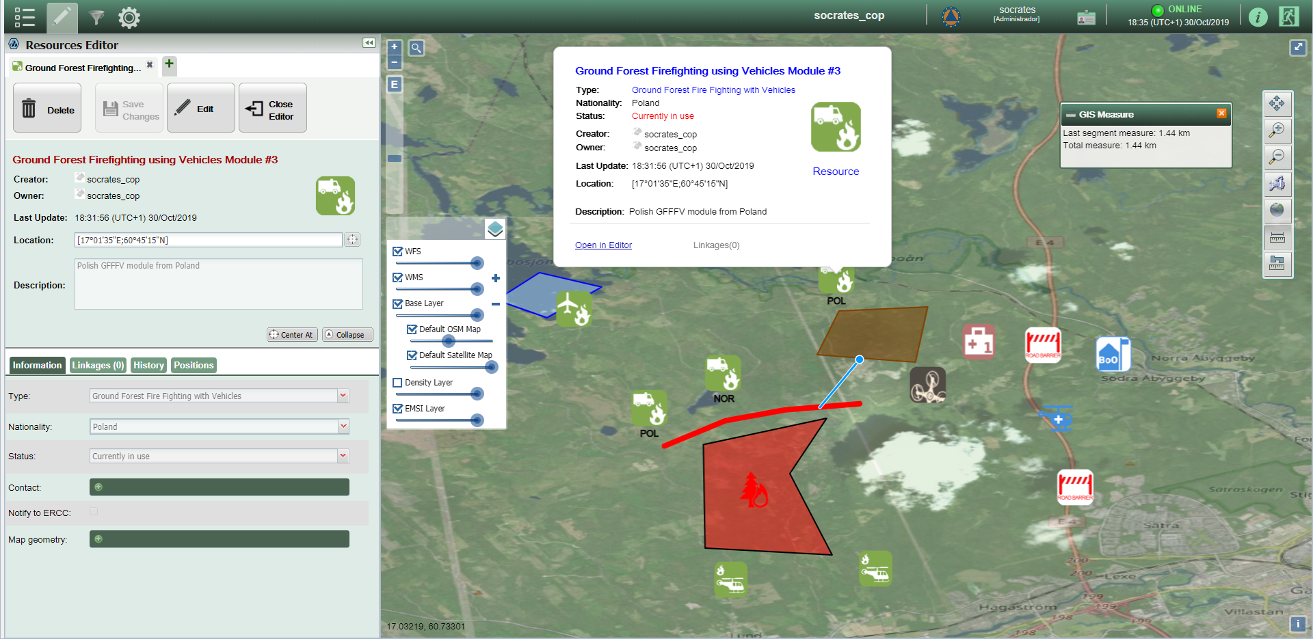
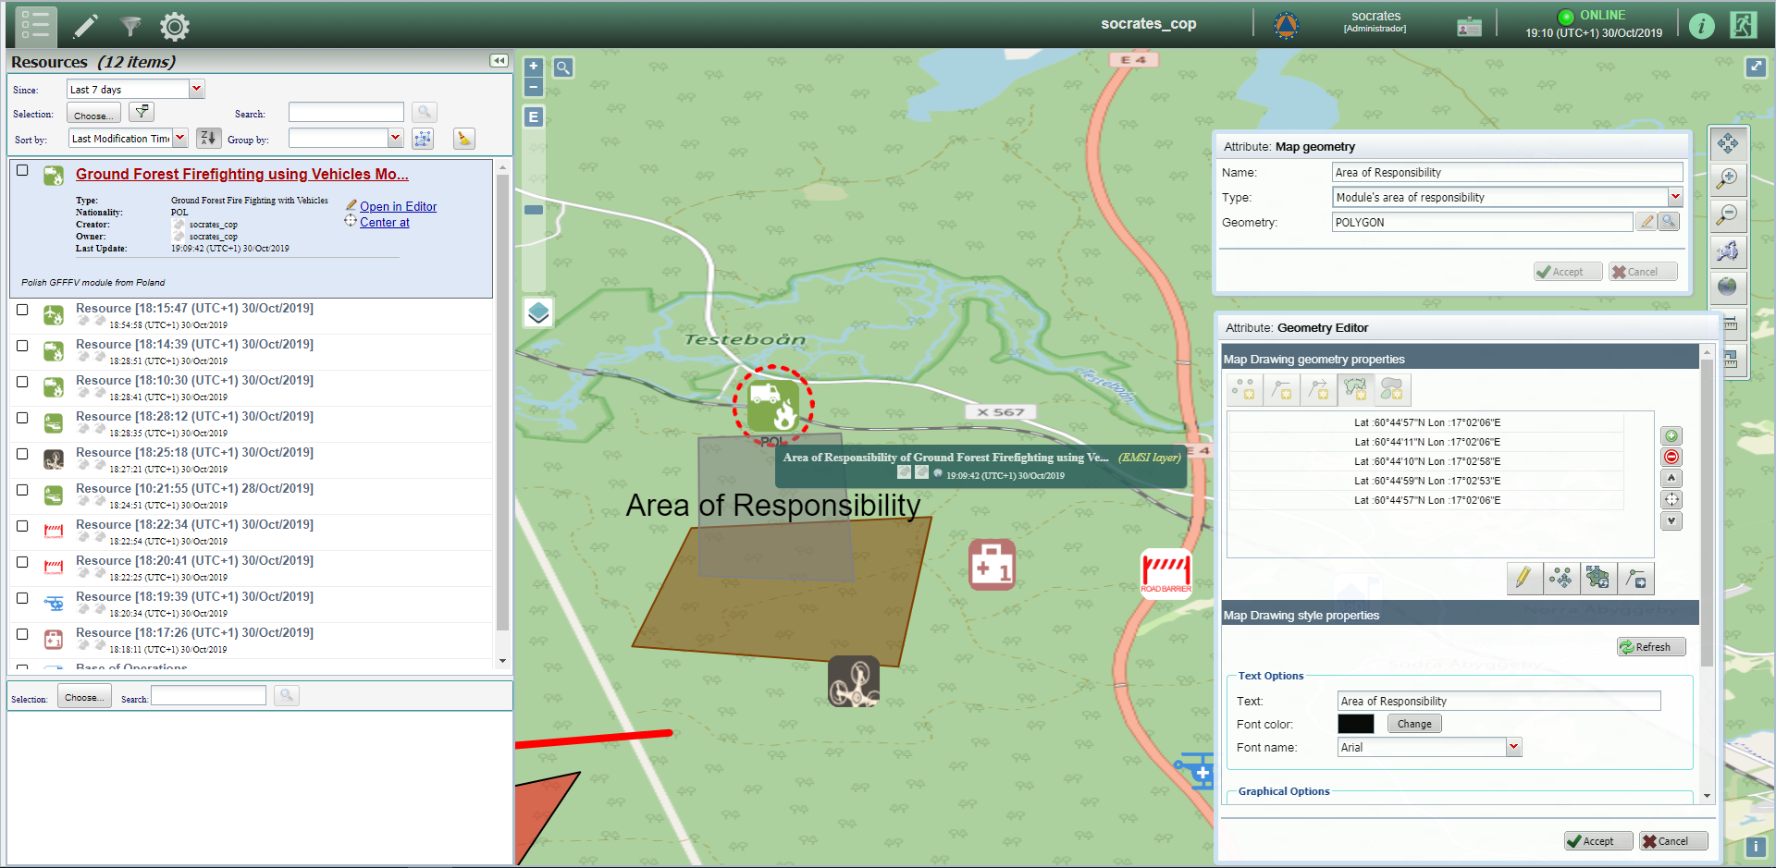
Socrates OC
C3 support solution for Op. Centres
Socrates OC is a shared situational awareness tool developed by GMV which depicts the Common Operational Picture (COP) in a CM scenario.
It enables setting up a network of Operations Centres based on:
the exchange of relevant information about the operational situation and
tasking & resource management features which provide support to the C3 and decision-making processes in crisis scenarios.

Slide 3
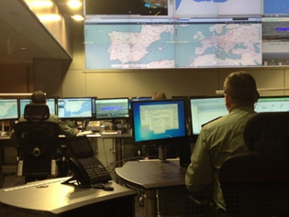
Socrates OC
Deployment of solution
Being operationally used in domains such as Maritime and Border Surveillance.
Also on R&D projects for pre-operational validation:
Socrates OC at the Guardia Civil‘s National Coordination Centre in Spain
Socrates OC at the Guardia Civil‘s National Coordination Centre in Spain
CLOSEYE: C3 system for Joint EU Border Surveillance Operations.
CAPSAT: Operational system deployed in Guardia Civil’s National Coordination Centre.
EUCISE: Light client for end-user institutions that do not have an existing legacy system.
ESPRES: COP solution supporting the display of the geographical information.
EXOMARS: COP solution displaying geographical information in the MPS for the Mars ROVER.

Slide 4
Socrates OC in DRIVER+ final demo
Functionalities to be used

Slide 5
Socrates OC In DRIVER+ FINAL DEMO
CM functionalities
In DRIVER+ Final Demo, Socrates OC users will be able to:
Insert in the map relevant information regarding some event.
E.g.: location and type of the event, affected areas, location of the base of operations, location and type of resources (e.g. EU modules), modules’ areas of responsibility, etc.
Link or assign resources to events.
Find places and identifying routes.
Monitor the overall operational situation (status of events, assigned resources…)
Receive info from external sources (fire danger forecast, weather forecast, etc.) as map layers through WMS.

Slide 6
Socrates OC In DRIVER+ FINAL DEMO
EXAMPLE of Usage during Episode E1/M1
E1 | Preparation for ERCC briefing | EUCPT prepares for the meeting, all members are at Frankfurt airport
E1 | ERCC briefing | Teleconference EUCPT – ERCC
E1 | TIME JUMP FOR FLIGHT | Teams on the way to Arlanda Airport, telco internal summary
E1/M1 | Virtual modules update | GFFF Norway updates others about arrival to Hudiksvall
E1/M1 | Virtual modules update | GFFF France informs about arrival to Farila
E1/M1 | EUCPT + VM on the way to Coordination Cell | Preparation of the report, initial PoA, Team splits
M1 | M3 informs others about itinerary | Some tips on the road planning for tomorrow
M1 | M6 updates other teams and EUCPT | GFFF Norway in the possible BoO
E1/M1 | NDMA F2F meeting with EUCPT | First meeting in Farila Coord Cell, short situation introduction
E1/M1 | RDC Staff F2F meeting with UNDAC | Mandate, area of responsibility, communication channel, meeting in Nynashamn harbor
E1/M1 | RDC Procedure | Modules meet RDC staff at the harbor, initial information
M1 | Modules road to Farila | Itinerary planning, roadblock, failure etc.
E1 | EUCPT - RDC staff information exchange | EUCPT staff shares information gathered in Farila and Stockholm

Slide 7
Socrates OC In DRIVER+ FINAL DEMO
EXAMPLE of Usage during Episode E1/M1
E1 | Preparation for ERCC briefing | EUCPT prepares for the meeting, all members are at Frankfurt airport
E1 | ERCC briefing | Teleconference EUCPT – ERCC
E1 | TIME JUMP FOR FLIGHT | Teams on the way to Arlanda Airport, telco internal summary
E1/M1 | Virtual modules update | GFFF Norway updates others about arrival to Hudiksvall
E1/M1 | Virtual modules update | GFFF France informs about arrival to Farila
E1/M1 | EUCPT + VM on the way to Coordination Cell | Preparation of the report, initial PoA, Team splits
M1 | M3 informs others about itinerary | Some tips on the road planning for tomorrow
M1 | M6 updates other teams and EUCPT | GFFF Norway in the possible BoO
E1/M1 | NDMA F2F meeting with EUCPT | First meeting in Farila Coord Cell, short situation introduction
E1/M1 | RDC Staff F2F meeting with UNDAC | Mandate, area of responsibility, communication channel, meeting in Nynashamn harbor
E1/M1 | RDC Procedure | Modules meet RDC staff at the harbor, initial information
M1 | Modules road to Farila | Itinerary planning, roadblock, failure etc.
E1 | EUCPT - RDC staff information exchange | EUCPT staff shares information gathered in Farila and Stockholm
E1/M1 - Virtual modules update - GFFF Norway updates others about arrival to Hudiksvall
E1/M1 - Virtual modules update - GFFF France informs about arrival to Farila
Create modules in Socrates map, assign them to the event and
move them to the corresponding locations
E1/M1 - M6 updates other teams and EUCPT - GFFF Norway in the possible BoO
Possible BoO is located in the map
Draw modules’ areas of responsibility in Socrates map
E1/M1 - RDC Staff F2F meeting with UNDA - Mandate, area of responsibility, …
M1 - Modules road to Farila - Itinerary planning, roadblock, failure etc.
Route planning using Socrates.
Route, roadblocks, etc. located in the map

Slide 8
Interaction with other solutions
Information exchange

Slide 9
Integration of solutions
Technical perspective
CAP
(operational situation)
vieWTerra
Integration through
DRIVER+ Test-bed
Technical Infrastructure
WMS map layers
(drone ortophotos)
Socrates OC
Drones Rapid Mapping
Socrates OC will:
Receive orthophotos (as map layers) from Drones Rapid Mapping.
Send the operational situation through CAP messages to vieWTerra and Crisis Suite
CAP
(operational situation)
Crisis Suite

Slide 10
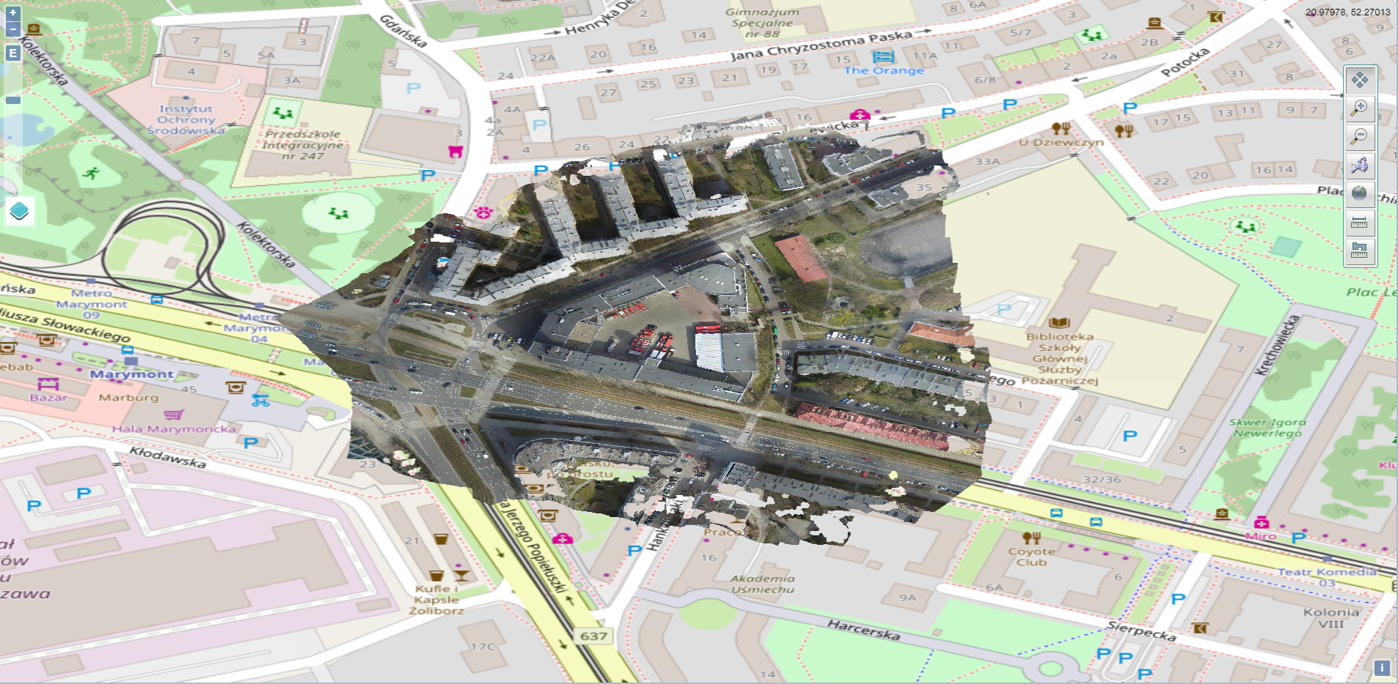
Integration of solutions
E.g.: Socrates OC displaying
DRM’s orthophoto as a map layer
(received through WMS)
Technical perspective
Drones Rapid Mapping
vieWTerra
WMS map layers
(drone ortophotos)
CAP
(operational situation)
Socrates
Images
(on-field photos)
CAP
(operational situation)
FRT
Crisis Suite

