Slide 1
WP934 Rumour Debunker
W0 presentation of solutions
Joachim Klerx, AIT (Warsaw, SP93 solutions meeting)
2018-01-29

Slide 2
Overview
Solution: Rumour Debunker
Provide the best possible strategic relevant information to crisis and disaster managers
Typical scenarios
Dramatic advances in technologies supporting disinformation generation
Additional capabilities for CDM
Solution Platform
Possible options for Integration

Slide 3
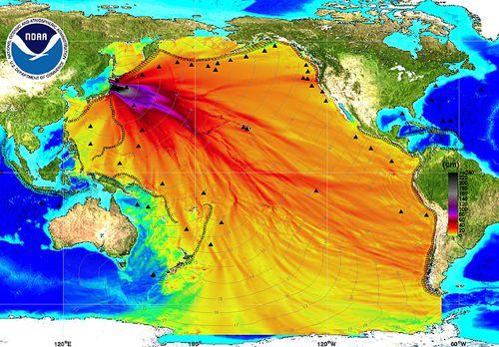
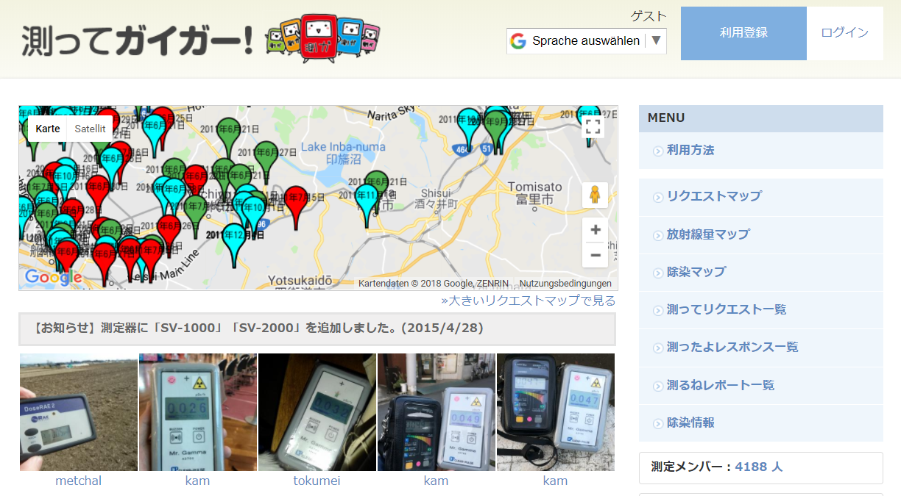
Typical Scenario I
Mis- and Disinformation in large scale Nuclear Disaster
Published as radiation spread, 2014
But according to Snopes a map of projected tsunami wave heights
Crowd colaboration platform to unveil Fukushima propaganda 2018
Nuclear explosion in Czech 2007

Slide 4
Typical Scenario II
Miss and Dissinformation in large scale pandemic Management
What do you think?
Dr Wodarg has branded the H1N1 outbreak as 'one of the greatest medical scandals of the century'.
Do we have a refugee crisis?

Slide 5
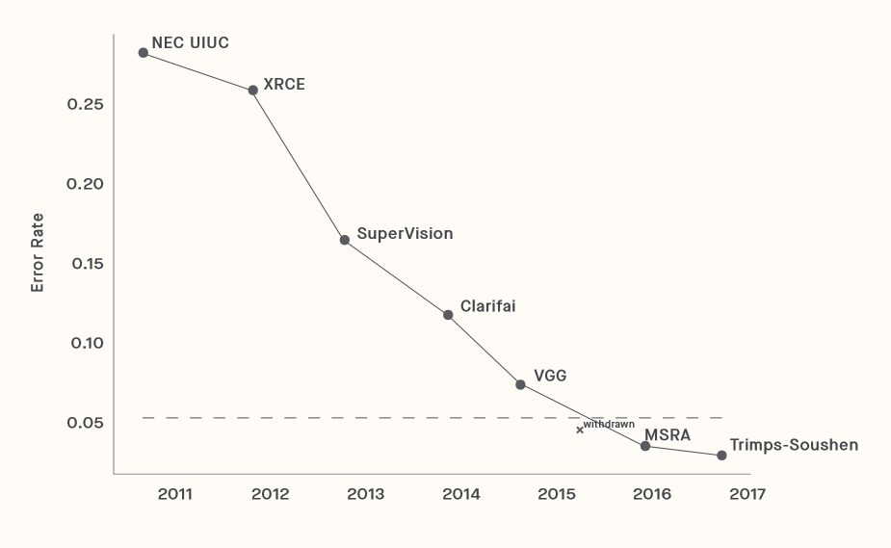
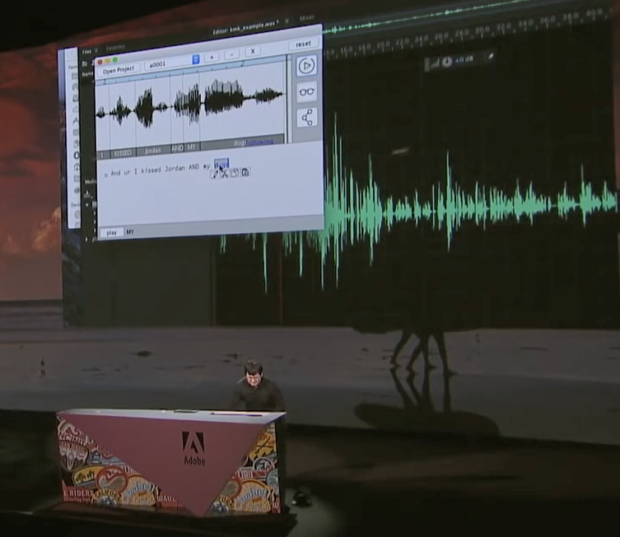
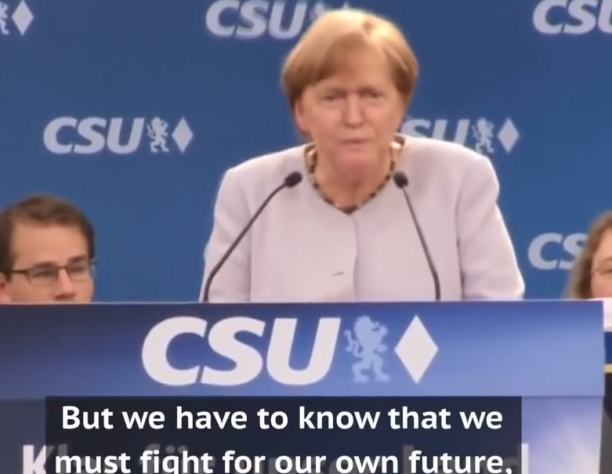
Technologies supporting Disinformation
Trends in AI methods to produce fake information
Dramatic improvement in methods for fake production
Miles Brundage, et.al., The Malicious Use of Artificial Intelligence: Forecasting, Prevention, and Mitigation, Future of Humanity Institute, University of Oxford; Arizona State University, February 2018

Slide 6
Additional capabilities for CDM
Rumour Debunker
Fake news are produced with with very realistuc fabricated video and audio
Rumour Debunker will give a risk measurment for news in the system and news add to the system
Automated hyper-personalised disinformation campaigns
Rumour Debunker will inform user if they are target of a hyper-personalised disinformation campaign
Automated, AI enabled analysis of social networks to identify key influencers for targeted disinformation campains
Rumour Debunker will identify key influencer networks
Identify bot driven large-scale information generation and denial of information attacks
Rumour Debunker will identify bot user and mark their activity, transparent to the user

Slide 7
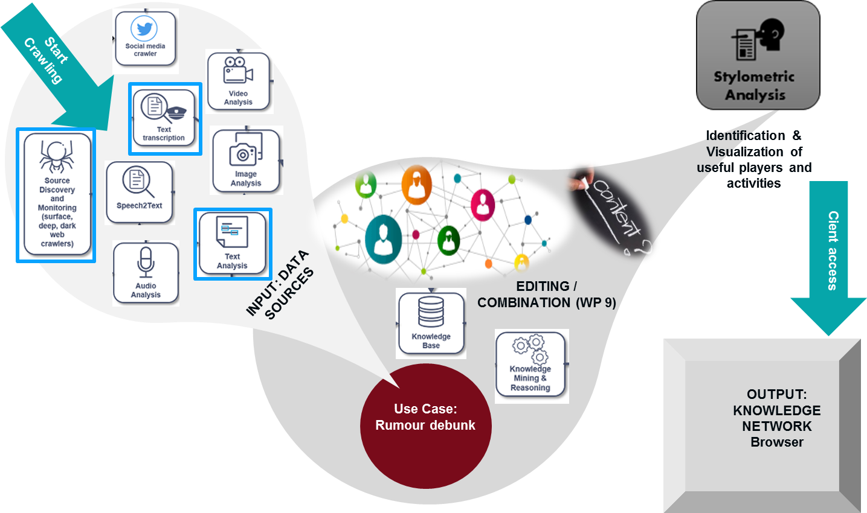
Solution Platform
High performance cloud bases Analytical Platform
Google Risk Analytics rules

Slide 8
Possible options for Trial Integration
Interfaces in DRIVER
Mobile Clients
+ Observers
Volunteer reports
Crowd Tasker App
RumDebunk API
Other COP tools API
Quality improved Alerts, Reminders
Identification of misinformation / classification
+ Observers
Volunteers with android phones: quality check and reporting tasks
Backend users: Set up crawling, analyse results, reporting
+ Observers
Informing
8
8

